Slide 1
Introduction to Public Affairs
PIA 2020
Historical Models, Contemporary Models and
Socio-economic change
Week Five

Slide 2
The 1933 Election
The comedy behind the Serious
The Jon Stewart of the Day

Slide 3
Africa Emergent
Who is the narrator and Elias? What do they symbolize?
What is portrayed about racial and socio-economic disparities through this story?
What are the policy and administrative issues that arise in the story? Why are they important?
What is the story symbolizing about the government and legal system?
What is the moral of the story? How might this be an important for us to take away as future leaders, decision makers, and administrators?

Slide 4
The Greatest Man in the World
Who is and why is he called the ‘greatest man in the world’?
What is the story trying to reflect about this character? What is the contrast between his real life and his public life?
What is the important take away/message from this story?
How does this story relate to other core readings or from your specialized readings?

Slide 5
Degree Specific Readings
Get in the same groups as last time to discuss your reading thus far, using the questions below. Be prepared to share your answers with the class:
What new developments have happened in the book?
What was 1-2 quotes that for you are symbolic or profound, or made you reflect?
What are 1-2 key themes that this book seems to cover or speak to (see final PP slides from last week or themes discussed in Recitation)?
How are you liking the book so far?

Slide 6
Theories of Social Class
First a Bit of Theory

Slide 7
Introduction to Public Affairs
Theories of Governance and Political Economy

Slide 8
Three Themes:
Social and Economic Debates
Political Instutions
Public Policy Institutions

Slide 9
Overview
The Public Sector and the Economy: “Contemporary Models” of Governance and Socio-Economic Change
Keynes and he European Model, North Atlantic Unity and Japan
Neo-Orthodoxy: The Debates Over Development: Africa, Asia and Latin America
Models of Governance Institutions
Comparative Methodology Issues

Slide 10
2. The Public Sector and the Economy
Free Market
Mixed or Social Democratic
Socialist Industrialization
Autarcky with Rural Mobilization
Corporate/ Fascist

Slide 11
Ideology as Social Science

Slide 12
The Public Sector and the Economy
Reminder:
Karl Marx- The Other German-
Source of ideas about the developmental state. Marx as a Social Scientist not an Ideologue. The contemporary of Max Weber

Slide 13
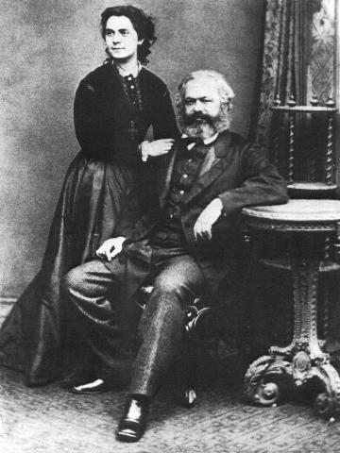
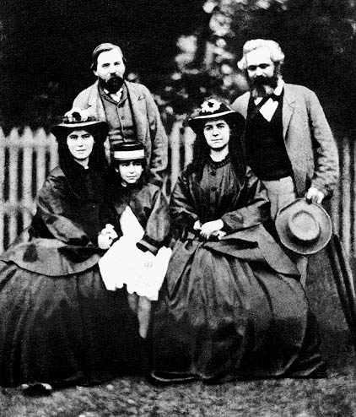
Marx with his Wife Jenny (1869) and with Friedrich Engels and Family (1864)

Slide 14
Karl Marx: Another Five Minute History
a.. Original Marxian views- State as the instrument of the ruling classes
b. The dialectic and Historical Materialism
c. Model: (John Armstrong- The Conservative Marxist)
-Thesis
-Antithesis
-Synthesis

Slide 15
Dialectic
Thesis Antithesis
Synthesis

Slide 16
Vladimir Ilyich Ulyanov (Lenin) (April 22 1870 – January 21, 1924)

Slide 17
Class Conflict: Four Epochs
Slavery
Feudalism
Capitalism
Socialism (National Socialism?)
e. Functionaries as the petty bourgeoisie
Communism- state and the bureaucracy whither away
Fascism- Society will Whither Away

Slide 18
Command Economy- Revised by Keynes and Franklin D. Roosevelt
Under socialism, government, the bureaucracy should manage the economy
The development of an elaborate national planning system
Keynes- Failure of market
European Social Democracy

Slide 19
Command Economy
The debate: Keynesianism and European Socialism (the Rose)- How much is this part of Command Economy Framework? (Guy Peters)
Development Administration: Command Economics in the Third World? (Heady, Riggs vs. Vincent and Eleanor Ostrom)
Development Management: An Oxymoron

Slide 20
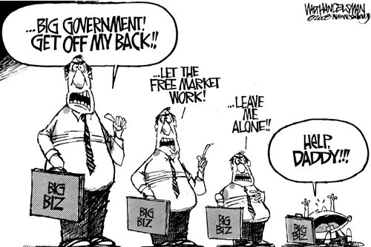

Slide 21
3. The European Model, North Atlantic Unity and Japan
Focus on the State Economic System
Collectivist vs. Individualist Approach
Europe vs. Anglo-Saxon
Debates about Groups: Competitive vs. Cooperative (Corporatist)

Slide 22
Continental Europe
Counter-influence of St. Simonism- an interventionist view (Not Adam Smith).
“the era of abundance could be attained certainly and quickly. The guaranteed means were applications of science and technology to unrestricted mastery of nature.”
Count de Saint-Simon
1760-1825

Slide 23
Count Henri de Saint-simon

Slide 24
Social Democracy: Debate
The Rose as a Symbol
Socialism and the Rise of Labor in Europe
The Second International
All European Countries have a Social Democratic Party (The Second International)

Slide 26
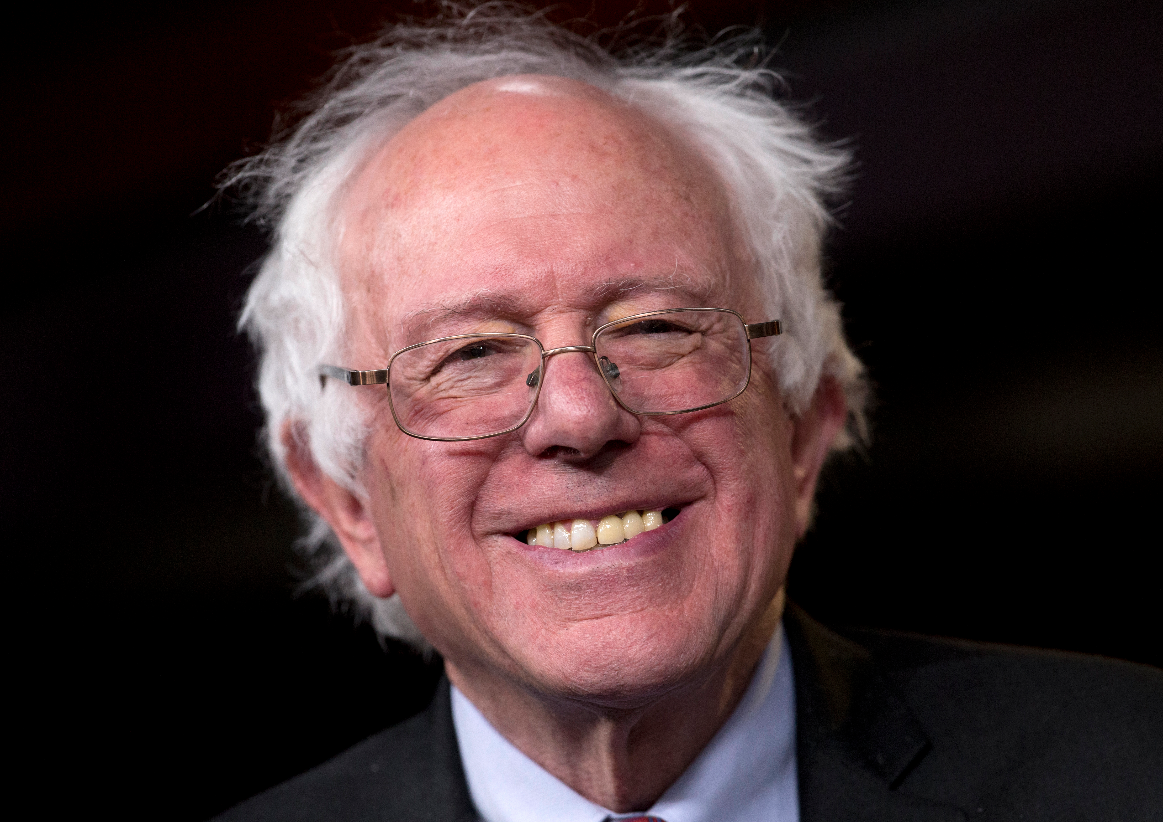
American Activism vs. European Socialism (U.S. Social Democratic Party)
Is Bernie Sanders a Socialist?

Slide 27
Unification of the North Atlantic- 1930s-1970s- The Primacy of Keynesianism
BASICS OF KEYNSIANISM
1. Monetary Policy
2. Fiscal Policy
3. Wage and Price controls

Slide 28
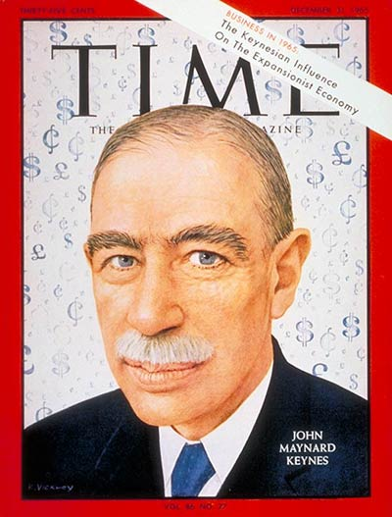
“We’re All Keynesians Now” Friday, Dec. 31, 1965

Slide 29
The Functions of Government under Keynesian Control
1. Traditional- police and law and order
2. National Defense
3. Social Services- Education and Health and Welfare
4. Resource Mobilization for Economic Growth
5. Promotion of Economic Development

Slide 30
The Functions of Government under Keynesian Control- Continued
6. Economic Growth generation: From Roosevelt and the New Deal to Kennedy and Johnson, The Great Society
6. LDCs and Modernization Theory: Agraria vs. Industria (Turner and Holm)
7.The challenge of Public Choice, rationalism and the University of Chicago School: Neo-Orthodoxy- less influence outside of the Anglo-Saxon world

Slide 31
The Development Model
Modernization Theory
State as Development Manager
Industrialization vs. Rural Development
The Take Off Point: Capital Accumulation

Slide 33
Conceptual: Agraria vs. Industria

Slide 34
Japan and Ministry of International Trade and Industry (MITI)
Asian Model
Corporatist- Inter-meshing of state and Private Sector
Management (not Political) Focus
Growth and Export
Model for Asian Tigers

Slide 35
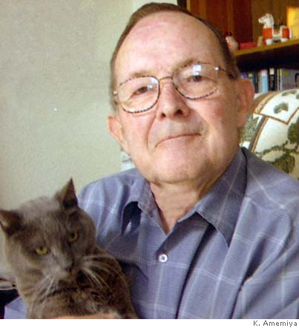
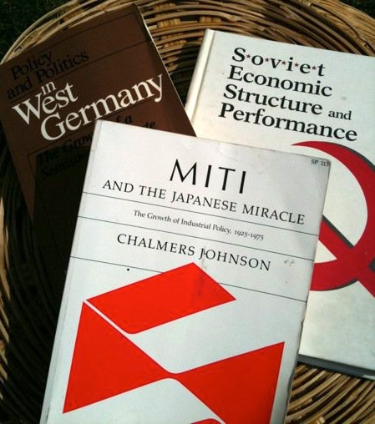
Japan and Economic Development Chalmers Johnson Author of the Week

Slide 36
Legacy: Ministry of International Trade and Industry (in Asia)
Block 10, Government Offices Complex, Jalan Duta, 50622 KL, Malaysia Tel no: 603-6203 3022 Fax no: 603-6201 2337 Email:webmiti@miti.gov.my

