Slide 1
Introduction to Public Affairs
PIA 2020
Week Five

Slide 2
Theories of Social Class
First a Bit of Theory

Slide 3
Introduction to Public Affairs
Theories of Governance and Political Economy

Slide 4
Overview
The Public Sector and the Economy: “Contemporary Models” of Governance and Socio-Economic Change
Keynes and he European Model, North Atlantic Unity and Japan
Neo-Orthodoxy: The Debates Over Development: Africa, Asia and Latin America
Models of Governance Institutions
Comparative Methodology Issues

Slide 5
Three Themes:
Social and Economic Debates
Political Instutions
Public Policy Institutions

Slide 6
2. The Public Sector and the Economy
Free Market
Mixed or Social Democratic
Socialist Industrialization
Autarcky with Rural Mobilization
Corporate/ Fascist

Slide 7
Ideology as Social Science

Slide 8
The Public Sector and the Economy
Reminder:
Karl Marx- The Other German-
Source of ideas about the developmental state. Marx as a Social Scientist not an Ideologue. The contemporary of Max Weber

Slide 9
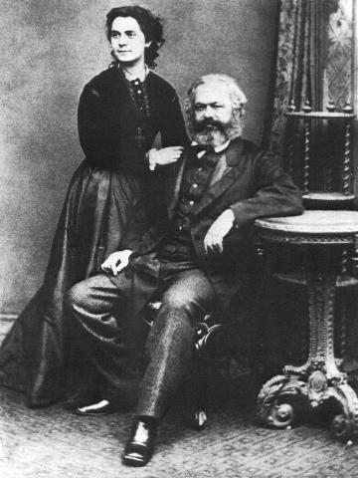
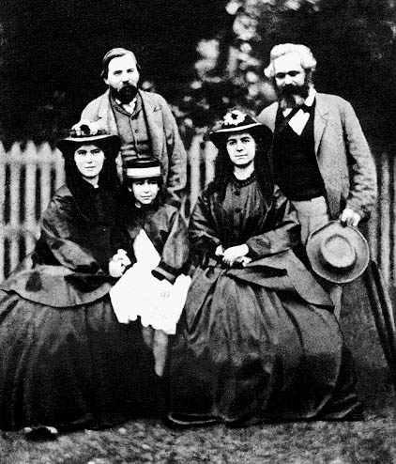
Marx with his Wife Jenny (1869) and with Friedrich Engels and Family (1864)

Slide 10
Karl Marx: Another Five Minutes
a.. Original Marxian views- State as the instrument of the ruling classes
b. The dialectic and Historical Materialism
c. Model: (John Armstrong- The Conservative Marxist)
-Thesis
-Antithesis
-Synthesis

Slide 11
Command Economy- Revised by Keynes and Franklin D. Roosevelt
Under socialism, government, the bureaucracy should manage the economy
The development of an elaborate national planning system
Keynes- Failure of market
European Social Democracy

Slide 12
Dialectic
Thesis Antithesis
Synthesis

Slide 13
Vladimir Ilyich Ulyanov (Lenin) (April 22 1870 – January 21, 1924)

Slide 14
Class Conflict: Four Epochs
Slavery
Feudalism
Capitalism
Socialism (National Socialism?)
e. Functionaries as the petty bourgeoisie
Communism- state and the bureaucracy whither away
Fascism- Society will Whither Away

Slide 16
Command Economy
The debate: Keynesianism and European Socialism (the Rose)- How much is this part of Command Economy Framework? (Guy Peters)
Development Administration: Command Economics in the Third World? (Heady, Riggs vs. Vincent and Eleanor Ostrom)
Development Management: An Oxymoron

Slide 17
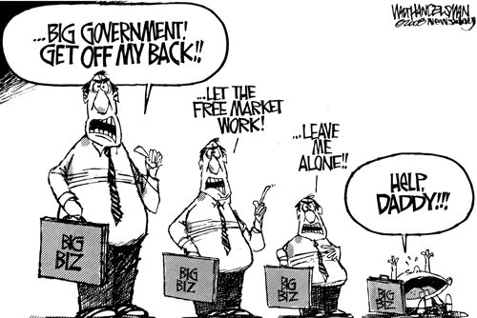

Slide 18
3. The European Model, North Atlantic Unity and Japan
Focus on the State Economic System
Collectivist vs. Individualist Approach
Europe vs. Anglo-Saxon
Debates about Groups: Competitive vs. Cooperative (Corporatist)

Slide 19
Continental Europe
Counter-influence of St. Simonism- an interventionist view (Not Adam Smith).
“the era of abundance could be attained certainly and quickly. The guaranteed means were applications of science and technology to unrestricted mastery of nature.”
Count de Saint-Simon
1760-1825

Slide 20
Count Henri de Saint-simon

Slide 21
Social Democracy: Debate
The Rose as a Symbol
Socialism and the Rise of Labor in Europe
The Second International
All European Countries have a Social Democratic Party (The Second International)

Slide 22
American Activism vs. European Socialism (U.S. Social Democratic Party)

Slide 23
Unification of the North Atlantic- 1930s-1970s- The Primacy of Keynesianism
1. Monetary Policy
2. Fiscal Policy
3. Wage and Price controls

Slide 24
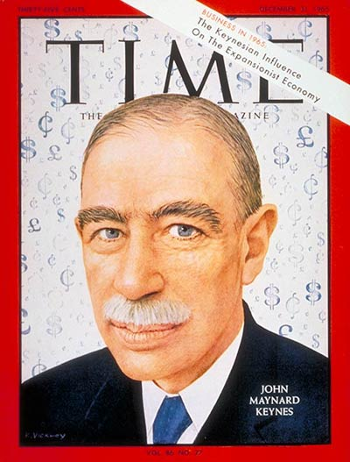
“We’re All Keynesians Now” Friday, Dec. 31, 1965

Slide 25
The Functions of Government under Keynesian Control
1. Traditional- police and law and order
2. National Defense
3. Social Services- Education and Health and Welfare
4. Resource Mobilization

Slide 26
The Development Model
Modernization Theory
State as Development Manager
Industrialization vs. Rural Development
The Take Off Point: Capital Accumulation

Slide 27
The Functions of Government under Keynesian Control- Continued
6. Economic Growth generation: From Roosevelt and the New Deal to Kennedy and Johnson, The Great Society
6. LDCs and Modernization Theory: Agraria vs. Industria (Turner and Holm)
7.The challenge of Public Choice, rationalism and the University of Chicago School: Neo-Orthodoxy- less influence outside of the Anglo-Saxon world

Slide 29
Conceptual: Agraria vs. Industria

Slide 30
Japan and Ministry of International Trade and Industry (MITI)
Asian Model
Corporatist- Inter-meshing of state and Private Sector
Management (not Political) Focus
Growth and Export
Model for Asian Tigers

Slide 31
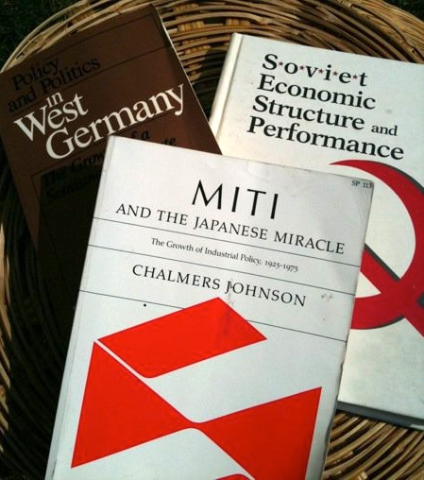
Japan and Economic Development Chalmers Johnson Author of the Week

Slide 32
Legacy: Ministry of International Trade and Industry (in Asia)
Block 10, Government Offices Complex, Jalan Duta, 50622 KL, Malaysia Tel no: 603-6203 3022 Fax no: 603-6201 2337 Email:webmiti@miti.gov.my

Slide 33
2001-Present
Micro-Issues:
Debate about “Whole of Government
Public-Private Partnerships
Evaluation and Contracting Out
Three D’s: Diplomacy, Defense and Development

Slide 34
The Debates Over Development: Africa, Asia and Latin America
Colonial Heritage
Political Nationalization
Adapted Keynesianism
Anti-Private Sector:
Pariah Groups, White Settlers, Chinese, Indians, Lebanese-Arabs (The Jews in Europe Debates)

Slide 35
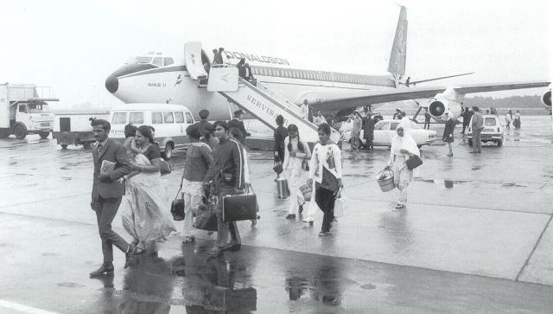
Uganda Asians Expelled 1972

Slide 36
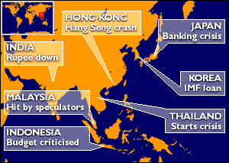
Asian Tigers Under Attack, 1997-98

Slide 37
4. Neo-Orthodoxy. Rejection of Keynes

Slide 38
Summary: Debate over the Economy
1. The International Contemporary State: Continental Europe vs. the U.S. or the U.K.
2. Adam Smith, "the hidden hand" and Classical Economics- An Anglo-Saxon View esp. USA
3. Eastern Europe and Former Soviet Union: Command Economy (whole or part): Images of the Cold War- A Propaganda Film- VIDEO
Eastern Europe Was Not Social Democratic

Slide 40
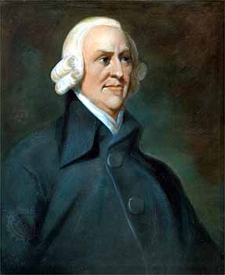
Rejection of Big Government It Starts with Adam Smith June 5, 1723 – July 17, 1790

Slide 41
The Debate about Mercantilism
Mercantilism is an economic theory and practice, dominant in Europe from the 16th to the 18th century, that promotes governmental regulation of a nation’s economy for the purpose of augmenting state power at the expense of rival national powers.

Slide 42
Rejecting Mercantilism and “Neo-Mercantilism”
Themes:
Building overseas colonies;
Forbidding colonies to trade with other nations;
Monopolizing markets through State Supported Companies;
Forbidding trade to be carried in foreign ships;
Export subsidies;
Promoting manufacturing with research or direct subsidies;
Maximizing the use of domestic resources;

Slide 43
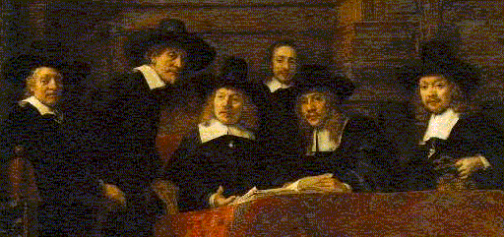
Rembrandt's painting “The Mercantilists”

Slide 44
Orthodox Economics
Adam Smith is often touted as the world's first free-market capitalist. He the father of modern economics and a major proponent of laissez-faire economic policies is quite secure.
Laissez-faire philosophies, such as minimizing the role of government intervention and taxation in the free markets, and the idea that an "invisible hand" guides supply and demand.
.Smith argued that the market should guide all economic activities.

Slide 45
Classical Liberalism?

Slide 46
Classical Liberalism?

Slide 47
Liberalism or Not Liberalism

Slide 48
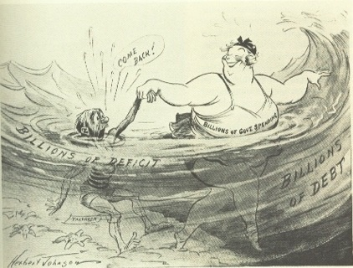
A New Debate? A 1930s Cartoon

Slide 49
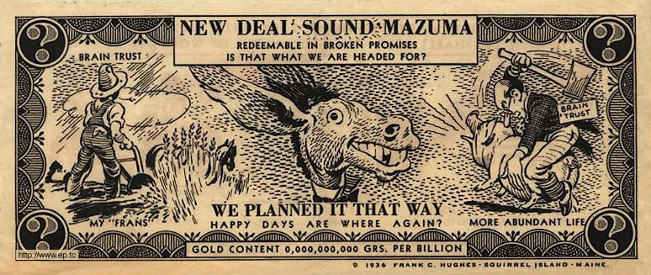
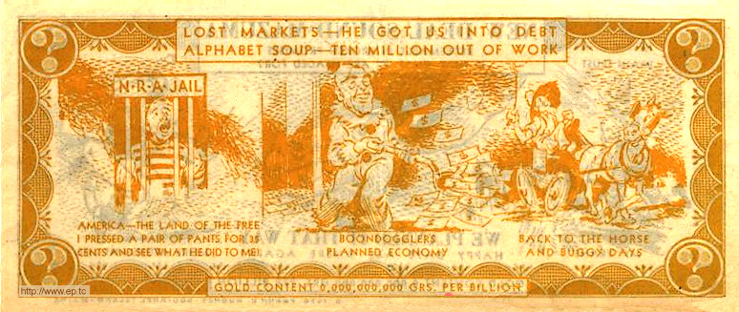

Slide 50
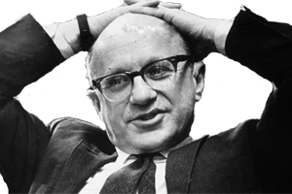
Milton Friedman (July 31, 1912 – November 16, 2006) Neo-Orthodoxy

Slide 51
Neo-Orthodoxy or the University of Chicago School
People have rational preferences between outcomes that can be identified and associated with values.
Individuals maximize utility and firms maximize profits.
People act independently on the basis of full and relevant information.
Government should not interfere with individual behavior
The Invisible Hand of the Market is the key to Economic Growth
International Reform is called Structural Adjustment

Slide 52
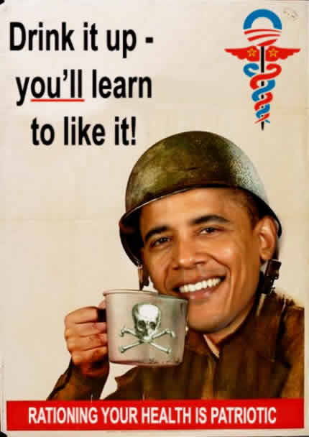
2011- Debates About “Obamacare?”

Slide 53
From 1989-2014
End of Cold War
Application of Structural Adjustment to Socialist Countries
September 11
Democracy and Governance
Public Private Partnerships
Whole of Government Approach

Slide 54
2001-Present
Micro-Issues:
Debate about “Whole of Government
Public-Private Partnerships
Evaluation and Contracting Out
Three D’s: Diplomacy, Defense and Development

Slide 55
Breaktime
Ten Minute Break

Slide 56
II. Political Institutions: Models of Governance
Who Gets:

Slide 57
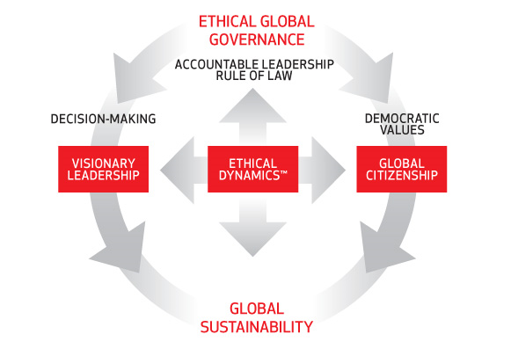
1. Models of Governance: An Ideal

Slide 58
Political Models
Separation of Powers
Parliamentary System
Mixed Systems of Government
One Party or No Party Systems
Military and Authoritarian Systems

Slide 59
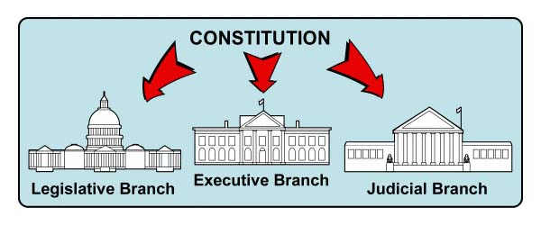
Separation of Powers
“Presidential System”
U.S.
Mexico
Philippines
Many Latin
American
Countries

Slide 60
Parliamentary System: Cabinet or Fused Government
United Kingdom
Scandinavia
Central Europe
India
Former British Colonies

Slide 61
The French Hybrid- The Mixed Presidential Model
France
French Colonies
Weak Hybrids with a Ceremonial President

Slide 62
One Party States: “Democratic Centralism”
Communist or
Leninist States
Afro-Marxist
Fascist
“No Party Regimes”
Weak Party Systems

Slide 63
“Absolutism”

Slide 64
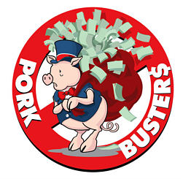
Authoritarianism
Authoritarian systems- Structures absent to protect citizens from fused state and bureaucracy
Non-Constitutional Systems: Military Regimes and One Party States- Politicized bureaucracy
Rent Seeking, Nepotism and Corruption

Slide 65
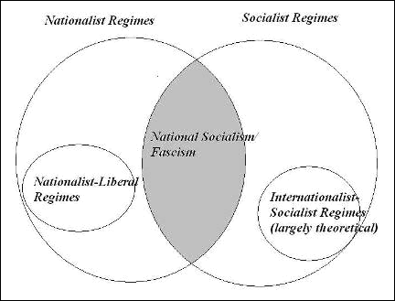
Does This Help?

Slide 66
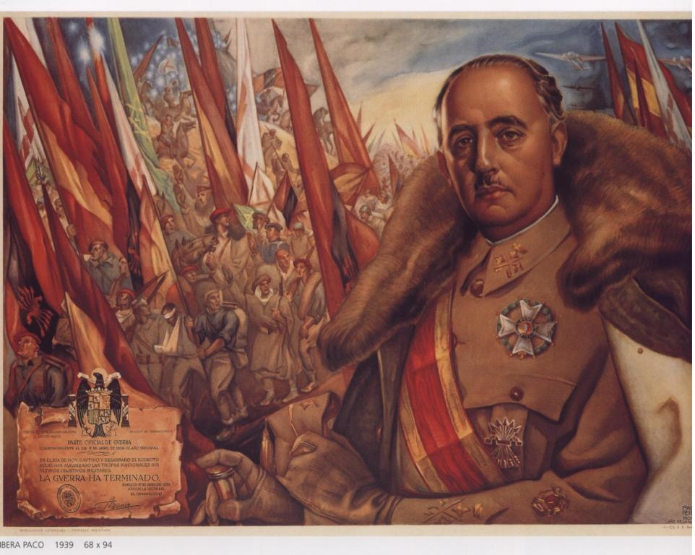
Corporatism as the Alternative Concept- Groups and Leadership Francisco Franco

Slide 67
Political Structures and Society
Statist view of Society- Collectivist (Frances FitzGerald- Fire in the Lake on Vietnam)- Four Views
a. Idea of an active, creative state, development oriented (Keynes)
b. Marxist-Leninist model- communitarian
c. Corporatist idea of society as groups- civil service as a group (Western Europe)
d. Focus- Group Mobilization

Slide 68
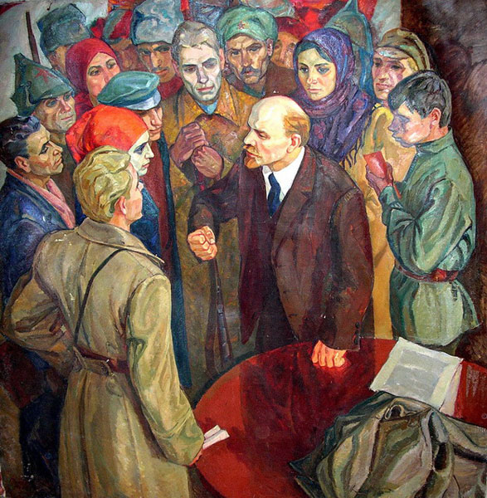
Mobilization of Working Class

Slide 69
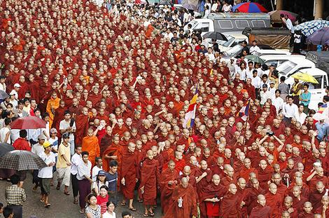
The Power of the Group

Slide 70
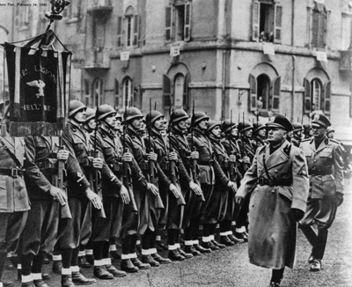
Fascism and Italy
VIDEO
The Banality of Authoritarianism

Slide 71
Questions and Discussion
Reading and the lectures

