Slide 1
Supplementary Slides
Bureaucratic Behavior

Slide 2
THE PROBLEM
Management of the public sector organization is separated from the major management functions-
eg. promotion, firing, discipline, collective bargaining

Slide 3
Basic Principles?
The Bureaucracy is an institution of government
a. The public bureaucrat has greater recourse to sanctions than the private
b. Only partly true- the credit card company and the collection agency

Slide 4
Origins of bureaucratic power
a. Bureaucracy is largely autonomous, only 10% of actions controlled by politicos
b. Actions are seldom subjected to political or judicial review
c. Problem of bureaucratic lethargy- resists change

Slide 5
Origins of bureaucratic power-2
d. Bureaucracies are COMPLEX ORGANIZATIONS and are difficult to control
e. Bureaucrats have the market cornered on expertise
f. Bureaucrats play "bureaucratic politics" behind the politicians' backs

Slide 6
Recruitment: The Only Game in Town (for Reform)
KEY: The recruitment of professionals and specialists contradicts with the issue of political control
a. Problem- management, eg. the Department, often does not control recruitment
b. Legislation sets the rules- merit system with civil service commission overseeing the process
c. Civil Service Commission or Office of Personnel acts as an intermediary

Slide 7
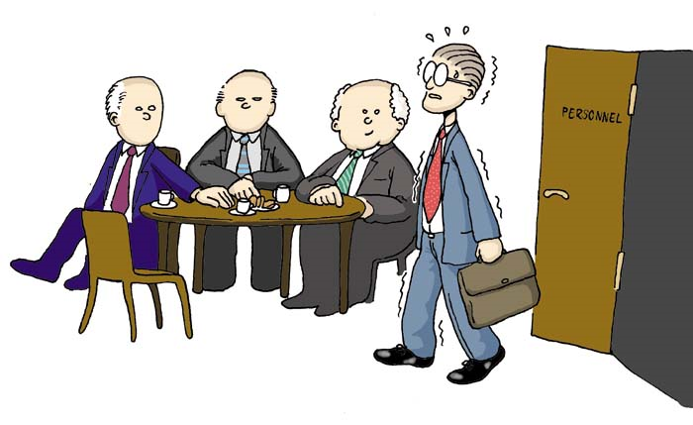
The Process: Images of Recruitment

Slide 8
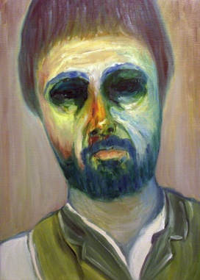
Lethargy (Dong Eun Kim)

Slide 9
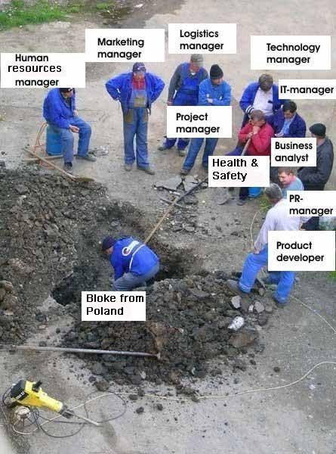
Bureaucratic Method: U.K.

Slide 10
Theories of Behavior
Rational Behavior and Decision-Making
Standard Operating Behavior (SOPs)
Bureaucratic Politics- Turf and Control
Group Think

Slide 11
Role Theory

Slide 12
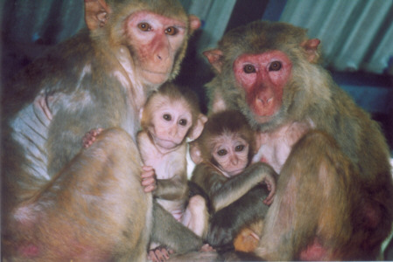
Role Theory: Animal Behavior?
The bureaucrat can have a complex set of interpersonal relationships
1. Analyst and advocate
2. Planner
3. Managers and lobbyists
4. Professional and employee
5. Citizen
6. Spouse and Parent

Slide 13
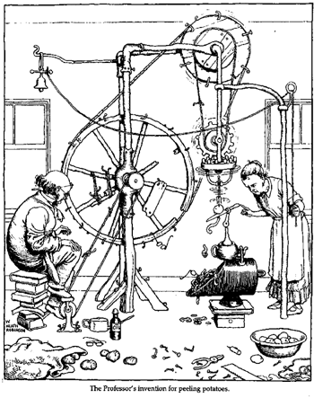
Bureaucratic Norms?

Slide 14
Graham Allison: Org. Theory
Cuban Missle Crisis
Kennedy Center, Harvard
Born, March 23, 1940

Slide 15
The Rights of the Bureaucrat
The role of Unions and strikes in the public service
Restrictions on political activity, eg. the Hatch Act in the U.S.
Secrecy, Clearance and Whistle Blowing

Slide 16
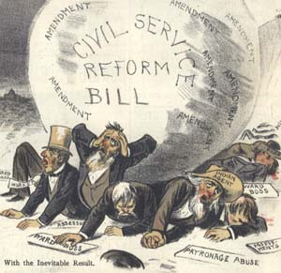
Hatch Act
1833-1896

Slide 17
Governance Theory in the 1990s
a. Often turns out to be very specific: i.e. focused institutions
1. Ombudsman
2. Auditor General
3. Territorial Governor as rep. of national authority- the Prefectoral system
b. The Problem: Comparative studies of institutions are very expensive-run out of money/go back to case studies
c. The New Solution: Integration- The Whole of Government Approach

Slide 18
Whole of Government

Slide 19
Swedish Ombudsman

Slide 20
Comparative Methodology Issues
Impact of the “Asian Model” and international experience
Debates about Soft State Problem
Weak Private Sector Problem
Debates about Governance and Authoritarianism

Slide 21
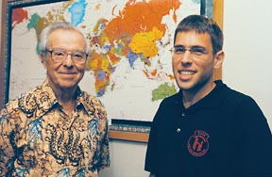
THEORY: Civil Society vs. State
DEBATES
John D. Montgomery vs. Milton Esman
(Experience Japan and Vietnam)

Slide 22
Middle Range Theory:
a. Role Theory, Exchange Theory
b. Focus on specific relationships: eg. bureaucracy and political and moral variables within a country
c. Mostly case studies- Egypt, Botswana, the U.S. All the same method. "The Case Study"

Slide 23
The political implications of role theory
ROLE SETS (Robert Merton)
Role Conflict in the bureaucracy
Role vs. Status vs. Individuals

Slide 24
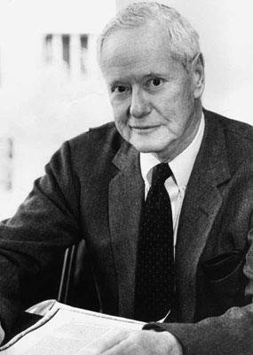
Robert King Merton July 4, 1910 - February 23, 2003

Slide 25
The political implications of role theory
ROLE SETS (Robert Merton)
Role Conflict in the bureaucracy
Role vs. Status vs. Individuals

Slide 26
The Situation in 1983:Modified "traditional Approach"- A Micro and Meso level approach
a. Most like an "orthodoxy" of public administration
b. Comparative Study of:
1. Parts of the System- budgeting, personnel, inter-governmental relations, policy process- Focus on Relationships
2. Or whole systems- Britain vs. France, U.S. vs. Russia, Botswana vs. Tanzania- Not Comparative

