Slide 1
PIA 2020 Week 7
Jessi Hanson

Slide 2
Timeline
Study Sessions Thursday October 20th from 6-8pm
Friday 21st from 1-2pm
Mid-term will be October 26th
No ‘notes’, come with 5-7 sheets of blank paper, pens & pencils, all items will be put away and cleared off table and laps
If you have special requirements for the exam, please confirm with Jessi a time to take it as you will take it at another time

Slide 3
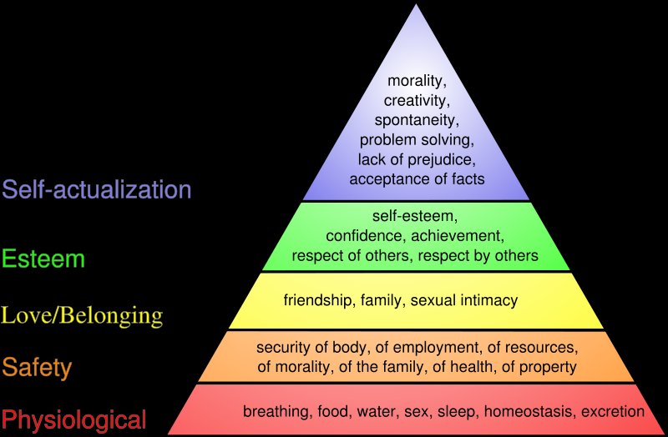
The Hierarchy of Needs and Roles (Abraham Maslov)

Slide 4
V. Human Resource Development and Education
1. The Key to Merit
2. Issue: the difference between Education and Training
3. Professional vs. Management
Video: The G.I. Bill- Look at film
A Form of Affirmative Action
LETS FINISH THIS SECTION PLEASE IN THE DISCUSSION/RECITATION NOTES

Slide 5
Essay Example
Everyone please read the essay example presented on board with your group
Discuss the elements in its:
Introduction
Topic Sentence
Body
Transitions between paragraphs
Evidence- What type did it have?
Conclusion

Slide 6
Prep Question 1
Look back to Schiavo-Campo & McFerson’s description of ‘Good Governance’
Let’s map 3 countries
How would each rank in terms of accountability, transparency, rule of law, and participation?

