Slide 1
Introduction to Public Affairs
PIA 2020
Historical Models, Contemporary Models and
Socio-economic change
Week Six

Slide 2
Development and Under-Development 2001-Present
Micro-Issues:
Debate about “Whole of Government
Public-Private Partnerships
Evaluation and Contracting Out
Three D’s: Diplomacy, Defense and Development

Slide 3
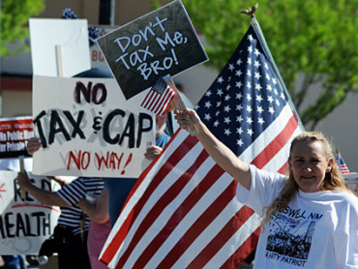
4. Neo-Orthodoxy. Rejection of Keynes

Slide 4
The Debates Over Development: Africa, Asia and Latin America
Colonial Heritage
Political Nationalization
Adapted Keynesianism
Anti-Private Sector:
Pariah Groups, White Settlers, Chinese, Indians, Lebanese-Arabs (The Jews in Europe Debates)

Slide 5
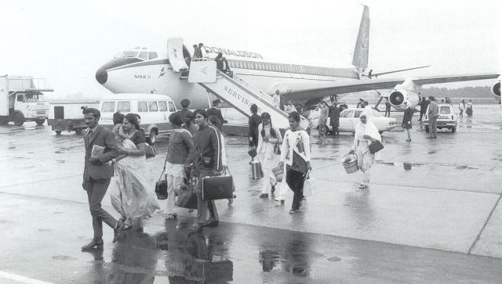
Uganda Asians Expelled 1972

Slide 6
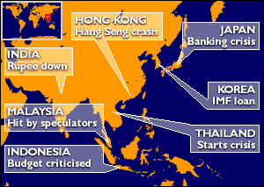
Asian Tigers Under Attack, 1997-98

Slide 8
Summary: Debate over the Economy
1. The International Contemporary State: Continental Europe vs. the U.S. or the U.K.
2. Adam Smith, "the hidden hand" and Classical Economics- An Anglo-Saxon View esp. USA
3. Eastern Europe and Former Soviet Union: Command Economy (whole or part): Images of the Cold War- A Propaganda Film- VIDEO
Eastern Europe Was Not Social Democratic

Slide 9
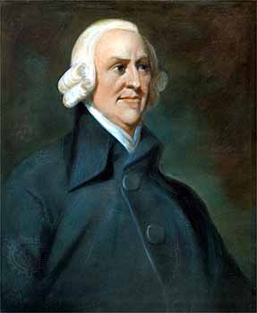
Rejection of Big Government It Starts with Adam Smith June 5, 1723 – July 17, 1790

Slide 10
The Debate about Mercantilism
Mercantilism is an economic theory and practice, dominant in Europe from the 16th to the 18th century, that promotes governmental regulation of a nation’s economy for the purpose of augmenting state power at the expense of rival national powers.

Slide 11
Rejecting Mercantilism and “Neo-Mercantilism”
Themes: Mercantilism
Building overseas colonies;
Forbidding colonies to trade with other nations;
Monopolizing markets through State Supported Companies;
Forbidding trade to be carried in foreign ships;
Export subsidies;
Promoting manufacturing with research or direct subsidies;
Maximizing the use of domestic resources;

Slide 12
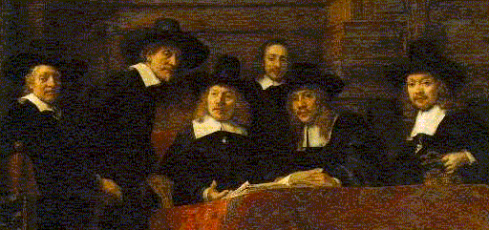
Rembrandt's painting “The Mercantilists”

Slide 13
Orthodox Economics
Adam Smith is often touted as the world's first free-market capitalist. He the father of modern economics and a major proponent of laissez-faire economic policies is quite secure.
Laissez-faire philosophies, such as minimizing the role of government intervention and taxation in the free markets, and the idea that an "invisible hand" guides supply and demand.
.Smith argued that the market should guide all economic activities.

Slide 14
Classical Liberalism?

Slide 15
Classical Liberalism?

Slide 16
Liberalism or Not Liberalism

Slide 17
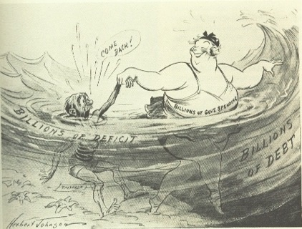
A New Debate? A 1930s Cartoon

Slide 18
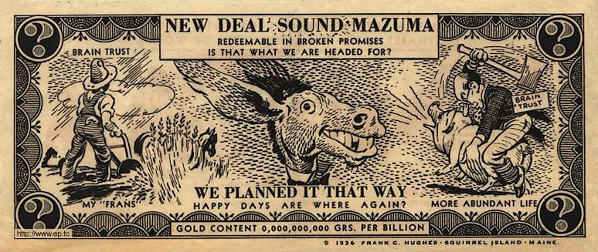
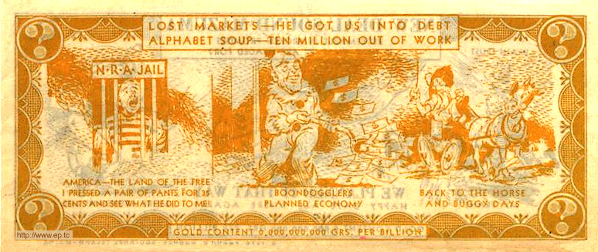

Slide 19
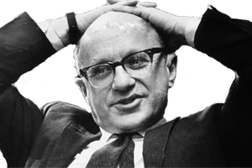
Milton Friedman (July 31, 1912 – November 16, 2006) Neo-Orthodoxy

Slide 20
Neo-Orthodoxy or the University of Chicago School
People have rational preferences between outcomes that can be identified and associated with values.
Individuals maximize utility and firms maximize profits.
People act independently on the basis of full and relevant information.
Government should not interfere with individual behavior
The Invisible Hand of the Market is the key to Economic Growth
International Reform is called Structural Adjustment

Slide 21
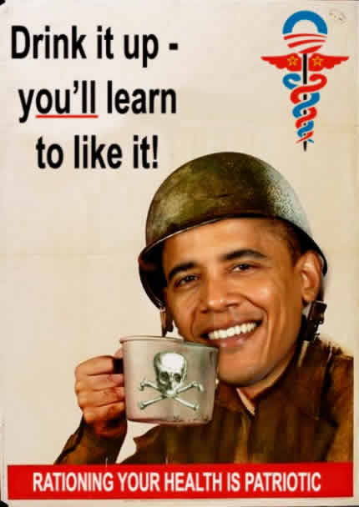
2011- Debates About “Obamacare?”

Slide 22
From 1989-2014
End of Cold War
Application of Structural Adjustment to Socialist Countries
September 11
Democracy and Governance
Public Private Partnerships
Whole of Government Approach

Slide 23
2001-Present (REVIEW)
Micro-Issues:
Debate about “Whole of Government
Public-Private Partnerships
Evaluation and Contracting Out
Three D’s: Diplomacy, Defense and Development

Slide 24
Political Institutions: Models of Governance
Who Gets:

Slide 25
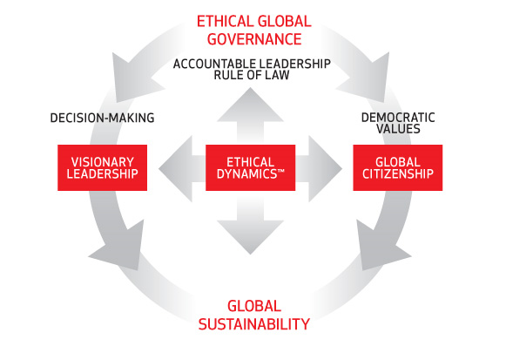
1. Models of Governance: An Ideal

Slide 26
Political Models
Separation of Powers
Parliamentary System
Mixed Systems of Government
One Party or No Party Systems
Military and Authoritarian Systems

Slide 27
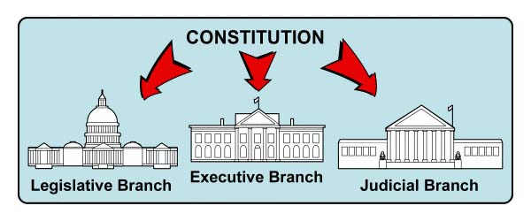
Separation of Powers
“Presidential System”
U.S.
Mexico
Philippines
Many Latin
American
Countries

Slide 28
Parliamentary System: Cabinet or Fused Government
United Kingdom
Scandinavia
Central Europe
India
Former British Colonies

Slide 29
The French Hybrid- The Mixed Presidential Model
France
French Colonies
Weak Hybrids with a Ceremonial President

Slide 30
One Party States: “Democratic Centralism”
Communist or
Leninist States
Afro-Marxist
Fascist
“No Party Regimes”
Weak Party Systems

Slide 31
“Absolutism”

Slide 32
Authoritarianism
Authoritarian systems- Structures absent to protect citizens from fused state and bureaucracy
Non-Constitutional Systems: Military Regimes and One Party States- Politicized bureaucracy
Rent Seeking, Nepotism and Corruption

Slide 33
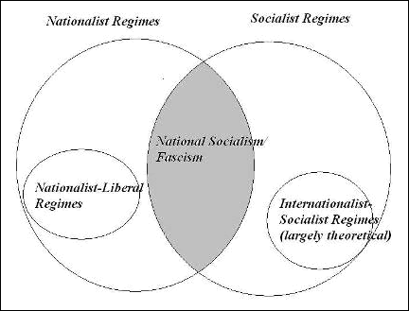
Does This Help?

Slide 34
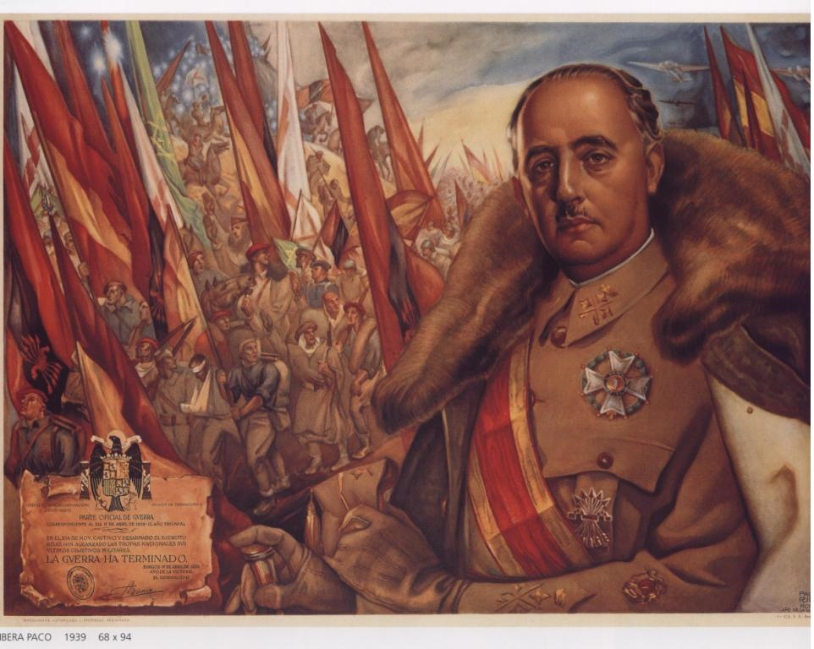
Corporatism as the Alternative Concept- Groups and Leadership Francisco Franco

Slide 35
Political Structures and Society
Statist view of Society- Collectivist (Frances FitzGerald- Fire in the Lake on Vietnam)- Four Views
a. Idea of an active, creative state, development oriented (Keynes)
b. Marxist-Leninist model- communitarian
c. Corporatist idea of society as groups- civil service as a group (Western Europe)
d. Focus- Group Mobilization

Slide 36
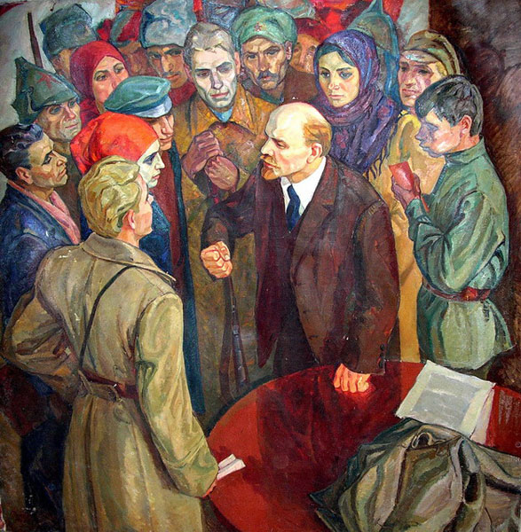
Mobilization of Working Class

Slide 37
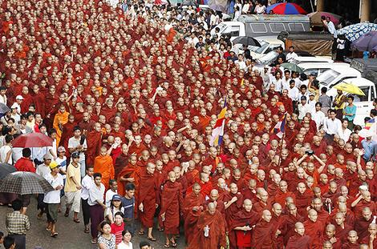
The Power of the Group

Slide 38
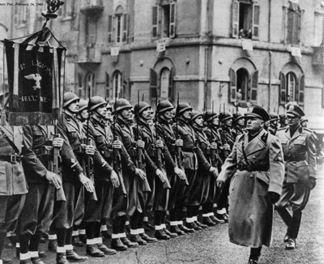
Fascism and Italy
VIDEO
The Banality of Authoritarianism

Slide 39
Questions and Discussion
Reading and the lectures

