Slide 1
PIA 2020 Introduction to Public Affairs
THEORIES OF GOVERNANCE AND POLITICAL ECONOMY
Week FIVE

Slide 2
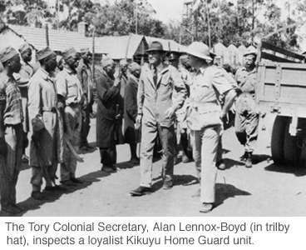
1870-1960 THE COLONIAL WORLD (Of This More Later)

Slide 3
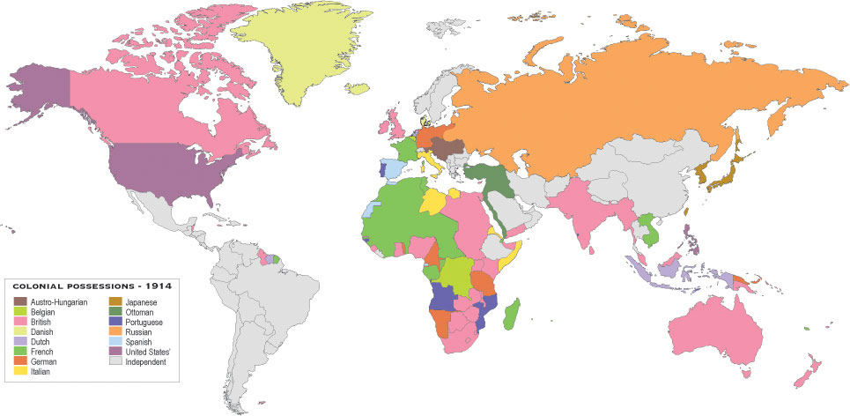
The Colonial World Map-1914

Slide 4
Independence of Namibia 1989

Slide 5
Majority Rule in South Africa, June 1994

Slide 6
Independence for South Sudan July 2011

Slide 7
International Development

Slide 8
DEVELOPMENT THEORY FROM THE FRENCH REVOLUTION TO KEYNES
WHAT IS POLITICAL ECONOMY
THE RELATIONSHIP BETWEEN MARKETS, TRADE AND MONEY
WITH LAW, GOVERNANCE AND MONEY

Slide 9
Count Henri de Saint-simon (October 17, 1760-May 19, 1825}

Slide 10
SAINT-SIMONISM
STRATEGY OF STATE LEADS INDUSTRIALIZATION THAT DIFFERS FROM ADAM SMITH AND KARL MARX
FOCUS ON PRIVATE SECTOR-GOVERNMENT CO-MANAGED PROCESS
GOVERNMENT TO CONSTRUCT MEANS OF COMMUNICATION- BRIDGES, ROADS AND INFRASTRUCTURE
PROTECT BOTH PRIVATE SECTOR AND WORKERS RIGHTS
INFLUENCES LATER IDEAS OF KEYNES ESPECIALLY IN DEVELOPING COUNTRIES

Slide 11
Conceptual: Agraria vs. Industria

Slide 12
The Development Model Post World War II
Keynes and Modernization Theory
State as Development Manager
Industrialization vs. Rural Development
The Take Off Point: Capital Accumulation

Slide 13
The Development Model: Keynes from Saint-Simon
Use of the Government to promote economic growth and development
Thus importance of the Chalmers Johnson book on MITI
Japan has been a "state guided Market economy“
Thesis- Economic Development involved an expansion of the official bureaucracy
By Indirection- Focus on Africa, Caribbean, Latin America, South Asia and the Middle East

Slide 14
Ministry of International Trade and Industry and the Asia Model

Slide 15
Japan and Ministry of International Trade and Industry (MITI)
Asian Model
Corporatist- Inter-meshing of state and Private Sector
Management (not Political) Focus
Growth and Export
Model for Asian Tigers

Slide 16
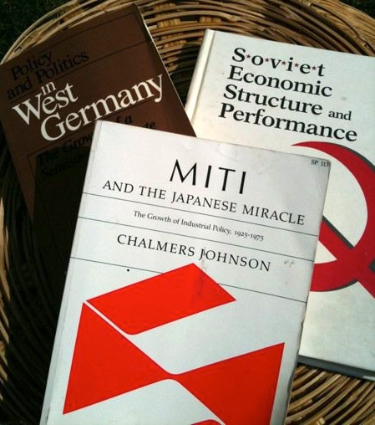
Japan and Economic Development Chalmers Johnson Author of the Week

Slide 17
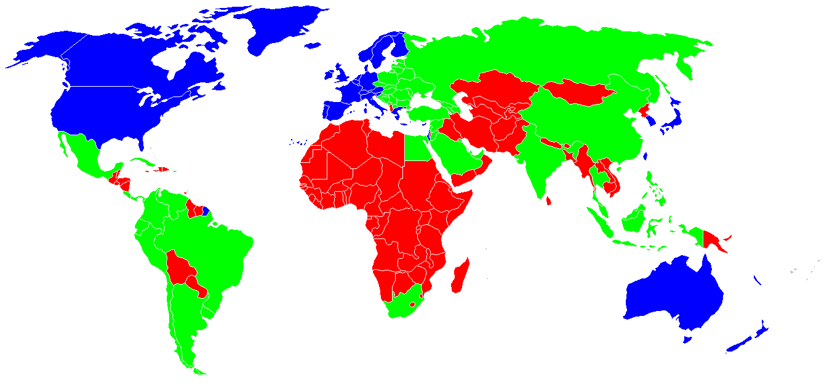
Classification of the countries by developing status. Blue - developed countries Green - developing countries Red - underdeveloped countries

Slide 18
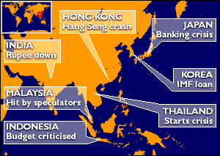
Asian Tigers Under Attack, 1997-98

Slide 19
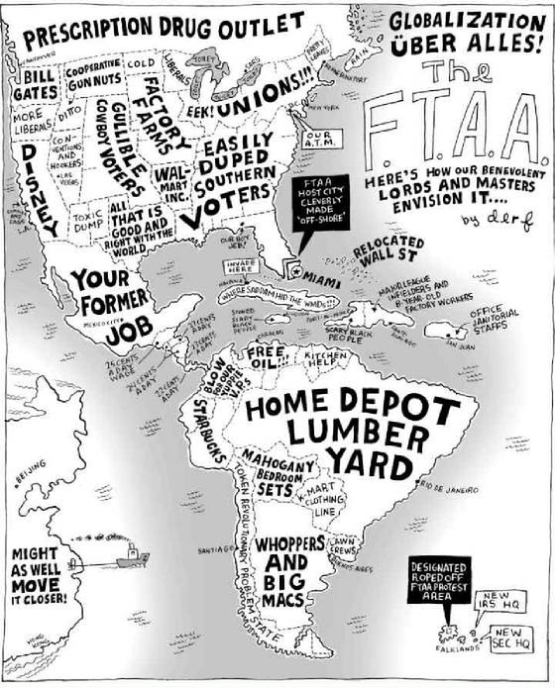
Globalization: U.S. Style?

Slide 20
The Public Sector Problem:
Inefficiency
Corruption
Interest Influence
Authoritarianism
Patronage

Slide 21
REVIEW: THE DEBATES OVER DEVELOPMENT
Colonial Heritage
Political Nationalization
Adapted Keynesianism
Anti-Private Sector:
Pariah Groups, White Settlers, Chinese, Indians, Lebanese-Arabs (The Jews in Europe Debates)

Slide 22
Debates about development- An overview of “Dead Aid” Arguments

Slide 23
Dambisa Moyo
“The Financial Times summarized the book's argument, stating "Limitless development assistance to African governments, [Moyo] argues, has fostered dependency, encouraged corruption and ultimately perpetuated poor governance and poverty."

Slide 24
Critique of Keynes and Development: The So-called Nanny State

Slide 25
Contemporary Issue: Privatization and the Political Economy
In the last decade, critics of the public service have argued that efficient government is small government.
Privatization has been the order of the day.
Eg. Private Security

Slide 26
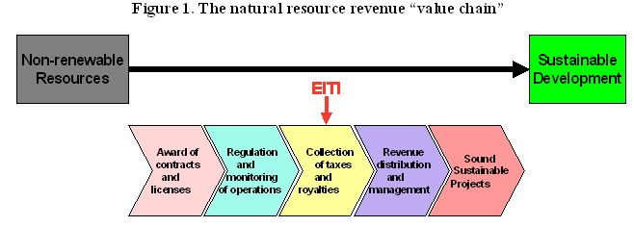
Sustainability and International Public Policy: The Extractive Industries Transparency Initiative- International Monetary Fund (IMF)- An An Alternative Ideal

Slide 27
Debates about Contracting-
Bureaucrat Bashing
Social Change and the Private Sector
For profit privates and the non-profit sector
The problem: What South Africans Call “Tenderocracy”

Slide 28
Privatization: Contracting and non-profits
The Answer to Bad Governance, Corruption and Inefficiency?
This "neo-classical" model of development has been exported overseas
Especially to the less developed and transitional states in Africa, Asia, Eastern and Central Europe and Latin America.

Slide 29
Privatized Water Supplies

Slide 30
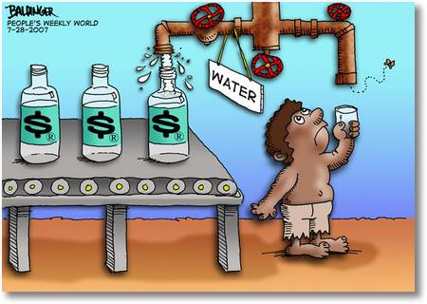
Privatization?

Slide 31
Key: Issue of Relationship between government and the economy.
Issue of Privatization
Public-Private Partnerships- Including NGOs (The new buzz word).
Note: John Armstrong's argument that education and training are critical variables in understanding “development" strategies in Western Europe and then Soviet Union. HRD not culture or structure defines economic systems
Argument: PPPs get around bureaucratic rigidity and private sector corruption

Slide 32
Privatization in Security Services? Executive outcomes or Blackwater?

Slide 33
President International Stability Operations Association, Doug Brooks, GSPIA PhD Alum

Slide 34
The Problem of Pariah Groups: Compete Unfairly in Private Sector
Historically- Jews in Europe
Chinese in Asia
Koreans in U.S. Cities
Indians and Arab Speakers in Africa

Slide 35
Uganda Asians Expelled 1972

Slide 36
LDCs
An absence of "clients" or Too many?
The Role of patronage, corruption and Crony capitalism.
-Indonesia
-Korea
-West and West Africa
-South Africa
-China
-U.S.?

Slide 37
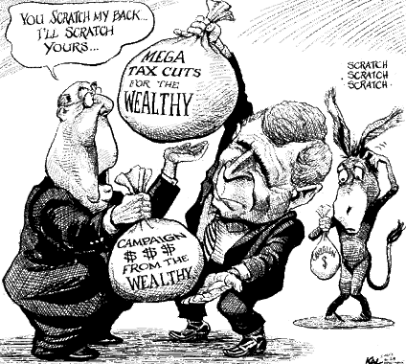
Privatization Leads to Crony Capitalism in Developed, Transitional and Developing Countries

Slide 38
Human Rights vs. Human Security: Level of Rights and Human Security
1. Basic needs: food, shelter, security
2. Political Rights: Speech, Representation, Religion
3. Social: Health and Education
4. Economic: Employment, income

Slide 39
Conflict and Human Security: Is This the Problem? The Lord’s Resistance Army in Uganda

Slide 40
2001-Present: A Review
Micro-Issues:
Debate about Development
Keynesianism
Human Rights and Human Security
Public-Private Partnerships
Evaluation and Contracting Out
Three Ds: Diplomacy, Defense and Development

Slide 41
The True Nature of the Contract
According to Marx

Slide 42
Discussion Questions
Name three or four issues that you see as critical from the lectures.
Where are there disagreements within the text?
Are their ideas or conflicts from class thus far that need to be discussed?

