Slide 1
PIA 2020. Introduction to Public Affairs
Week Four:
Debates About Democracy and Public Policy

Slide 2
Degree Specific Readings
Discuss and share your answer:
What will this book be about?
Why do you think it is assigned to you to read in this class? Aka. What might you gain in learning in reading it?
How did the assigned reading for today relate to the Core and/or Classic readings? What were common or overlapping themes?

Slide 3
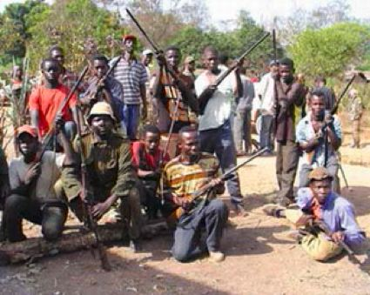
Conflict and Human Security: Is This the Problem? The Lord’s Resistance Army

Slide 4
Public Affairs from a Comparative Perspective: Environmental Issues for the Session
Legal Rational Model and Democracy and Governance
Institutions vs. Charisma
Public Sector Reform: Legal, Behavioral, Fiscal
Keynesianism and Good Governance
International Development and the Intersection of Public Sector and Civil Society
Contracts and Privatization

Slide 5
The True Nature of the Contract
According to Marx

Slide 6
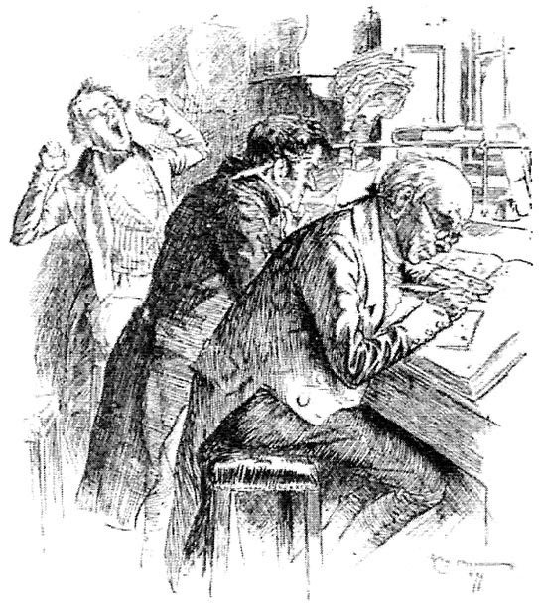
The British Administrator- 1875: Rule of Law or Rule of lawyers and clerks

Slide 7
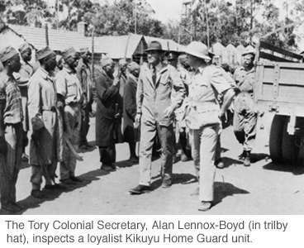
One Example: Colonial Administration

Slide 8
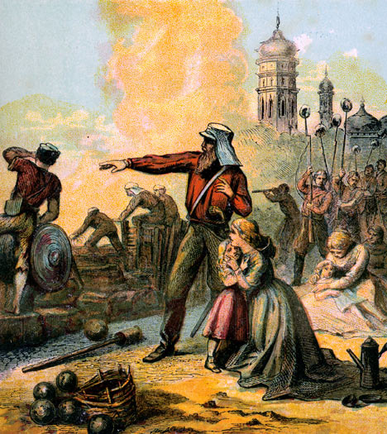
However, Classic Colonial Image: Threat to Women and Children

Slide 9
Max Weber’s Models of Management
Traditional- Monarchy
Charismatic- Revolution
Legal Rational Model

Slide 10
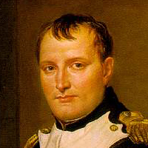
Charismatic?

Slide 11
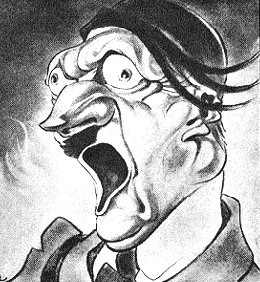
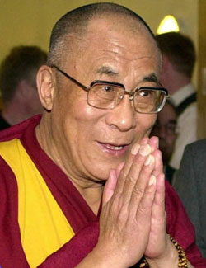
Institutions vs. Charisma?

Slide 12
Legal-Rational Model
Legal-Rational Model- Modern-specialized/technical:
Characteristics: BASED ON “DEMOCRATIC “PRINCIPLES
a. Merit Selection
b. Hierarchy- Chain of Command
c. Routinisation of Charisma
d. Institutions and the Rule of Law

Slide 13
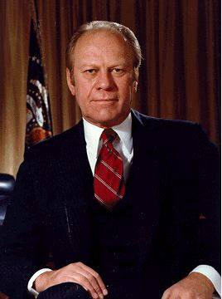
Gerald R. Ford?

Slide 14
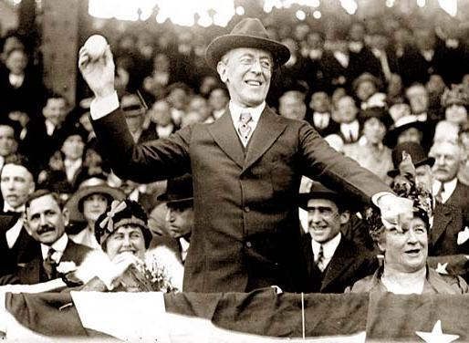
No- Woodrow Wilson, Political Scientist and the Separation of Politics and Administration (Successor to Weber): Routinization of Charisma

Slide 15
Legal-Rational Continued
e. Division of Labor and functional specialization
f. Administrative work: full time, no sinecures
g. Contractual agreement
h. Professional or technical training
i. The Problem of Corruption

Slide 16
Human Rights vs. Human Security
The Human Rights and Security Issue: What is Democracy?
1. Political Rights: Speech, Representation, Religion
2. Social: Health and Education
3. Economic: Employment, income

Slide 17
Contemporary Democracy and Public Policy Issues
Democracy and Public Policy- Representation
Historical vs. Contemporary Models: Law and Order vs. Economic and Social Policy
Governance and Political Economy: Who gets what when
and how
Recruitment- affirmative action and representative bureaucracy
Regulation and Deregulation- Privatization and Contracting Out
More Developed States vs. Less Developed States

Slide 18
Comparative Public Affairs Issues
These include ways in which administrators interact with their political environment and influence the policy making process.
We will also examine several specific administrative problems that have themselves become contentious policy issues

Slide 19
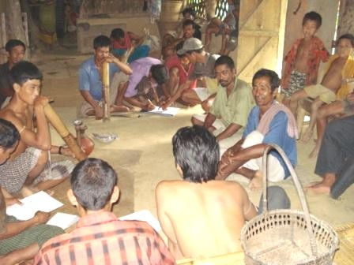
Governance in Bangladesh

Slide 20
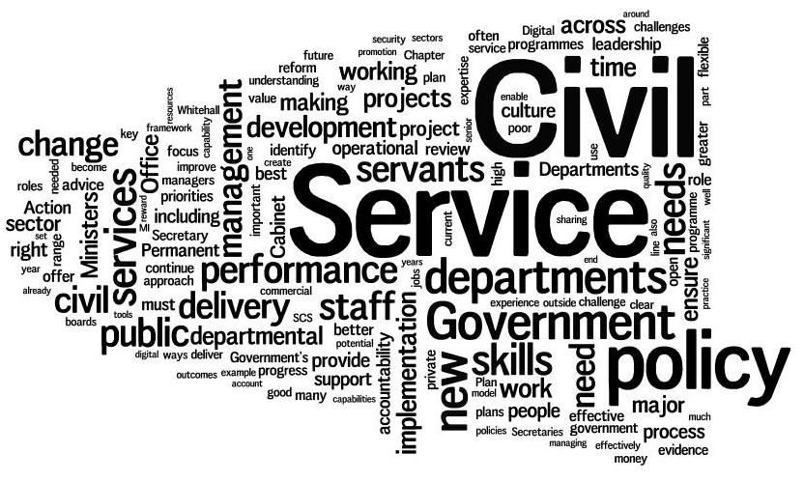
Civil Service Reform
Is This the key to Governance?

Slide 21
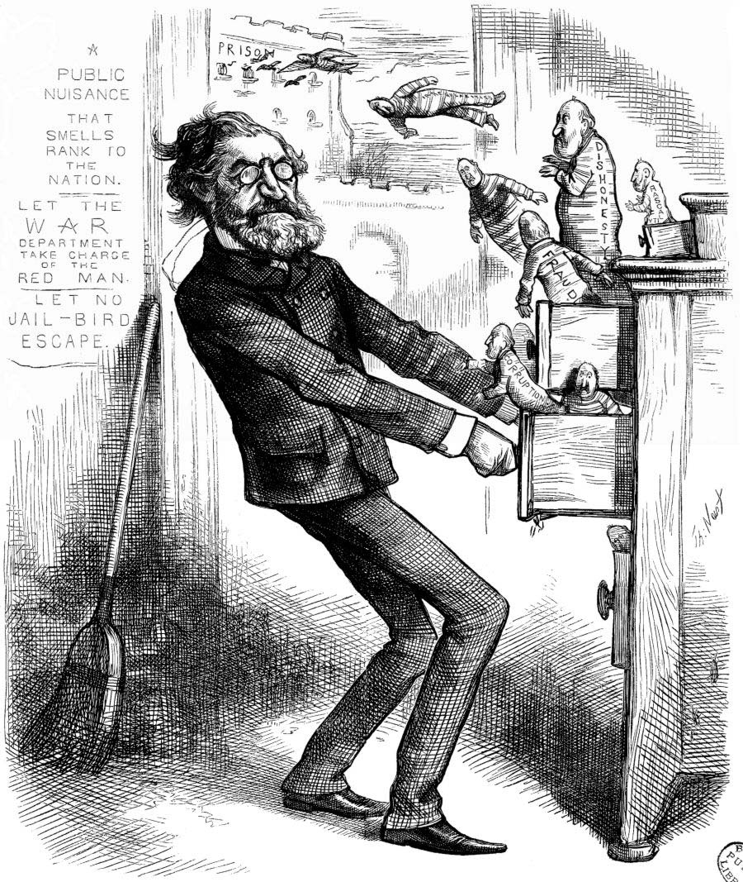
Rutherford B. Hays, 1877-1881 (Indian Affairs)

Slide 22
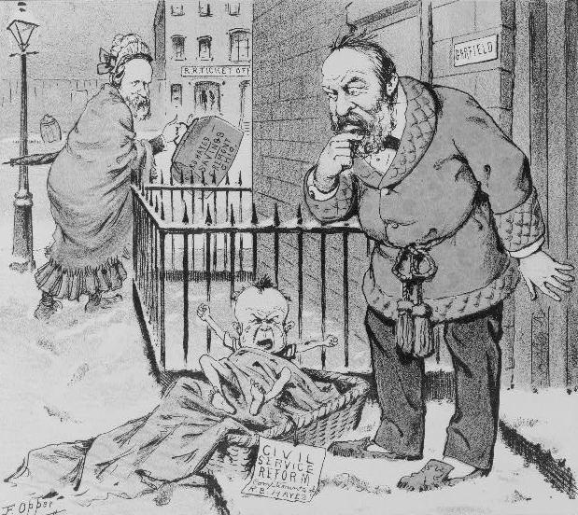
Civil Service Reform: Puck Political Cartoon

Slide 23
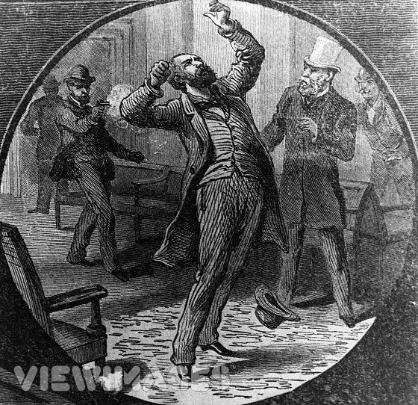
James A. Garfield Assassination July 2, 1881

Slide 24
U.S.A. Post-1883 Political Reforms- The Pendleton Civil Service Reform Act
1. Spoils, patronage and 1883 reforms. Selling jobs
2. Woodrow Wilson and Progressivism: Babies and Bathwater?
3. Dichotomy- politics and administration

Slide 25
U.S.A. As a Model?
4. Wilson Popularized Max Weber's ideas
5. Keynesianism and Good Government
6. Privatization, Free Trade and Small Government
7. Debate about Contracting Out

Slide 26
MACRO-ISSUE

Slide 27
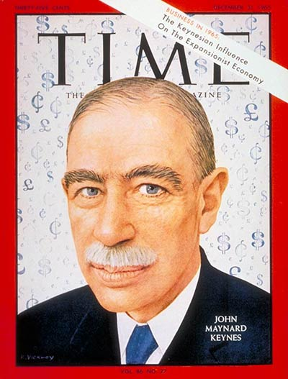
F. The Public Sector and Development- Weber vs. Marx
John Maynard Keynes
1883-1946
One of the major goals of this course will be to examine this issue (Law and Order vs. Social and Economic Change) and
Examine the role that the bureaucracy has played in the development process in Europe, the states of the former Soviet Union, the United States and the newly industrializing states of East Asia, Africa and Latin America.
OR NOT!!!

Slide 28
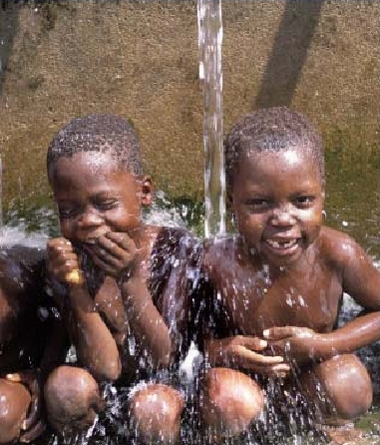
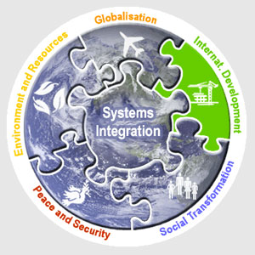
International Development

Slide 29
The Development Model
Use of the Government to promote economic growth and development
Thus importance of the Chambers Johnson book on MITI
Japan has been a "state guided Market economy“
Thesis- Economic Development involved an expansion of the official bureaucracy
By Indirection- Focus on Africa, Caribbean, Latin America, South Asia and the Middle East

Slide 30
Ministry of International Trade and Industry and the Asia Model

Slide 31
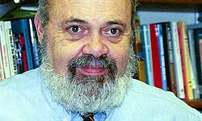
Bureaucracy and its Dysfunction- Author of the Day: PITT’s B. Guy Peters (THE OR NOT PROBLEM)

Slide 32
Definition from Peters
1. Public Administration- Rule Application
2. Bureaucracy- Hierarchical organizations designed to utilize the enforcement of universal and impersonal rules to maintain authority
3. Public Policy- Key: Rule making as well as rule application

Slide 33
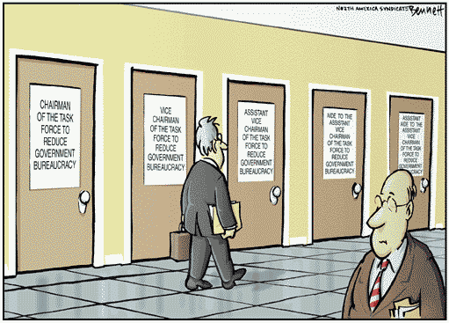
A More Cynical View

Slide 34
Bureaucracy and Power
Recruitment?
The control of bureaucratic power, upon which comparisons of diverse bureaucracies can be valid.
The Use of History: Historical Kingdoms in Asia, Africa and Europe all precursors to modern state system

Slide 35
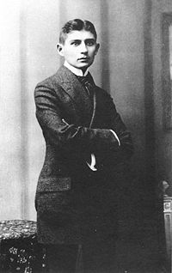
An Early Bureaucrat
Basher
Franz Kafka-
Man About Prague
(July 3, 1883-June 3, 1924)

Slide 36
The Problem: Corruption and Dysfunctional Bureaucracy
Kafkaesque
Dysfunctional Bureaucracy
Maze of Regulations
Image of Public Sector as Inefficient

Slide 37
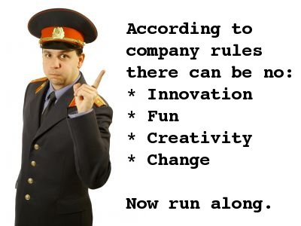
Key Issue: Bureaucrat Bashing

Slide 38
The perennial tensions between official and personal norms in organizations
The issue of the "bureaucratic experience," (Hummel), that differs from the social (human) experience
Hummel says "dehumanizing“
Standards and policies defined by the past and standardized for all
e. g. people, as cases
Source of Corruption

Slide 39
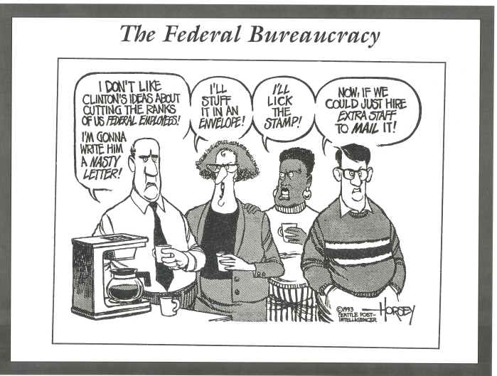
Civil Service/Public Sector Reform

Slide 40
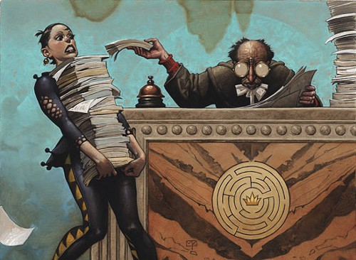
Bureaucrat Bashing as a Problem?

Slide 41
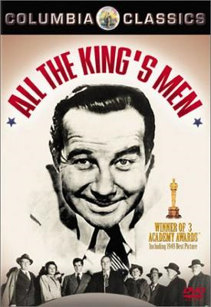
Peters Thesis dissected
A Great Film- More Later
Thesis- Attacks the artificial dichotomy between politics and administration
Problem- critics of "rational bureaucracy" say it is the end of politics eg. End of "all the kings men“
Goal- get into the magic "black box" of bureaucratic politics

Slide 42
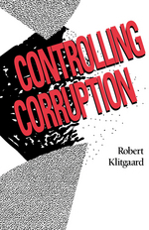
Author of the Week Robert Klitgaard the president of Claremont Graduate University and his book on Corruption

Slide 43
Institutions and Corruption
One View

Slide 44
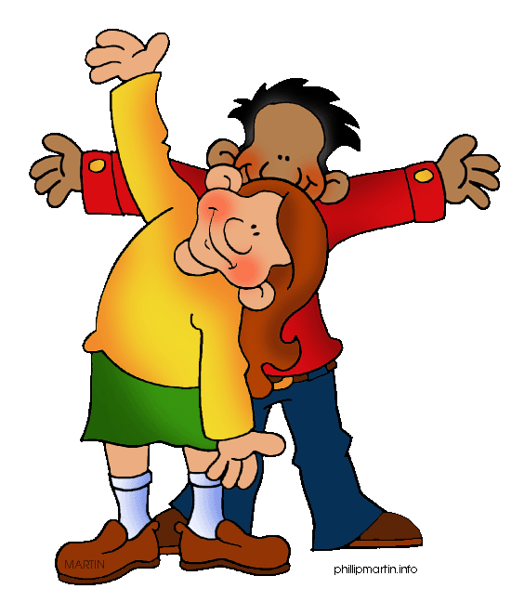
Summary: The Importance of the Comparative Approach
Cultural Dimension
Contingency Approach (orgs. for prisons vs. research)
Effects of diffusion- colonies and the world bureaucratic system
Implementation- Hopes that are dashed in the doing

Slide 45
Privatization: Contracting and non-profits
The Answer to Bad Governance, Corruption and Inefficiency?
This "neo-classical" model of development has been exported overseas
Especially to the less developed and transitional states in Africa, Asia, Eastern and Central Europe and Latin America.

Slide 46
Debates about Contracting-
Related to Bureaucrat Bashing
Social Change and the Private Sector
For profit privates and the non-profit sector
The problem: What South Africans Call “Tenderocracy”

Slide 47
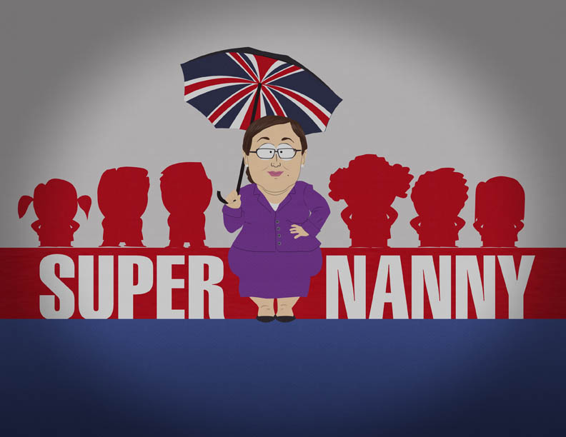
Critique: The So-called Nanny State

Slide 48
Contemporary Issue: Privatization and the Political Economy
In the last decade, critics of the public service have argued that efficient government is small government.
Privatization has been the order of the day.
Eg. Private Security

Slide 49
Executive outcomes or Blackwater?

Slide 50
President International Stability Operations Association, Doug Brooks, GSPIA PhD Alum

Slide 51
Privatized Water Supplies

Slide 52
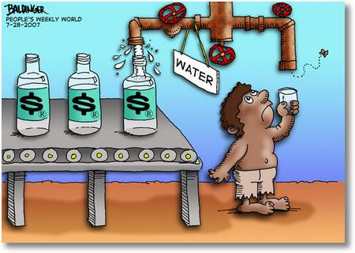
Privatization?

Slide 53
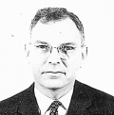
Key: Issue of Relationship between government and the economy.
Issue of Privatization
Public-Private Partnerships- Including NGOs (The new buzz word).
Note: John Armstrong's argument that education and training are critical variables in understanding “development" strategies in Western Europe and then Soviet Union. HRD not culture or structure defines economic systems
Argument: PPPs get around bureaucratic rigidity and private sector corrpuption

Slide 54
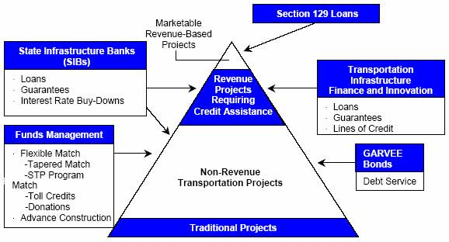
UNITED STATES DEPARTMENT OF TRANSPORTATION REPORT TO CONGRESS ON PUBLIC-PRIVATE PARTNERSHIPS

Slide 55
Enduring Features of Government and Comparative Methodology
Patterns of organization
Recruitment of bureaucrats
Certain common programs of governments
Problem of Dysfuncton

Slide 56
Enduring Features in Organizations
Capacities and performance
The perennial tensions between official (and)
Personal norms and the control of bureaucratic power (Corruption)
Ecology and the Environment
Internationalization of Public Policy

Slide 57
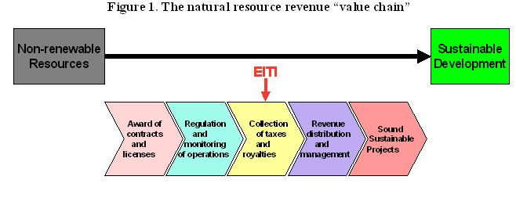
International Public Policy: The Extractive Industries Transparency Initiative- International Monetary Fund (IMF)- An Example

Slide 58
Contemporary Policy Issues- Future Topics for Discussion
Organizations, Socialization and Motivation- Status and Role Theory
budgetary decision making- The Fiscus
government reorganization- Public Sector Reform
Decentralization- Grassroots and Local Governance
Civil Society and Social Capital- Pluralism vs. Corporatism
International Development and Foreign Aid- and Foreign and Security Policy - The Three D’s (Defense, Diplomacy and Development

Slide 59
Public Policy and Management: Images

Slide 60
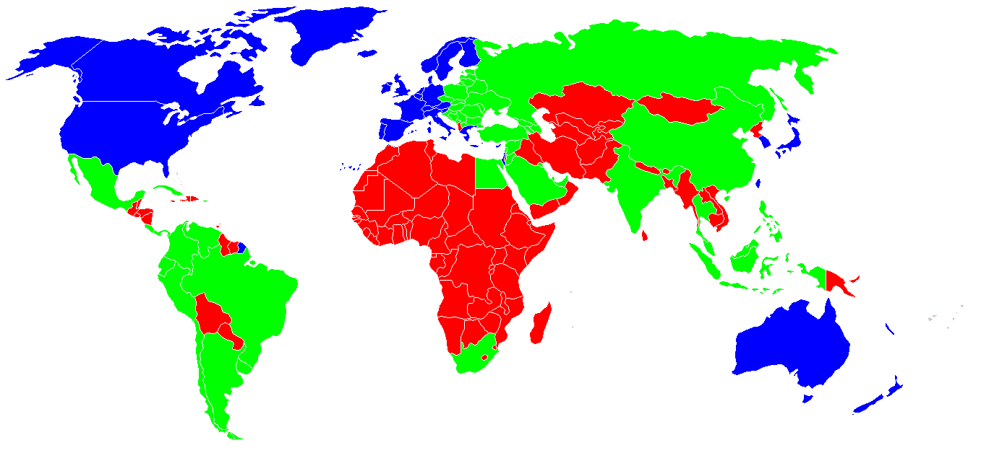
Classification of the countries by developing status. Blue - developed countries Green - developing countries Red - underdeveloped countries

Slide 61
”The Purpose of the Geographic Commands is the "3D" goals (the merging of defense, diplomacy and development)” Referenced from: http://thomaspmbarnett.com/globlogization/tag/us-military?currentPage=2#ixzz1WQjbBYKE

Slide 62
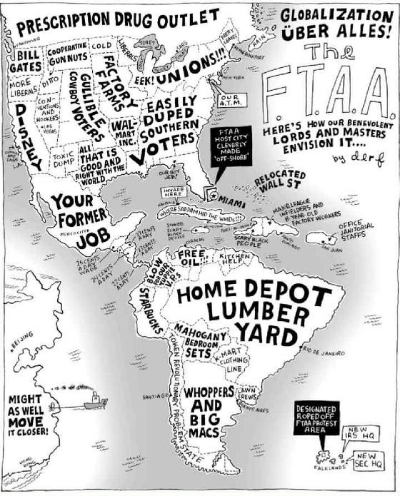
Globalization
U.S. Style?

Slide 63
DebateThus Far: Further Reading
Debates about Historical Epochs: Relevance to 21st century problems (James C. Scott and John Armstrong)
Debate about, Corruption, Political and Organizational Culture (Michel Crozier and Robert Klitgaard)
Debates about Bureaucrat Bashing (Guy Peters and Franz Kafka (1883-1924) in the Castle)

Slide 64
Contemporary Issues:
4. Defining Comparative: Methodology, Theory, Case Study analysis (David Truman)
5. Public Administration vs. Public Policy and Management (administration vs. Politics dichotomy) (Ferrel Heady)
6. The Anti-Bureaucracy Machine: Comparative and International Issues (Picard)

Slide 65
Themes: Review
The Environment of Public Affairs
The Debate about Institutions
A Short “History” of Public Administration and Public Affairs
Traditional, Charismatic and Legal-Rational Models of Public Administration
Corruption and Civil Service Reform
Debates about Contracting
Review: Comparative Methodology
Authoritarian Leadership

Slide 66
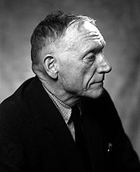
The Public Sector Problem: All The Kings Men
Studies in Italy in 1930s
Concern about the Rise of Fascism
Huey Long, Father Charles Coughlin and Rev. Gerald L.K. Smith “Social Justice and Share the work”
Robert Penn Warren

Slide 67
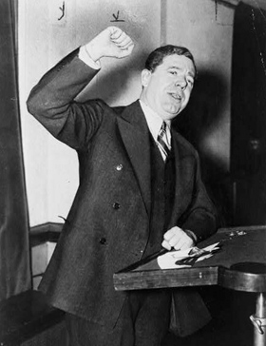
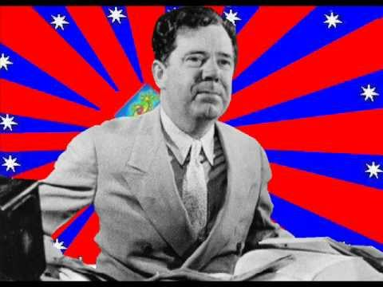
An Anti-Bureaucrat Politician Huey P. Long
Governor and Senator, Louisiana
“Every Man a King”

Slide 68
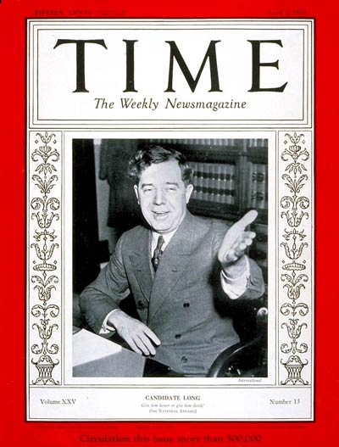
Huey Pierce Long, Jr. (August 30, 1893 -- September 10, 1935), nicknamed “The Kingfish”, was an American politician from the U.S. State of Louisiana. Cover Picture from Apr. 1, 1935

Slide 69
“Every Man a King” Huey P. Long

Slide 70
Review of Issues
Questions and Comments?

