Slide 1
PIA 2020: Introduction to Public Affairs
Management of Contracts and Impace
Privatization, Grants and Contracting Out

Slide 2
Privatization
Possibilities and Limitations

Slide 3
Privatization: In the U.S. and the World
Definition:
The process of divesting direct civil service responsibility for the provision of public services or the collection of revenues
Focus here on the World View in the 1980s as defined by the U.S.

Slide 4
Privatization: Grants and Contracts
The Key to Understanding Contracting Out
Prior to 1979: Focus of Contracts was Purchases and construction (Physical)
Before 1979- Social Services: “Block Grants
Now Social Services: Contracted Out or Categorical Grants (Tied Grants)

Slide 5
Block Grants vs. Categorial Grants
Community Development Block Grants
Categorial Grants

Slide 6
Context of Privatization: The Reagan-Thatcher Revolutions
Economic Reform and Structural Adjustment:
a. IMF Stabilization and trade liberalization
b. Currency reform, auctions-end
of subsidies (end urban privileges) to end radical inflation

Slide 7
Target for Currency Auction

Slide 8
The Reagan-Thatcher Revolutions
Market prices for agriculture and industrial goods
Deregulate the economy
Most Importantly: Free Trade
Domestic Changes followed International Reforms (Contracts and Tendering)

Slide 9
Tendering is the procurement of acquisition of goods and/or services at the best possible total cost of ownership, in the correct quantity and quality, at the right time, in the right place for the direct benefit or use of governments, corporations, or local authorities, generally by a contract.

Slide 10
One View of Free Trade

Slide 11
Conditionality and Privatization
Conditionality- World Bank and UNDP and the "Management“
SAPs- /Structural Adjustment Programs
Focus on Policy and Administrative Reforms
Conditionality- World Bank and UNDP and the "Management“ of Structural Adjustment Countries

Slide 12
One View of SAPs

Slide 13
Conditionalities
Reform the Bureaucracy
Decrease Size of Public Service
Individual Consultants, Grantees and Contractors work with investments and the service/commercial sector
Bridging and sectoral loans and grants (Social Funds) major source of international involvement

Slide 14
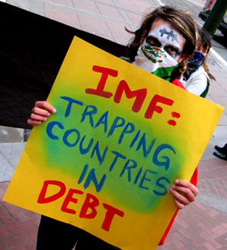
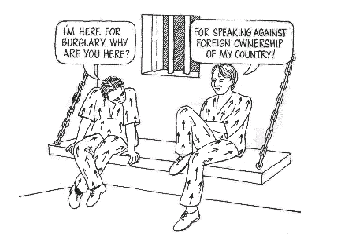
Critics
Europe
South Africa

Slide 15
Principles of Privatization
Key Conditionality- Privatization of the economy within a context of administrative Reform

Slide 16
Administrative Reforms
1. Strategic Planning and Management
2. Deregulation
3. Performance Management
5. Merit Recruitment
5. Contracting Out

Slide 17
Administrative Reforms and Privatization
End of Corruption
“Reinventing Government”- end to hierarchy and intra-governmental competition
Rewards based on Performance
Monitoring and contracts management

Slide 18
Principles of Privatization
a. divestiture
b. contracting out
c. liquidation
d. sell off public private partnership shares

Slide 19
The View from the 1080s

Slide 20
Principles of Privatization
International conditions for "good" bureaucrats, eg. World Bank Programs- special salaries for those on contract with the project
Goal: Return to the recurrent budgeting process and balanced budget principles of “Neo-Orthodox Economists”
Project the Vehicle for Contracts

Slide 21
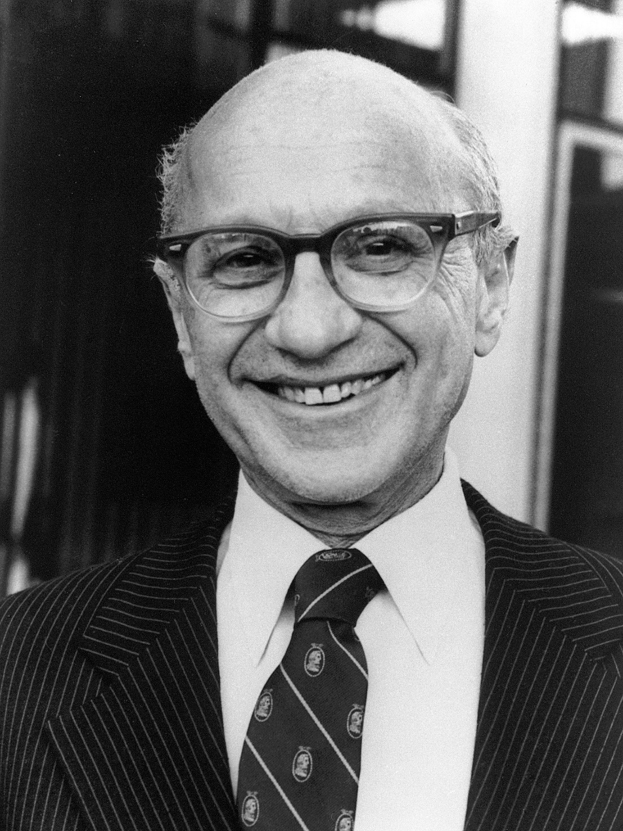
Milton Friedman, 1912-2006 University of Chicago

Slide 22
The Fundamental Assumption: Private Provision of Services
Use of conventional markets- No public sector involvement
Contracts with public agencies- Collection of Garbage; foreign aid and technical assistance
Monopoly Franchises: Hoover Dam; Cable Television; Amtrak (Controversial)

Slide 23
Private Provision of Services
Management Contracts- Public Enterprises such as airlines and hotels
Vouchers- private and charter schools
Consumer Cooperatives- Food clubs

Slide 24
Acting Vice Principal showing the their school vouchers.

Slide 25
Privatization “Ideal” No Taxes
Key to the provision of efficient and effective goods and services (Savas)
Need for Exclusion
User Fees, not taxes
The use of tolls

Slide 26
E-ZPASS

Slide 27
Privatization Reasons (Madsen Pirie)
High Production costs in Government
Low levels of efficiency
Featherbedded labor costs
Pork Barrel Capital Allocations

Slide 28
Privatization “Ideal”
Key to the provision of efficient and effective goods and services (Savas)
Need to exclude the Collective
Some would argue excluding “common pool goods” from privatization (Clean Air)
Worthy goods (health, education, etc.) are not collective goods

Slide 29
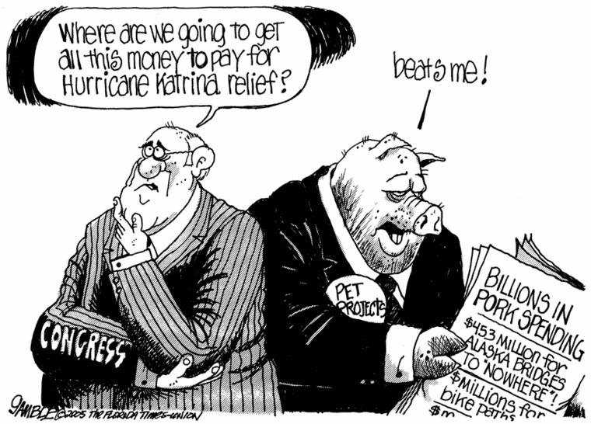

Slide 30
Privatization- Reasons (Madsen Pirie)
Low level consumer input
Poor Maintenance and loss of service
Inability of political leaders to impose cost control
Free Riders and Lemons

Slide 32
Privatization Means
Liquidation
Close down (Load Shedding)
Divestiture
Sell off in whole or in part government shares

Slide 33
Liquidation

Slide 34
Privatization Means
Public-Private partnerships
Commercialization
Autonomy and user fees

Slide 35
Privatization Means
Public Sector Reform
Cutback
the infamous 19% first cut
Transfer to a public service organization or union
Contracting Out

Slide 36
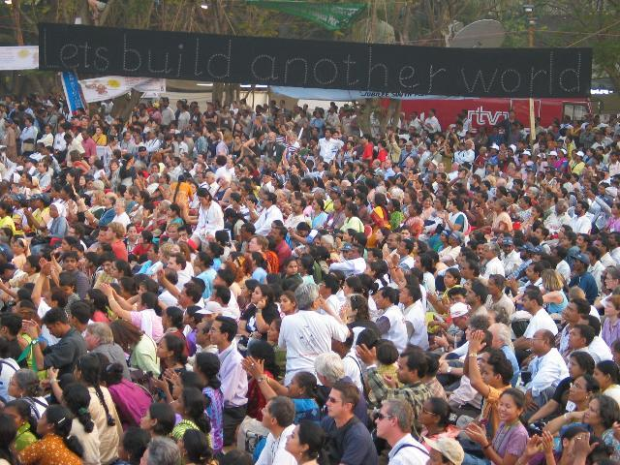
The World Bank Formula, 2007
World Bank attempt to privatise Mumbai's water runs aground: Citizens reject report

Slide 37
Privatization Criticism
Private sector and NGOs are not necessarily more effective and efficient than government agencies (Paul Nelson)
Loss of Coverage for social services
Rule of Structural Adjustment- lower health and education statistics

Slide 38
Privatization Criticism
Can replicate private sector Conditions within government (Core of Reinventing Government argument--Osborne and Gabler) (“Commercialization)
“Contracting In”- Government Agency provides services for another Agency, NGO or Private Sector (Generating Revenue) (USDA provides staff for USAID)

Slide 39
Options Under Reinventing Government

Slide 40
Privatization Criticism
Reinventing Government
Steering rather than Rowing
Customer Driven Government
Competition within Government and between units
Key is decentralization--not privatization

Slide 41
Reinventing Government a world wide phenomenon (Korea)

Slide 42
Privatization Criticism
Privatization enhances corruption
Enhanced by cultural differences
Gifts vs. Kickbacks
Corruption as lobbying the Executive (Klitgaard)

Slide 43
Problems with Administrative Reform: International Examples
1. Departments buy and sell goods & services- statistics in Zaire/Congo or setting up “privatization networks” to acquire state properties.
2. Sub-economic salaries: offices, houses and telephones- buying soap and selling chickens. International salaries for essential workers (Consulting Practices)

Slide 44
Privatization in LDCs

Slide 45
Problems with Privatization
Reality- The absence of recurrent budgets in LDCs
Activity (economy) driven by technical assistance projects the only game in town
NGOs and for profit contractors and consulting firms take the jobs
Result: Privatization means internationalization

Slide 46
The Principles: Review
Private Provision of Services:
Use of conventional Markets: no public sector involvement (Purely private)
Contracts with public agencies (Contracting Out)
Tenderocracy and Crony Capitalsim

Slide 47
The Principles: Review
Monopoly Franchises
Management Contracts
Vouchers
Consumer Cooperatives

Slide 48
Development and Charity
Fundraising for Human Security

