Slide 1
PIA 2020
Debates about Development Finance and Public Sector Reform (Week 10)
(Variations on a Theme?)

Slide 2
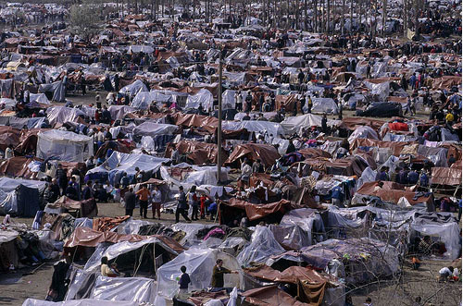
The Problem?

Slide 3
Public Sector Reform
The Importance of Satire

Slide 4
Overview: Stages in the Developmental State
Faith in the State
Basic Human Needs
New International Economic Order
Structural Adjustment
5. Governance and Capacity Building
6. Focus on Public Sector Reform
Return to Human Resource Issues
Whose Security?

Slide 5
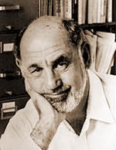
The History: Planning, Financial and Budgetary Management Systems in Poor Counties
Five historical periods- From
a development perspective
Caiden and Wildavsky- Planning and Budgeting in Poor Countries
Best Book on realities of Public
Budgeting and Development
Notes:
think of the budget first (cost benefit analysis) before taking on planning; planning is limited by interest groups or politicians wit hidden agendas, planners who are not supplied with human resourcing or resourcing needed to move a plan forward; planners are rational choice bound but it is not realistic for long-term which comes against the politics requiring compromising; poor countries nee dto convince foreign donors not to insist on formal planning as a prereq for aid; abandon the paper plan and instead put improve budgeting and procedure of expediting projects; focus on budgeting a significant potential advance; eliminate old data requirements but let them use what they use; lead into SAPs being necessary; balancing the budget

Slide 6
Historical Periods: Famous Six
I. Until the 1950s- recurrent budgets- law and order.
II. 1950s-1960s- growth. Domestic development Funds with bilateral technical assistance
=Recurrent vs. Development budgets
III. 1960s-1970s: Distribution and basic needs. World Bank and Poorest of the poor
Notes:
Recurrent budgets focus on operational costs over capital costs. Therefore, the expenses in the budget do not go toward improvements, such as infrastructure projects, which have fixed costs. The budget padding to account for unknown expenses takes away funding from non-recurrent budgets on paper.

Slide 7
IV. Mid-1970s to mid-1980s: Planning vs. Budgets
Planning demanded by technical assistance
Technical assistance- both grants and loans (no private loans to Africa)
Project planning "wins" over national planning and budgeting systems
Notes:
need more social capital through systems of bonding and networking; Putnam saw the development of technical and exclusive knowledge among administrators and other specialist groups as a mechanism by which power is stripped from the democratic process and slipped sideways to the advisors and specialists influencing the decision-making process (Putnam)

Slide 8
V. The Post-Cold Ward State of Financial Management (1990s to Present)
1. IMF Stabilization- currency reform, auctions and trade liberalization
2. Decentralized Budgeting- Part of Governance Debate
3. World Bank and UNDP "Management" - Opposing views to SAPs
4. Human Resource Development (Millennium Development Goals)
5. Exceptions for Security Challenge Countries (SCC)

Slide 9
The Current State of Financial Management
6. Continued Absence of recurrent budgets and loss of control in Crisis: especially re. “Terror Prone,” Collapsed and Fragile States
7. Activity (economy) driven by technical assistance projects - the only game in town
8. Bridging and sectoral loans and grants- major source of international involvement
9. Crisis in Governance and Human Security

Slide 10
Back to the Future? Somalia- 2008

Slide 11
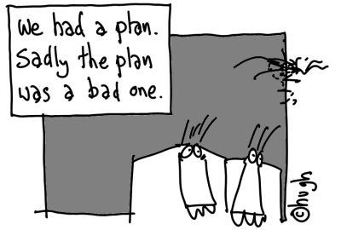
VI. The Current State of Financial Management: Structural Adjustment- 1983-2017
(since 2001)- Structural Adjustment vs. Social Crisis vs. Security
Discuss: Pro’s & Con’s?
Notes:
Question: what are the pros and cons of these three? Take

Slide 12
Conditionality- What is the post-security future?
Privatization of the economy
a. divestiture
b. contracting out
c. liquidation
d. sell off public private partnership shares

Slide 13
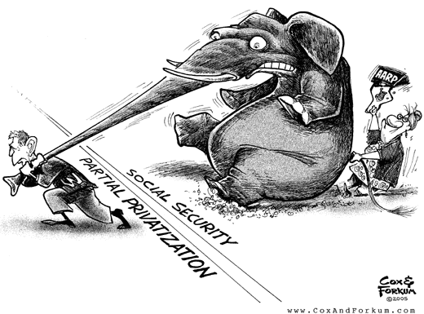
Privatization Debates

Slide 14
Privatization: Contracting and non-profits
The Answer to Bad Governance, Corruption and Inefficiency?
This "neo-classical" model of development has been exported overseas
Especially to the less developed and transitional states in Africa, Asia, Eastern and Central Europe and Latin America.

Slide 15
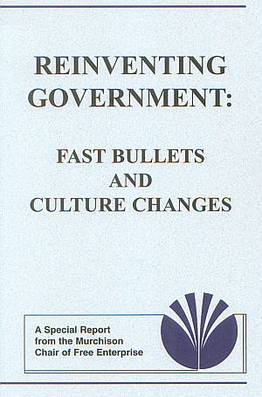
What is the Future?
Privatization (Commercialization) of the bureaucracy
vs. IN-SOURCING- Reinventing Government
Notes:
Insourcing is a business practice performed within an organization's operational infrastructure. Outsourcing, on the other hand, enlists the help of outside organizations not affiliated with the company to complete specific tasks. As a result, these differences effect cost, location and resource aspects of the organization, which influences decision making.
The cost associated with insourcing is different from the cost associated with outsourcing. Insourcing is typically more expensive for an organization as a result of implementing new processes to start a different division of the organization. Outsourcing uses the developed workforce of an outside organization to perform tasks.
Resources are another major difference between these two business practices. Outsourcing uses the resources of an outside organization for services and manufacturing products. Insourcing utilizes developed resources within the organization to perform tasks or to achieve a goal. For example, an organization may insource technical support for a new product as a result of having technical support setup for another product within the organization.
Read more: What's the difference between outsourcing and insourcing? | Investopedia http://www.investopedia.com/ask/answers/032715/whats-difference-between-outsourcing-and-insourcing.asp#ixzz4xBY3x0ym Follow us: Investopedia on Facebook

Slide 16
The Nature of the Debate: Local to Global
Domestic- Debt, Privatization and Spending Cuts (Public Policy and Public Affairs)
International- Structural Adjustment and Public Sector Reform (international Affairs, Foreign Policy and Development)
Is it different for Security driven areas?

Slide 17
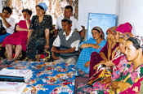
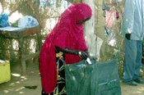
Focus: The Domestic Context, International Issues and the Developmental/Security Challenge

Slide 18
1. Faith in the State- 1950s
Industrialization
Stages of economic growth
Modernization
From John Maynard Keynes to Walt Rostow-
Do you agree?
Notes:
What are the stages of growth that Modernization promotes: hint this was a midterm question….

Slide 19
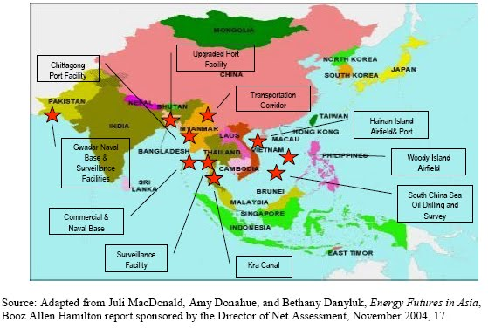
The Model: Asian Development State
Notes:
Developmental state, or hard state, is a term used by international political economy scholars to refer to the phenomenon of state-led macroeconomic planning in EastAsia in the late twentieth century. ... The first person to seriously conceptualize thedevelopmental state was Chalmers Johnson.

Slide 20
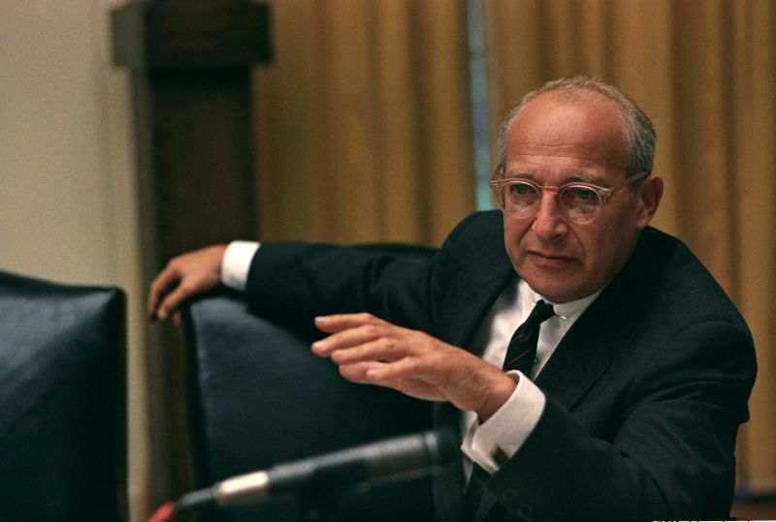
“Faith in the State”
John Maynard Keynes and his wife Lydia Lopokova
Walt Rostow

Slide 21
2. Basic Human Needs- 1965-1975
Basic Human Needs- growth With Equity
Robert McNamara and the World Bank
Integrated Rural Development
Internal Distribution
Review- what are some basic human needs vs. human rights?
Notes:
Human security has different meanings in different contexts, but in general it refers to basic needs such as food, shelter and security. The "right to survive" with dignity.
HS not fully defined as a theory, or coined as a trend, until the early 1990s by UNDP in the emergence of post-cold war era. HS is presented as a way to link humanitarian, social and economic stability to support ending human suffering resulting from insecurity.
It often takes on issues of organized violence, human rights, good governance, conflict, health & development, sustainable resource and environment; often criticized for being too encompassing a definition (Human Security Initiative 2016).
Human rights are moral principles/norms describing certain standards of human behavior and life linked to dignity, regularly protected as legal rights in law.
Political Rights: Speech, Representation, Religion, Participation; Social: like Health and Education; Economic: Employment, income, work with dignity

Slide 22
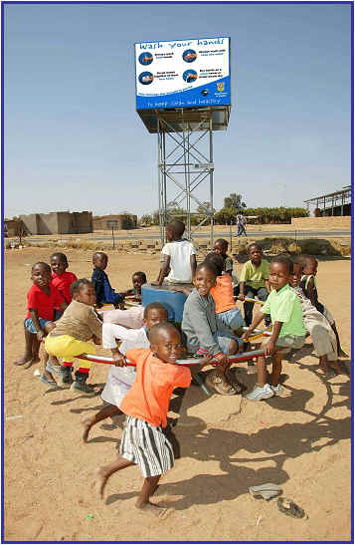
Robert McNamara and the World Bank

Slide 23
3. New International Economic Order Mid 1970s- 1983
1. Redistribution at the Local Level
2. Empowerment of south
3. Equity
4. Basic Human Needs vs. New International Economic Order (NIEO) part of the North-South dialogue
5. Brandt Commission

Slide 24
4. Structural Adjustment and neo-orthodoxy: The Dividing Line: 1983-1989
"We are the World" leads to Donor Fatigue
Illness and then death of Brezhnev in Soviet Union
Ronald Reagan and Margaret Thatcher at the height of their power
Public Sector Reform

Slide 25
5. Governance and Capacity Building- 1989-2017?
End of the Cold War
Failure of Structural Adjustment
September 11
Governance and Decentralization
New Public Management: “Reinventing Government”

Slide 26
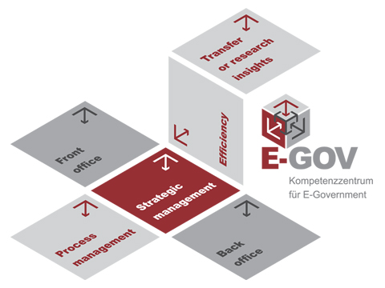
Reinventing Government

Slide 27
Reinventing Government: Had International Impact
Redefinition- "Reinventing Government" (Osborne and Gabler)-
Steering rather than rowing
2. Strengthen systems of accountability: Barzelay and customer approach
3. Simplification and deregulation
-Technical: Management Information Systems
-Operational Strategy: Policy Success
-”In-Sourcing”
4. Frame Plans, projects and programs (Morgan in Baker)

Slide 28
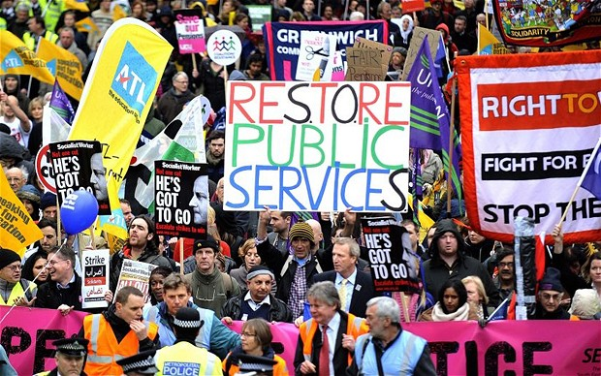
The Counter-Factual?

Slide 29
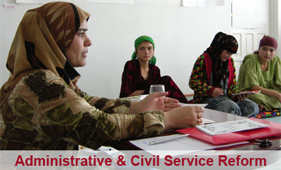
6. Deeper Focus on Public Sector Reform: (Stepping Back- 1979-2020?)
The Debates

Slide 30
The challenges
Cambodia, Nicaragua, Angola, Mozambique were transitional conflicts in 1990
New "Transitional States"- CIS and Eastern Europe (later Bosnia, Kosovo)
End of History and Beginning of History
State Deconstruction- Difference between Deconstruction and Decentralization?
Notes:
Two principles: Decentralization and Deconcentration. They often created confusion. Decentralization, at the "value/goal" level, is sharing part of governmental power by a ruling group with another ones. At the norms level, it involves formal political structures that cover a defined area, representing local interests as well as central ones. At the "collectivities and roles" level it means units of local government in which formal decision-making is in locally elected authorities. Deconcentration, at the first level, is sharing power between members of the same national ruling in different areas. At the second level, it means political structures which represent central interests. At the third level it means decision-making is still in the hands of central administration officials.

Slide 31
“We Are the World”- Private “power” (soft power?)
SILLY SONG?

Slide 32
Public Sector Reform-2
Prologue- End of assumption- Progress is inevitable
Robert McNamara resigns from the World Bank, 1981
International institutions abandon basic needs approach
International conflict shifts from East-West Rivalry and cold war to ethnic, regional and internal conflicts

Slide 33
Critics View of Structural Adjustment
One Size Fits All

Slide 34
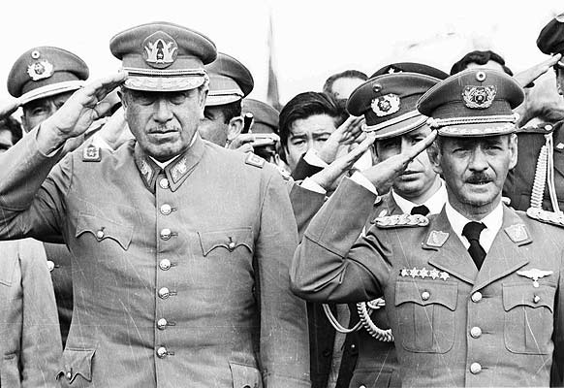
SAPS: Latin America Centralized Authoritarian Government, 1980s

Slide 35
Public Sector Reform- A Closer Look
i. Public Enterprises vs.
Civil Services
Vs. Public Services
Vs. Local Government
Broad issue of Human Resource Development

Slide 36
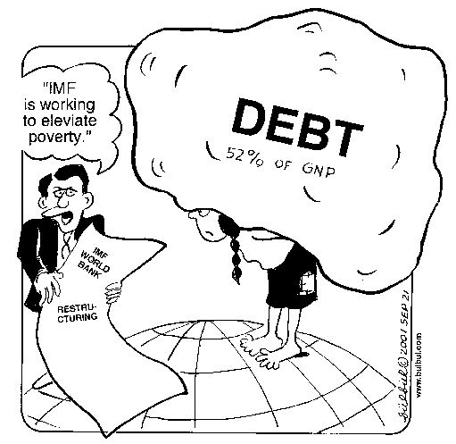
The Debt Burden

Slide 37
Public Sector Reform after 1987
Structural Adjustment with a Human Face
A Role for NGOs
International donors as managers

Slide 38
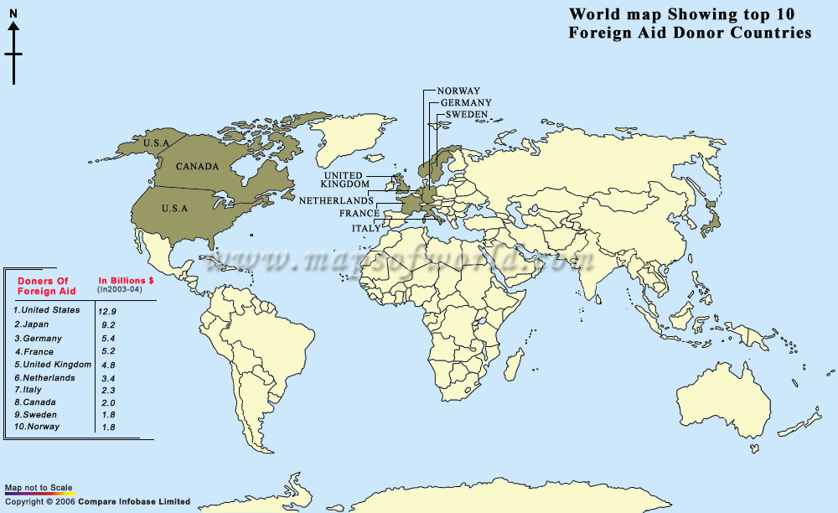

Slide 39
The Issues
1. The state as national planner
2. How large a state: When is the state sector too big?
3. Issue of state ownership, and unfair competition (international trade)
4. Vagueness of boundaries between government and society

Slide 40
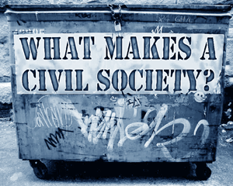
The Time for Civil Society
Civil? Is civil society a magic bullet for corruption and effectiveness?
Notes:
Civil society pros and cons? CS not always mean same problems don’t haunt us

Slide 41
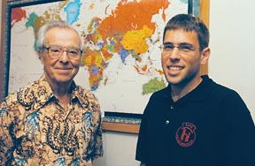
THEORY: Civil Society vs. State
DEBATES
John D. Montgomery vs. Milton Esman
(Experience Japan and Vietnam)

Slide 42
The Issues in Developed States
Hidden government: subsidies and entitlements.
Limitations of constitutions and public sectors- Decline in faith in government institutions in the 20th century
Failure of legislative, executive structures. Loss of control
Anti-bureaucracy- the myth of the neutral bureaucrat.
Subsidies or Free Trade

Slide 43
Focus on Reforms-1
Privatization of the bureaucracy
a. Savas- The key to efficient and effective goods and services
b. Critique: Nelson: impact of international organizations on NGOs- Distortion?
c. Turner and Hulme- Are NGOs and Private sector better than Public Enterprises?

Slide 44
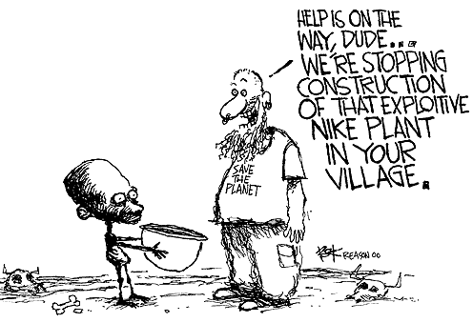
A Conservative View

Slide 45
Any Irony of INGOs?
https://www.youtube.com/watch?v=kNnkbkZeWKc
https://www.youtube.com/watch?v=muQVyDJUBZU
What do you think?

Slide 46
Overall: Reform Meant Attack on Hierarchy
Attacks on the European style Mandarins- European elitist systems of administration
=Permanent Secretary
=Director General
=State Secretary

Slide 47
Reforms- 2
Deregulation-
a. Deregulation- negative
b. Competition- positive (monopolies vs. utilities)
c. Regulations and Corruption: Klitgaard: Dealing with corruption and culture?

Slide 48
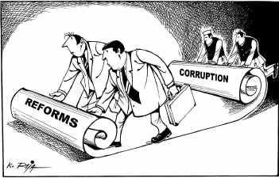
The Problem

Slide 49
Reforms-3
Civil Service Reform:
Picard Case Studies- South Africa,
Botswana,
Ghana,
Guinea-Conakry,
Eritrea and
Ethiopia

Slide 50
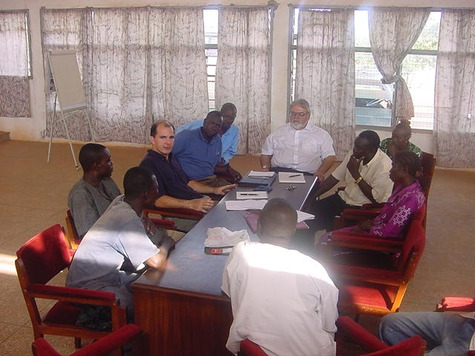
Discussions

Slide 51
4. Civil Service Reforms
Distinction- Public Sector Reform vs. Administrative reform (Civil Service Reform)
Purists go for PSR rather than CSR- latter not legitimate- oxymoron
Problem-"Bureaucrat bashing"

Slide 52
Comparative Public Administration Issues- Reminder
a. The politics-administration dichotomy
b. Environmental and cultural factors are important. Ecology as an issue
c. Bureaucracy as a Negative? Keep government out of people's lives
d. Search for a “non-Western Model”

Slide 53
Techniques: Public Sector Reform
i. Budgetary and Fiscal Reforms
Budgets as plans- (tax vs. spending)
ii.Personnel Reform- records base, motivation, promotion, review, retrenchment, etc. Problem: Collapsed states have no carrots
iii.Structural Reforms- Excessive centralization, militarization and politicization

Slide 54
Structural Reforms
1. Center-reorganizations- move or abolish
2. Decentralization- Transfer to local authorities or public corporations
a. devolution
b. deconcentration
c. delegation
d. privatization- what does it mean?
e. Sell, Liquidate, commercialize, partnership or contract out
3. Public-Private Partnerships

Slide 55
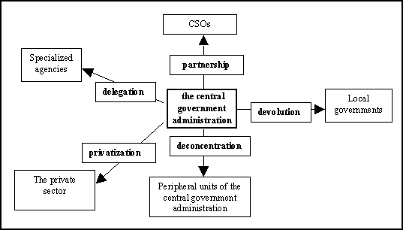
Decentralization

Slide 56
Reforms: Cutback Management- smaller, or more efficient, more effective
Cut back: percentage of civil service- Cutback the civil service. (the 19% solution)
Myth of Size- eg. Bureaucracy in Africa small
Turner and Holm: Bureaucracy and Development
Is Downsizing- "right sizing"

Slide 57
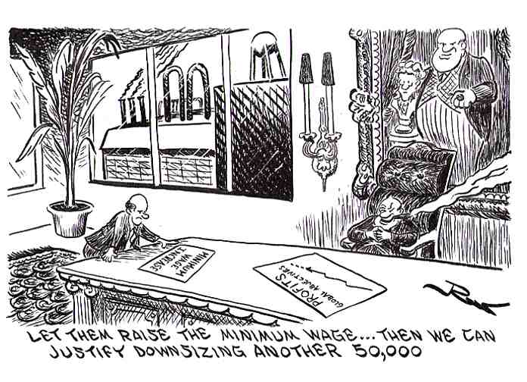
Downsizing or Rightsizing

Slide 58
7. Return to Human Resource Development
Training, recruitment, rewards and punishment (qualifications and salaries)
Personnel flexibility and pay for performance
Reform position classification (rank vs. position)
Return to meritocracy
Back to the Future in terms of state functions?

Slide 60
The Dilemma
Political-civil service reforms-relational, responsiveness of bureaucrats to politicians and Politicians to Bureaucrats
Rise of NGOs and multilateral: can you avoid the politicians?
Common interests: privileges in organization. Can’t avoid politics
Miewald: Politics- the critical factor?

Slide 61
Limited Impact with Training: The Flip Chart Syndrome

Slide 62
Afterward- World Bank Mission (2006) GOVERNANCE IN GUINEA-CONAKRY (Brfore Ebola)
A Small Diversion- Local Governance and Civil Society in Guinea Conakry
Creation of a Poverty Alleviation Fund- includes Micro-Credit
Design Capacity for Service Delivery
Role For Civil Society
December 12, 2008- Military Coup

Slide 63
HRD Dilemma
Guinea- Councillors, Illiterate, work in indigenous language, Self Interested Bureaucracy:
Defined by Law and French
The Dilemma of Merit: (Picard and Garrity)- Command and Control

Slide 64
Public Sector Debt: The Current Debate
The International Monetary Fund

Slide 65
Discussion: Schiavo-Campo, Chapters 6 and 7
What is the difference between proportional, regressive and progressive taxes? Which do you support?
How does auditing differ from accounting?
What is the difference between fiscal and monetary policy? Wage and Price Controls?
Explain “Right Sizing?”

Slide 66
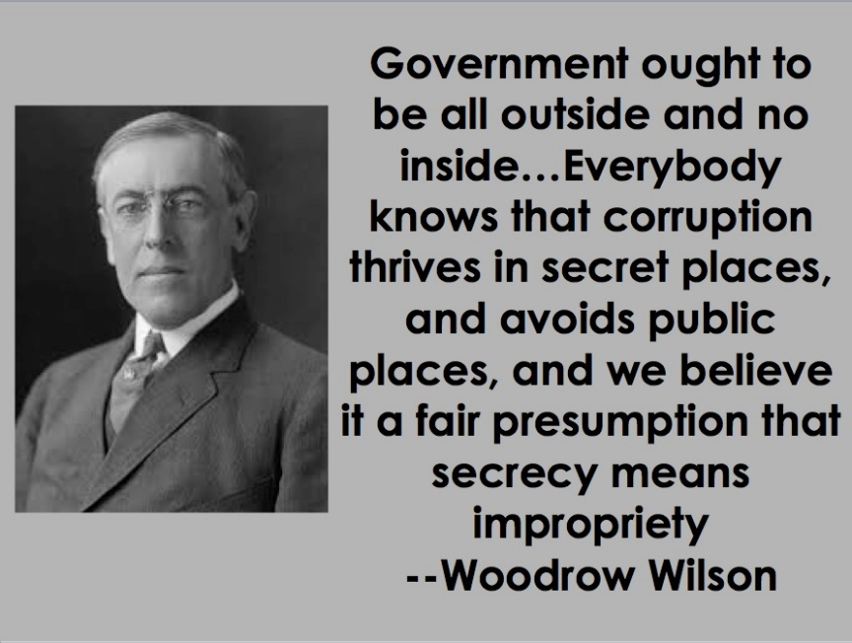
Woodrow Wilson ‘The Study of Administration’
What are the key take away’s from this reading?
What are aspects that relate to what we have already learned about Wilson’s Political Administrative Dichotomy?
Notes:
Administration lies outside the proper sphere of politics.
Although politics sets the tasks for administration, it should not be suffered to manipulate its offices. In his view, Politics and Administration should be separated to make the government more efficient and less corrupted.
However, it was considered a myth because It is not conceptually possible to have a dichotomy that keeps elected official out of administration but allows administrators to be active in policy.
The popularity of party system in western countries makes Political Administrative Dichotomy impossible to implement.
Out of “disappointment” of spoils system. Dysfunctionalism of spoils. phrase “don’t throw out the baby with the bathwater,” meant not to throw out the baby of democracy with the bathwater of corruption that came from the spoils system
Gives opinion

Slide 67
Janis & ‘Group Think’
What is ‘group think’ according to Janis?
Do you have other ways you have heard it?
Have you experienced it in your career?
Notes:
Administration lies outside the proper sphere of politics.
Although politics sets the tasks for administration, it should not be suffered to manipulate its offices. In his view, Politics and Administration should be separated to make the government more efficient and less corrupted.
However, it was considered a myth because It is not conceptually possible to have a dichotomy that keeps elected official out of administration but allows administrators to be active in policy.
The popularity of party system in western countries makes Political Administrative Dichotomy impossible to implement.
Out of “disappointment” of spoils system. Dysfunctionalism of spoils. phrase “don’t throw out the baby with the bathwater,” meant not to throw out the baby of democracy with the bathwater of corruption that came from the spoils system
Gives opinion

Slide 68
Zakaria
Are developed countries too rich? Why or why not?
To what extent is the U.S. (and the world) “stuck in the past?” Examples?
What does Zakaria mean by “Death of Authority?” Should countries have elites?
Explain Direct vs. Indirect Democracy. Factions? Examples and Assessment?

Slide 69
Picard and Buss
What do Picard and Buss mean by Dealing with Donors?
What is the overall message in the book?
Is Aid “Dead?” How is foreign aid best used?
What do Picard and Buss mean by the “Fragile Balance?”

Slide 70
Dhowli- Mahasweta Devi
What is the summary of this story?
How does this link to major themes that we are learning about?
What was a lesson/moral of the story?

Slide 71
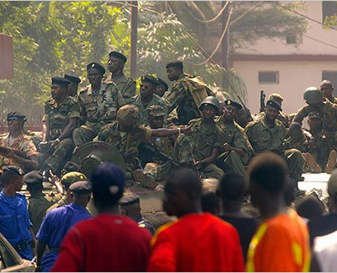
Picard & Moudoud’s 2008 Guinea Conakry Coup
What was this about?
Why does it state: December 2008 military coup opportunities have been lost in the promotion of democratic governance and more pluralistic group dynamics?
Do you agree with the solutions proposed?
Verses Liberia: https://www.youtube.com/watch?v=7DlJgK0K27U

