Slide 1
PIA 2020
Debates about Development Finance and Public Sector Reform (Week 10)
(Variations on a Theme?)

Slide 2
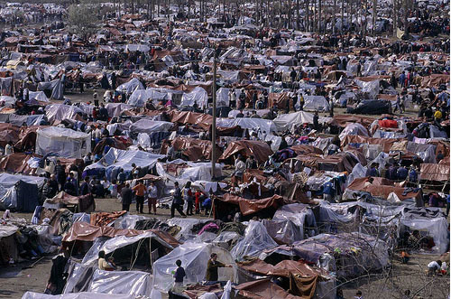
The Problem?

Slide 3
Public Sector Reform
The Importance of Satire

Slide 4
Overview: Stages in the Developmental State
Faith in the State
Basic Human Needs
New International Economic Order
Structural Adjustment
5. Governance and Capacity Building
6. Focus on Public Sector Reform
Return to Human Resource Issues
Whose Security?

Slide 5
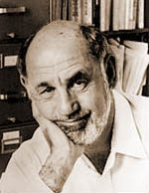
The History: Planning, Financial and Budgetary Management Systems in Poor Counties
Five historical periods- From
a development perspective
Caiden and Wildavsky- Planning and Budgeting in Poor Countries
Best Book on realities of Public
Budgeting and Development

Slide 6
Historical Periods: Famous Six
I. Until the 1950s- recurrent budgets- law and order.
II. 1950s-1960s- growth. Domestic development Funds with bilateral technical assistance
=Recurrent vs. Development budgets
III. 1960s-1970s: Distribution and basic needs. World Bank and Poorest of the poor

Slide 7
IV. Mid-1970s to mid-1980s: Planning vs. Budgets
Planning demanded by technical assistance
Technical assistance- both grants and loans (no private loans to Africa)
Project planning "wins" over national planning and budgeting systems

Slide 8
V. The Post-Cold Ward State of Financial Management (1990s to Present)
1. IMF Stabilization- currency reform, auctions and trade liberalization
2. Decentralized Budgeting- Part of Governance Debate
3. World Bank and UNDP "Management" - Opposing views to SAPs
4. Human Resource Development (Millennium Development Goals)
5. Exceptions for Security Challenge Countries (SCC)

Slide 9
The Current State of Financial Management
6. Continued Absence of recurrent budgets and loss of control in Crisis: especially re. “Terror Prone,” Collapsed and Fragile States
7. Activity (economy) driven by technical assistance projects - the only game in town
8. Bridging and sectoral loans and grants- major source of international involvement
9. Crisis in Governance and Human Security

Slide 10
Back to the Future? Somalia- 2008

Slide 11
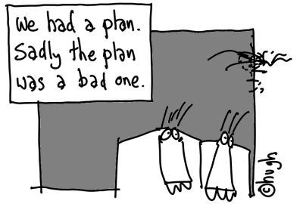
VI. The Current State of Financial Management: Structural Adjustment- 1983-2017
(since 2001)- Structural Adjustment vs. Social Crisis vs. Security

Slide 12
Conditionality- What is the post-security future?
Privatization of the economy
a. divestiture
b. contracting out
c. liquidation
d. sell off public private partnership shares

Slide 13
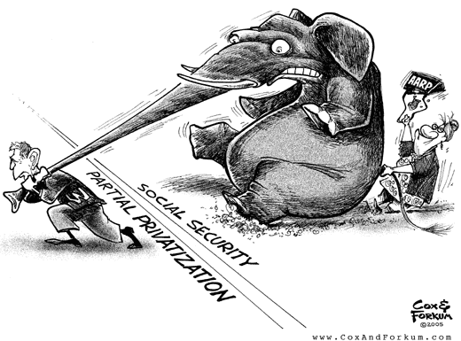
Privatization Debates

Slide 14
Privatization: Contracting and non-profits
The Answer to Bad Governance, Corruption and Inefficiency?
This "neo-classical" model of development has been exported overseas
Especially to the less developed and transitional states in Africa, Asia, Eastern and Central Europe and Latin America.

Slide 15
INDEPTH: ECONOMY Outsourcing: Contracting out becomes big business CBC News Online | March 7, 2006
Canadian Broadcasting System Image

Slide 16
What is the Future?
Privatization (Commercialization) of the bureaucracy
vs. IN-SOURCING- Reinventing Government

Slide 17
The Nature of the Debate: Local to Global
Domestic- Debt, Privatization and Spending Cuts (Public Policy and Public Affairs)
International- Structural Adjustment and Public Sector Reform (international Affairs, Foreign Policy and Development)
Is it different for Security driven areas?

Slide 18
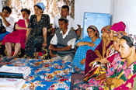
Focus: The Domestic Context, International Issues and the Developmental/Security Challenge

Slide 19
1. Faith in the State- 1950s
Industrialization
Stages of economic growth
Modernization
From John Maynard Keynes to Walt Rostow

Slide 20
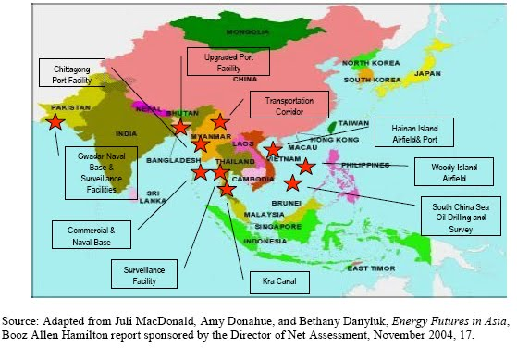
The Model: Asian Development State

Slide 21
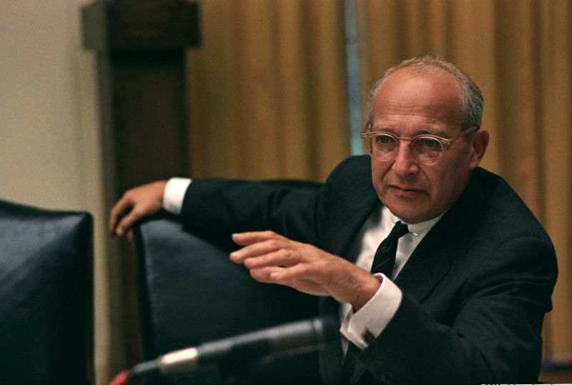
“Faith in the State”
John Maynard Keynes and his wife Lydia Lopokova
Walt Rostow

Slide 22
2. Basic Human Needs- 1965-1975
Basic Human Needs- growth With Equity
Robert McNamara and the World Bank
Integrated Rural Development
Internal Distribution

Slide 23
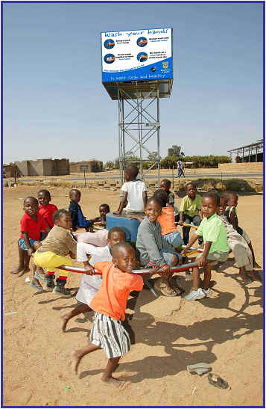
Robert McNamara and the World Bank

Slide 24
3. New International Economic Order Mid 1970s- 1983
1. Redistribution at the Local Level
2. Empowerment of south
3. Equity
4. Basic Human Needs vs. New International Economic Order (NIEO) part of the North-South dialogue
5. Brandt Commission

Slide 25
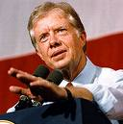
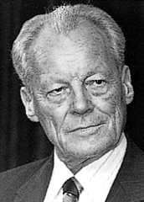
NIEO- Late 1970s
Jimmy Carter
Willy Brandt

Slide 26
4. Structural Adjustment and neo-orthodoxy: The Dividing Line: 1983-1989
"We are the World" leads to Donor Fatigue
Illness and then death of Brezhnev in Soviet Union
Ronald Reagan and Margaret Thatcher at the height of their power
Public Sector Reform

Slide 27
5. Governance and Capacity Building- 1989-2017?
End of the Cold War
Failure of Structural Adjustment
September 11
Governance and Decentralization
New Public Management: “Reinventing Government”

Slide 28
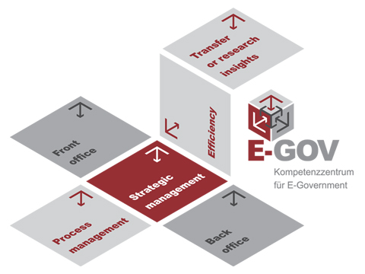
Reinventing Government

Slide 29
Reinventing Government: Had International Impact
Redefinition- "Reinventing Government" (Osborne and Gabler)-
Steering rather than rowing
2. Strengthen systems of accountability: Barzelay and customer approach
3. Simplification and deregulation
-Technical: Management Information Systems
-Operational Strategy: Policy Success
-”In-Sourcing”
4. Frame Plans, projects and programs (Morgan in Baker)

Slide 30
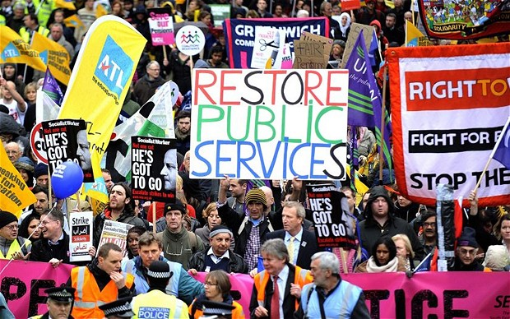
The Counter-Factual?

Slide 31
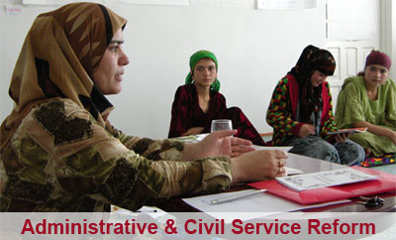
6. Deeper Focus on Public Sector Reform: (Stepping Back- 1979-2020?)
The Debates

Slide 32
The challenges
Cambodia, Nicaragua, Angola, Mozambique were transitional conflicts in 1990
New "Transitional States"- CIS and Eastern Europe (later Bosnia, Kosovo)
End of History and Beginning of History
State Deconstruction

Slide 33
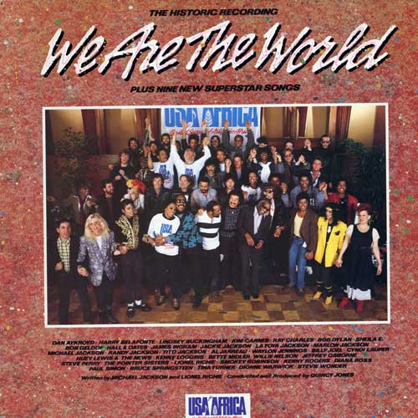
“We Are the World”- Private “power” (soft power?)
SILLY SONG?

Slide 34
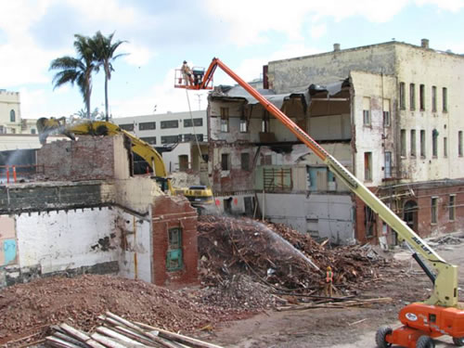
Deconstruction and Trumpism
Steve Bannon and the Administrative State

Slide 35
Public Sector Reform-2
Prologue- End of assumption- Progress is inevitable
Robert McNamara resigns from the World Bank, 1981
International institutions abandon basic needs approach
International conflict shifts from East-West Rivalry and cold war to ethnic, regional and internal conflicts
Francis Fukuyama: “End of History”

Slide 36
The Response: The End of History (or the end of the End) Declared: 7th - 9th October, 2005 Nottingham, UK

Slide 37
Critics View of Structural Adjustment
One Size Fits All

Slide 38
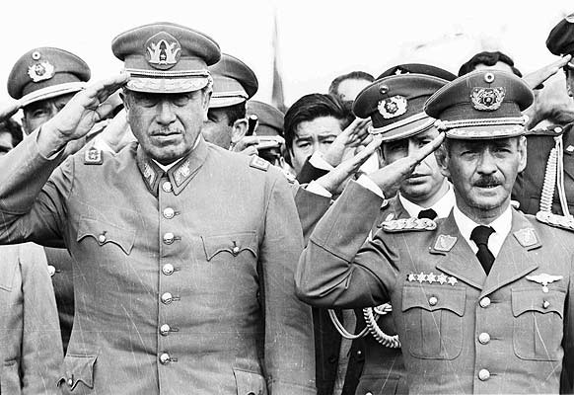
SAPS: Latin America Centralized Authoritarian Government, 1980s

Slide 39
Public Sector Reform- A Closer Look
i. Public Enterprises vs.
Civil Services
Vs. Public Services
Vs. Local Government
Broad issue of Human Resource Development

Slide 40
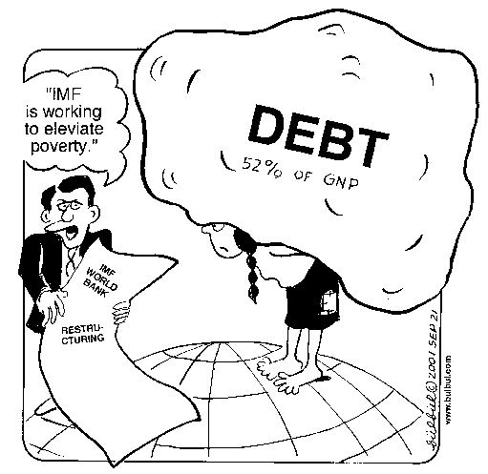
The Debt Burden

Slide 41
Public Sector Reform after 1987
Structural Adjustment with a Human Face
A Role for NGOs
International donors as managers

Slide 42
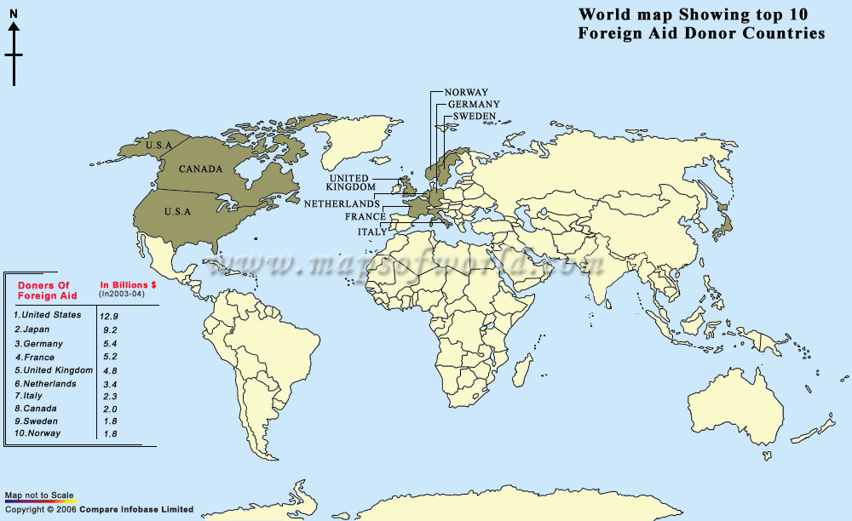

Slide 43
The Issues
1. The state as national planner
2. How large a state: When is the state sector too big?
3. Issue of state ownership, and unfair competition (international trade)
4. Vagueness of boundaries between government and society:

Slide 44
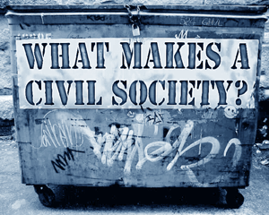
The Time for Civil Society
Civil?

Slide 45
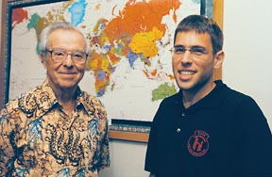
THEORY: Civil Society vs. State
DEBATES
John D. Montgomery vs. Milton Esman
(Experience Japan and Vietnam)

Slide 46
The Issues in Developed States
Hidden government: subsidies and entitlements. French Wine and Wisconsin cheese
Limitations of constitutions and public sectors- Decline in faith in government institutions in the 20th century
Failure of legislative, executive structures. Loss of control
Anti-bureaucracy- the myth of the neutral bureaucrat.
Subsidies or Free Trade

Slide 47
The Issue: French Wine or Wisconsin Cheese

Slide 48
Focus on Reforms-1
Privatization of the bureaucracy
a. Savas- The key to efficient and effective goods and services
b. Critique: Nelson: impact of international organizations on NGOs- Distortion?
c. Turner and Hulme- Are NGOs and Private sector better than Public Enterprises?

Slide 49
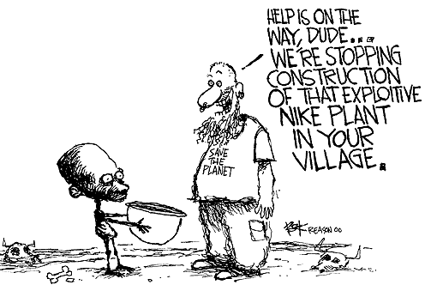
A Conservative View

Slide 50
Overall: Reform Meant Attack on Hierarchy
Attacks on the European style Mandarins- European elitist systems of administration
=Permanent Secretary
=Director General
=State Secretary

Slide 51
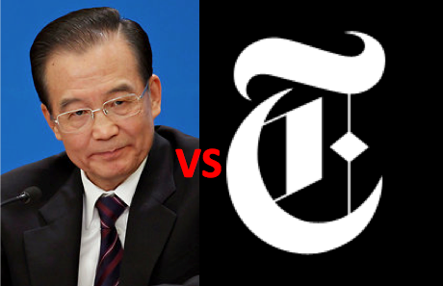
Wen Jiabao vs. New York Times

Slide 52
Reforms- 2
Deregulation-
a. Deregulation- negative
b. Competition- positive (monopolies vs. utilities)
c. Regulations and Corruption: Klitgaard: Dealing with corruption and culture?

Slide 53
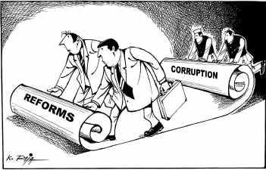
The Problem

Slide 54
Reforms-3
Civil Service Reform:
Picard Case Studies- South Africa,
Botswana,
Ghana,
Guinea-Conakry,
Eritrea and
Ethiopia

Slide 55
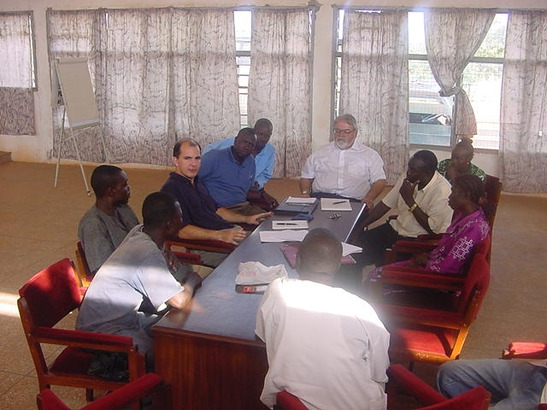
Discussions

Slide 56
4. Civil Service Reforms
Distinction- Public Sector Reform vs. Administrative reform (Civil Service Reform)
Purists go for PSR rather than CSR- latter not legitimate- oxymoron
Problem-"Bureaucrat bashing"

Slide 57
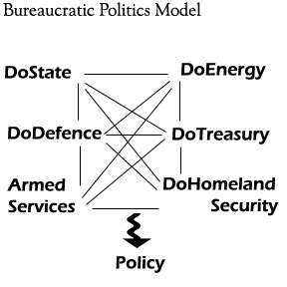
The Dilemma: The 30% Solution (Bannon)

Slide 58
Comparative Public Administration Issues- Reminder
a. The politics-administration dichotomy
b. Environmental and cultural factors are important. Ecology as an issue
c. Bureaucracy as a Negative? Keep government out of people's lives
d. Search for a “non-Western Model”

Slide 59
Techniques: Public Sector Reform
i. Budgetary and Fiscal Reforms
Budgets as plans- (tax vs. spending)
ii.Personnel Reform- records base, motivation, promotion, review, retrenchment, etc. Problem: Collapsed states have no carrots
iii.Structural Reforms- Excessive centralization, militarization and politicization

Slide 60
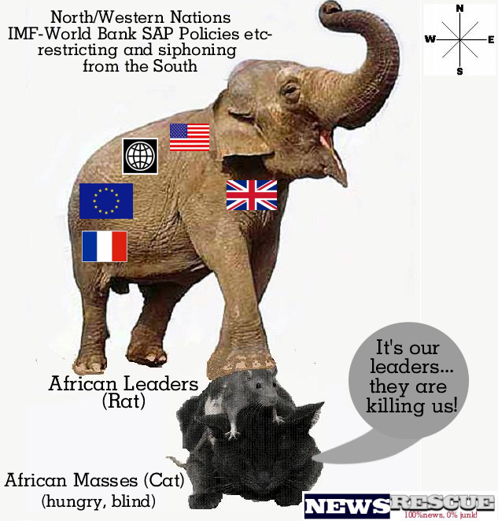

Slide 61
Structural Reforms
1. Center-reorganizations- move or abolish
2. Decentralization- Transfer to local authorities or public corporations
a. devolution
b. deconcentration
c. delegation
d. privatization- what does it mean?
e. Sell, Liquidate, commercialize, partnership or contract out
3. Public-Private Partnerships

Slide 62
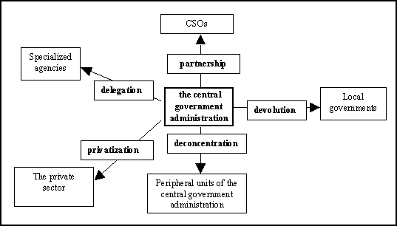
Decentralization

Slide 63
Reforms: Cutback Management- smaller, or more efficient, more effective
Cut back: percentage of civil service- Cutback the civil service. (the 19% solution)
Myth of Size- eg. Bureaucracy in Africa small
Turner and Holm: Bureaucracy and Development
Is Downsizing- "right sizing"

Slide 64
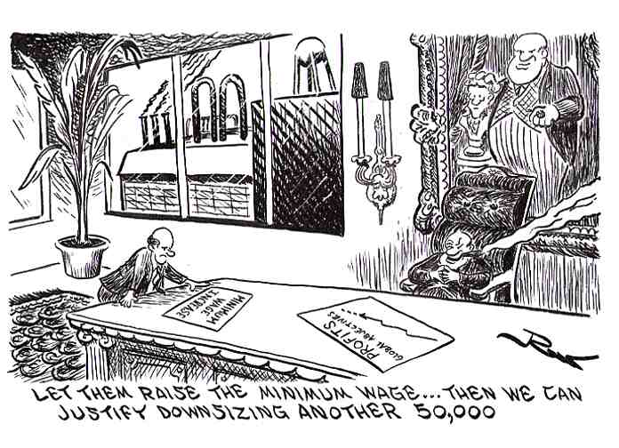
Downsizing or Rightsizing

Slide 65
7. Return to Human Resource Development
Training, recruitment, rewards and punishment (qualifications and salaries)
Personnel flexibility and pay for performance
Reform position classification (rank vs. position)
Return to meritocracy
Back to the Future in terms of state functions?

Slide 67
The Dilemma
Political-civil service reforms-relational, responsiveness of bureaucrats to politicians and Politicians to Bureaucrats
Rise of NGOs and multilateral: can you avoid the politicians?
Common interests: privileges in organization. Can’t avoid politics
Miewald: Politics- the critical factor?

Slide 68
Limited Impact with Training: The Flip Chart Syndrome

Slide 69
Afterward- World Bank Mission (2006) GOVERNANCE IN GUINEA-CONAKRY (Brfore Ebola)
A Small Diversion- Local Governance and Civil Society in Guinea Conakry
Creation of a Poverty Alleviation Fund- includes Micro-Credit
Design Capacity for Service Delivery
Role For Civil Society
December 12, 2008- Military Coup

Slide 70
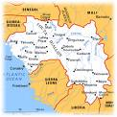
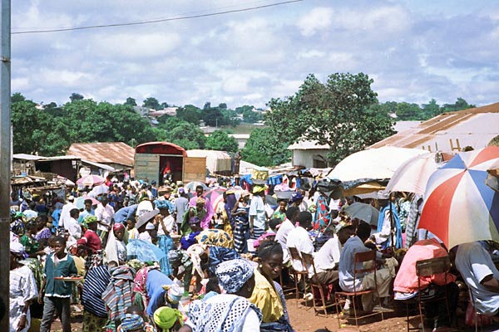
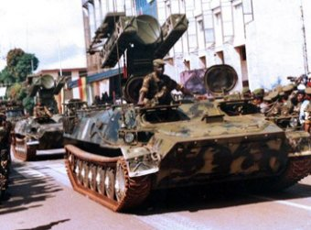
Guinea-Conakry

Slide 71
HRD Dilemma
Guinea- Councillors, Illiterate, work in indigenous language, Self Interested Bureaucracy:
Defined by Law and French
The Dilemma of Merit: (Picard and Garrity)- Command and Control

Slide 72
Public Sector Debt: The Current Debate
The International Monetary Fund

Slide 73
Discussion: Schiavo-Campo, Chapters 6 and 7
What is the difference between proportional, regressive and progressive taxes? Which do you support?
How does auditing differ from accounting?
What is the difference between fiscal and monetary policy? Wage and Price Controls?
Explain “Right Sizing?”

Slide 74
Zakaria
Are developed countries too rich? Why or why not?
To what extent is the U.S. (and the world) “stuck in the past?” Examples?
What does Zakaria mean by “Death of Authority?” Should countries have elites?
Explain Direct vs. Indirect Democracy. Factions? Examples and Assessment?

Slide 75
Picard and Buss
What do Picard and Buss mean by Dealing with Donors?
What is the overall message in the book?
Is Aid “Dead?” How is foreign aid best used?
What do Picard and Buss mean by the “Fragile Balance?”

