Slide 1
PIA 2020 Introduction to Public Affairs
Civil Society, Social Capital and Corruption: The State and Governance
An Overview and Review of Governance Themes

Slide 2
Review Themes
The Environment of Public Affairs
The Debate about Institutions
A Short “History” of Public Administration and Public Affairs
Traditional, Charismatic and Legal-Rational Models of Public Administration
Corruption and Civil Service Reform
Debates about Contracting
Review: Comparative Methodology
Authoritarian Leadership

Slide 3
Debate Thus Far: Some Further Reading
Debates about Historical Epochs: Relevance to 21st century problems (James C. Scott and John Armstrong)
Debate about, Corruption, Political and Organizational Culture (Michel Crozier and Robert Klitgaard)
Debates about Bureaucrat Bashing (Guy Peters and Franz Kafka (1883-1924) in the Castle)

Slide 4
Everything you needed to know but were not afraid to ask.: Images

Slide 5
Four Themes For Today
The Nature of the Problem
Our Understanding of Groups
The International Issues
The Importance of Comparison

Slide 6
Theme One
The Nature of the Problem

Slide 7
DebateThus Far: Further Reading
Debates about Historical Epochs: Relevance to 21st century problems (James C. Scott and John Armstrong)
Debate about, Corruption, Political and Organizational Culture (Michel Crozier and Robert Klitgaard)
Debates about Bureaucrat Bashing (Guy Peters and Franz Kafka (1883-1924) in the Castle)

Slide 8
The Structure and Process of Bureaucracies- First Cut
Political Institutions and Public Affairs
Debates about Public Sector Reform
Lobbyists, Networks and Pressures
Public Motives vs. Private Economics and Dealing with Corruption

Slide 9
Institutions and Corruption
One View

Slide 10
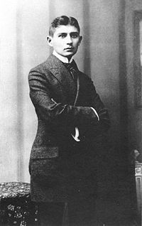
An Early Bureaucrat
Basher
Franz Kafka-
Man About Prague
(July 3, 1883-June 3, 1924)

Slide 11
The Problem: Corruption and Dysfunctional Bureaucracy
Kafkaesque
Dysfunctional Bureaucracy
Maze of Regulations
Image of Public Sector as Inefficient

Slide 12
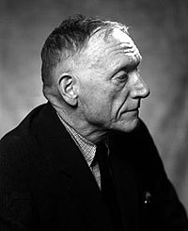
The Public Sector Problem: All The Kings Men
Studies in Italy in 1930s
Concern about the Rise of Fascism
Corruption at the Source of Dictatorship
Huey Long, Father Charles Coughlin and Rev. Gerald L.K. Smith “Social Justice and Share the work”
Wrote “All the Kings Men”
Robert Penn Warren

Slide 13
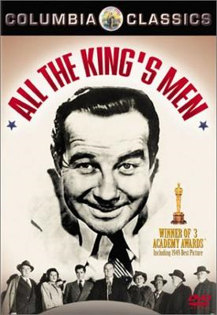
Peters Thesis dissected
A Great Film- More Later
Guy Peters Thesis- Attacks the artificial dichotomy between politics and administration
Problem- critics of "rational bureaucracy" say it is the end of politics eg. End of "all the kings men“
Goal- get into the magic "black box" of bureaucratic politics

Slide 14
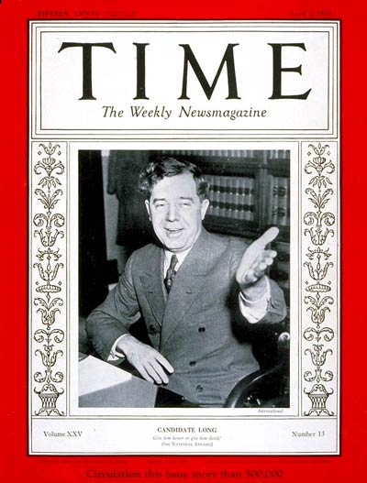
Huey Pierce Long, Jr. (August 30, 1893 -- September 10, 1935), nicknamed “The Kingfish”, was an American politician from the U.S. State of Louisiana. Cover Picture from Apr. 1, 1935

Slide 15
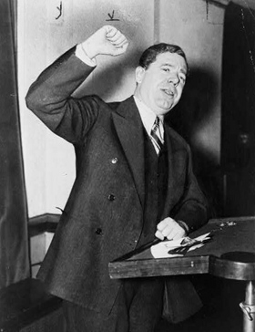
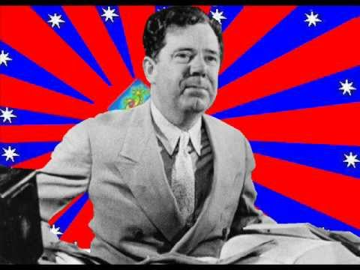
An Anti-Bureaucrat Politician Huey P. Long
Governor and Senator, Louisiana
“Every Man a King”

Slide 16
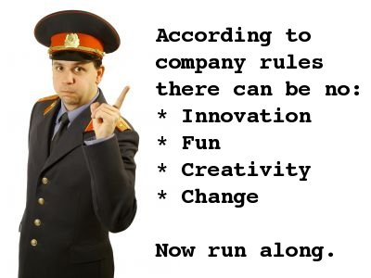
Out of this- Key Issue: Bureaucrat Bashing

Slide 17
Reform Epochs: A Reminder
16th Century France: Separation of King from retainers. Creation of Bureaucracy
18th Century Prussia: Cameralism- Defined civil
administrators in public and Corporate Sector
Nineteenth Century: British India and British Reforms:
Selection by Examination and Interview
Late Nineteenth and Early Twentieth Century U.K. and
U.S.: Civil Service Reform: Ending the Spoils (Hatch Act)
Last Part of the Twentieth Century: Structural Adjustment

Slide 18
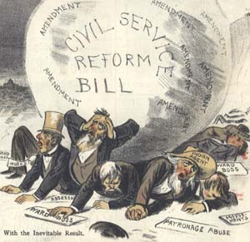
Hatch Act: Key to Civil Service Reform in the U.S.
1833-1896

Slide 19
AT ISSUE
Public Interest vs. private interests (and the bureaucracy as an interest group)
Question: Is there such a thing as a Public Interest Group? (PIG)
NGOs: Public, private or Ideological?

Slide 20
Differences between the public and the private sector- How much, or how little?
1. No significant differences between personnel in large private vs. public organizations
2. Differences in the structures within which the individual has to work
3. The bureaucracy is an institution of government

Slide 21
Government: Differences from the private sector-
Difference in Product
4. Private- emphasis is on profit, economy and efficiency
5. Public- need to account for the political and social- not what is always efficient
6. Issue- motivation or its absence in the public sector

Slide 22
The Rights of the Bureaucrat
The role of Unions and strikes in the public service
Restrictions on political activity, eg. the Hatch Act in the U.S.
Secrecy, Clearance and Whistle Blowing

Slide 23
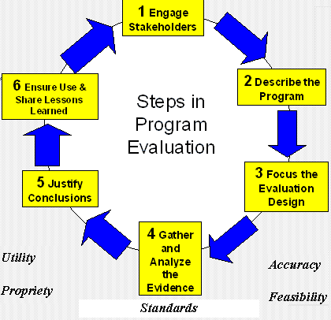
Evaluating Reforms?

Slide 24
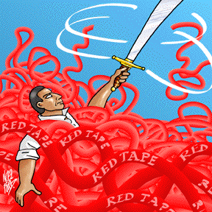
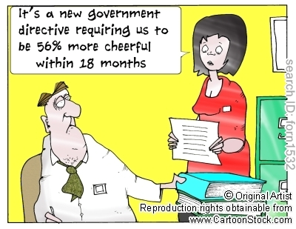
Two Views of Behavior

Slide 25
Bureaucracies, Politicians and Clients
Overall Themes
Characteristics of Bureaucracies (Schiavo-Campo)
Explaining Bureaucratic Behavior (Peters)
Clients: The comparative advantage of the "Iron Triangle" model (Executive Bureaucracy, Congress and Staff and Lobbyists). (Kharasch)
Clients and Democracy: The Power of the Lobbyist (Zakaria)
Corporatism as the Alternative Concept (Conspiracy?) (Mills and Wedel)
Evaluating Reform and Understanding behavior (Wilson)

Slide 26
Theme Two
Our understanding of Groups

Slide 27
The Role of Groups
Reform Perspective
Extent of access to public sector
Iron Triangle
Problem of Illicit Access

Slide 28
Group Influences-Five Models:
1. Japan/Asia- Johnson's perspective (State Centric Planning and one way movement – State to Private Sector)
2. Europe- (Orwell, Greene, Ferrel Heady (Representation vs. Corporatism)
3. U.S.- Pluralism vs. Elite Theory (Dahl vs. C. Wright Mills)
4. Latin America: Military Corporatism and Patron Client Relationships
5. Africa/Middle East: Crony Capitalism

Slide 29
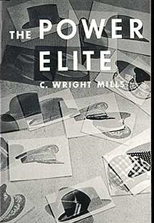
Pluralist vs. Controlling
Power Elite- Class
Pluralist (Competitive)

Slide 30
C. Wright Mills, The Power Elite (1916-1962)
Mills commuted to Columbia College on his motorcycle, 1950s
“Military-Industrial Complex” How Valid?

Slide 31
Peronism vs. Chile Video:

Slide 32
Theme Three
International Issues:
From Development Administration to “Dead Aid?”

Slide 33
Fred Warren Riggs, 90, University of Hawai‘i at Mānoa, Professor emeritus of political science, passed away on February 9, 2008 “Father” of Comparative Approach to Public Affairs

Slide 34
Riggs Life
Professor Riggs was born in Kuling, China on July 3, 1917, the son of agricultural missionary parents Charles H. and Grace (Frederick) Riggs. He attended Nanking University, 1934-35. Research in Thailand and Philippines.

Slide 35
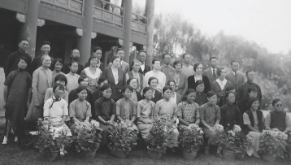
Missionary Life: Impact on International Development

Slide 36
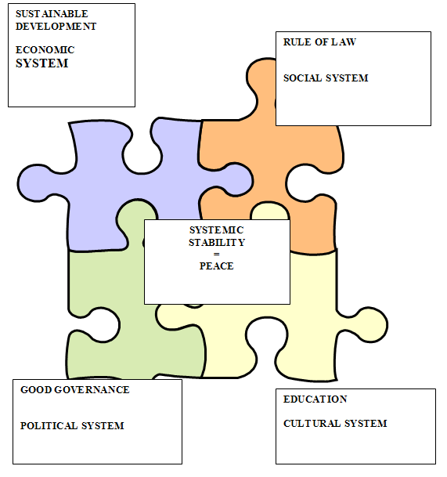
Systemic Approach to Governance and Development

Slide 37
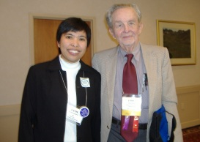
Development Administration: C.A.G.- Focus on comparative and development administration. Now Section on Comparative Administration American Society of Public Administration
Foundations and CAG- chalets in Italy to discuss administrative and political development
USAID and Universities- 3 out of every 4 dollars never left the U.S. Now .93 never leaves.
Post-Vietnam and Iran: Bad Reputation
Afghanistan and Iraq: Everything worse
Ferrel Heady, Founder of
SICA, 1916-2006 Spent much
Time in Asia

Slide 38
Comparative Methodology Issues
Impact of the “Asian Model” and international experience
Debates about Soft State Problem
Weak Private Sector Problem
Debates about Governance and Authoritarianism

Slide 39
International Development
NIPAs, staff colleges and IDMs spring up all over Africa and Asia
After 1975/80- Foundations pulled the plug
CAG End of Ford grant, 1974- Foundations lose “faith” in Government
Post-Vietnam syndrome: Withdrawals, Ayatollas, now nine-one-one
End of Development as a consensus
Northern Tier goal
Development Management Flounders after 1983?
IS AID DEAD? DISCUSSION

Slide 40
Theme Four
The Importance of Comparison

Slide 41
Comparative Methods

Slide 42
Summary: The Importance of the Comparative Approach
Cultural Dimension
Contingency Approach (orgs. for prisons vs. research)
Effects of diffusion- colonies and the world bureaucratic system
Implementation- Hopes that are dashed in the doing

Slide 43
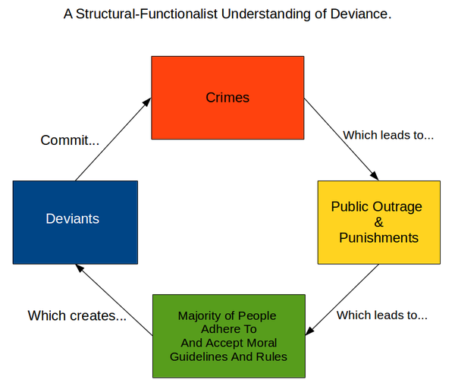

Slide 44
Enduring Features of Government and Comparative Methodology
Patterns of organization
Recruitment of bureaucrats
Certain common programs of governments
Problem of Dysfuncton

Slide 45
Contemporary Issues:
Defining Comparative: Methodology, Theory, Case Study analysis (David Truman)
Public Administration vs. Public Policy and Management (administration vs. Politics dichotomy) (Ferrel Heady)
The Anti-Bureaucracy Machine: Comparative and International Issues (Picard)

Slide 46
Political Structures and Public Management
1. Structure of Civil Service Systems: The role of Mandarins and political penetration into the civil service
2. Decayed and Transferred Institutions: (Kings and Colonies)- The creation of an organizational bourgeoisie (Irving Markovitz)
3. Corporatist Systems can be royalist, military, social (Spain, Argentina, Scandinavia)

Slide 47
Political Structures and Public Management
4. Elite vs. egalitarian views of public service. (A Reminder)- Interests within the State)
a. Maximum Deferred Achievement (No pre-selection)
b. Maximum Ascriptive Model (Class based)
c. Progressive Equal Attrition Model Egalitarian- Professional- collectivist

Slide 48
Governance Theory in the 1990s
a. Often turns out to be very specific: i.e. focused individual institutions
1. Ombudsman
2. Auditor General
3. Territorial Governor as rep. of national authority- the Prefectoral system
b. The Problem: Comparative studies of institutions are very expensive-run out of money/go back to case studies
c. The New Solution: Integration- The Whole of Government Approach

Slide 49
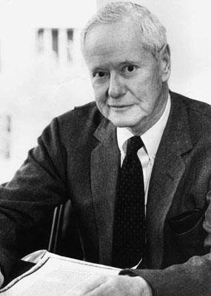
Importance of Robert King Merton July 4, 1910 - February 23, 2003

Slide 50
Middle Range Theory:
a. Role Theory, Exchange Theory
b. Focus on specific relationships: eg. bureaucracy and political and moral variables within a country
c. Mostly case studies- Egypt, Botswana, the U.S. All the same method. "The Case Study"

Slide 51
The political implications of role theory
ROLE SETS (Robert Merton)
Role Conflict in the bureaucracy
Role vs. Status vs. Individuals

Slide 52
The Situation since 1983:Modified "traditional Approach"- A Micro and Meso-level approach (Middle)
a. Most like an "orthodoxy" of public administration
b. Comparative Study of:
1. Parts of the System- budgeting, personnel, inter-governmental relations, policy process- Focus on Relationships
2. Or whole systems- Britain vs. France, U.S. vs. Russia, Botswana vs. Tanzania- Not Comparative

Slide 53
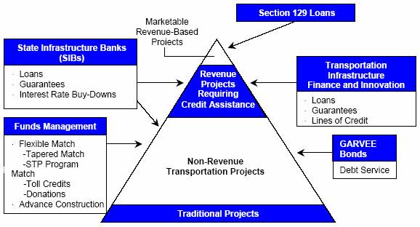
UNITED STATES DEPARTMENT OF TRANSPORTATION REPORT TO CONGRESS ON PUBLIC-PRIVATE PARTNERSHIPS

Slide 54
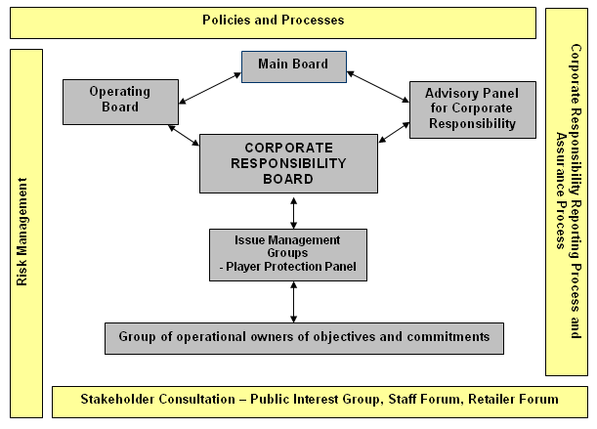
The Ideal: The Problem with Organizational Boxes

Slide 55
Whole of Government

Slide 56
Where Are We Now? U.S. vs. the World?
R. W. Reagan- Privatization
G.H. W. Bush- Privatization and a Thousand Points of Light
W. J. Clinton- Reinventing Government and Public Private Partnerships
G.W. Bush- Nation Building
B. H. Obama- Whole of Government- Rationality
D. J. Trump- “Lets Make a Deal?”
DISCUSSION

