Slide 1
PIA 2020 Discussion Session
Week 3

Slide 2
Thurber’s Greatest Man in the World
Who are the main characters?
Why are they important? What do they represent?
What government or national symbols are presented? What the significance?
What is the main reason or lesson from this story related to the readings or themes this week?

Slide 3
Gordimer “Africa Emergent”
Who are the main characters?
What is happening in the story? Why is this important?
What was the tone of this story?
What are the tensions presented?
What is one important line/sentence/quote that represents the purpose of this story?
What is the purpose of reading this story related to class do you think?

Slide 4
Discussion Notes
Break into your standard groups and volunteer for 2 or more of the main topics
Discuss for 10-15 minutes while note taker types them in
Note taker can paste them in from Word instead of directly typing if you feel
Share with large group and discuss
If group wants to make modification do so after discussion session

Slide 5
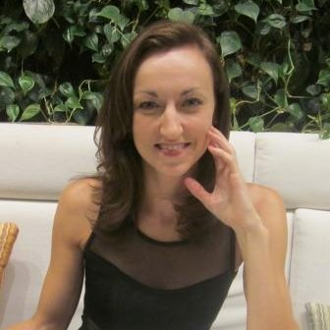
Speaker: Carolyn Ziv Humanitarian Worker
International human rights and development professional with diverse background in qualitative research and analysis, project and grants management, external communications, communications for development (BCC), and fundraising. Over eight years of experience working with international organizations (UN and NGO), including three years based overseas (Liberia and Tajikistan)
Communications Officer, Human Rights and Story Development
Communications Officer, Ebola Response- UNICEF
Information Analyst, Joint Mission Analysis Center, UN Mission in Liberia (UNMIL)
Worked for Human Rights Watch (HRW)

