Slide 1
Test Prep
PIA 2020
2017

Slide 2
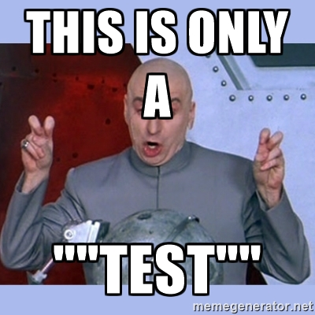
Rules
Each team works together to come up with their answer to a question. Select one speaker to give your team answers when called on. (1 min)
No notes or computers or iPhones, please, but you can take notes
A group will be randomly selected from the pile of names to give their answer
They will receive 0-5 points for their response according the Discussion Notes and Rubric standards
CHALLENGE: If a team thinks that they have a BETTER or more COMPLETE answer, they can raise their hand to give it. The first team to raise their hand AFTER the first team is finished giving their answer wins the chance to challenge. If their answer is more complete, they give the total points awarded plus the other team’s points.
PRIZE: The Team with the most points in the end wins 2 free weeks of no discussion notes, plus a prize!

Slide 3
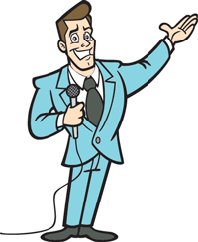
Question
What is the differences between Public Policy, Public Administration vs. Public Affairs?
Notes:
Public Policy: a collection of laws, mandates, or regulations established through a political process.What policy will be created.
Public Administration: The management of public policy and performance through established standards, procedures, and ethics. (Schiavo-Campo 18-19) How policy will be carried out.
Public Affairs: all affairs related to public field, including public policy and public administration.
Need examples or more….

Slide 4
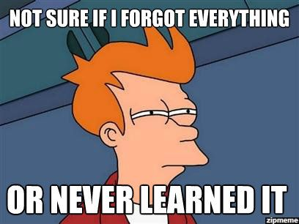
Question
What are the four Es of Administration Effectiveness?
Notes:
1. economy – the acquisition of goods and services of a given quality at lowest cost and on a timely basis
2. efficiency – production at the lowest possible unit cost (for a given quality)
3. effectiveness – the extent to which the ultimate objectives of the activity are achieved
4. equity – the welfare of society is evaluated by the conditions of the base, not of the top

Slide 5
Question
What is the Temple of Good Governance?
Notes:
Four pillars of governance; Accountability, Transparency, Predictability (Rule of law), Participation. All supported by the foundation of a strong, active civil society.

Slide 6
Question
What is Max Weber’s Opinion of Democracy, giving one example?
Notes:
Max Weber’s Opinion of Democracy: (DDD)
Max Weber believed in democracy as an important means of delivering public services
He was an advocate for capitalism and the protestant ethic which he believe created competition leading to capitalism leading to wealth

Slide 7
Question
What are Marx’s Dialectic and its 4 Epochs?
Notes:
Marx’s Dialectic and the 4 Epochs: (Cthulhu)
Thesis vs antithesis will lead to synthesis. In terms of the evolution of epochs, subordinate group (antithesis) vs ruling group (thesis) will lead to the next epoch (synthesis), which becomes the thesis of next step.
Slavery – Citizens vs Slaves
Feudalism – Lords vs Serfs
Capitalism – Bourgeoisie vs Proletarian
Socialism

Slide 8
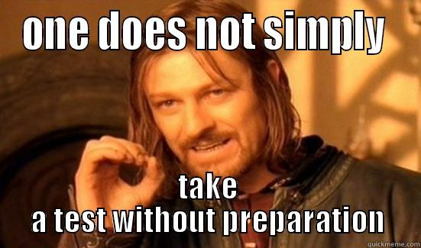
Question
What is Zakaria’s definition of Illiberalism, and differences between liberty and democracy?
Notes:
Zakaria’s definition of Illiberalism, and differences between liberty and democracy: (MPyAy!)
Illiberal democracy – when democratically elected regimes ignore constitutional limits on power
Liberty - the freedom of the individual from arbitrary authority
Democracy – simple definition = rule of the people
For Westerners liberty and democracy are hard to separate, but they are not intrinsically related (ex: Hitler was democratically elected)

Slide 9
Question
What is Zakaria’s definition of Illiberalism, and differences between liberty and democracy?
Notes:
Zakaria’s definition of Illiberalism, and differences between liberty and democracy: (MPyAy!)
Illiberal democracy – when democratically elected regimes ignore constitutional limits on power
Liberty - the freedom of the individual from arbitrary authority
Democracy – simple definition = rule of the people
For Westerners liberty and democracy are hard to separate, but they are not intrinsically related (ex: Hitler was democratically elected)

Slide 10
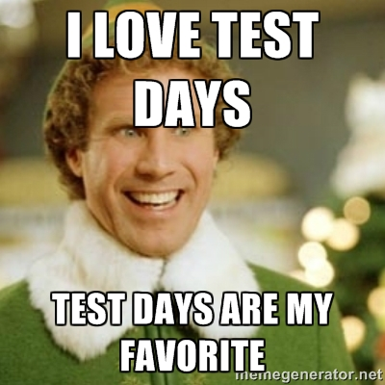
Question
What did Confucius promote on moral value system and political order?
Notes:
Confucius on moral value system and political order (SCM):
Political order - “Government of the people and for the people but not by the people”
Basic principles of Confucian administration are order, unity, harmony, and sustainability
The Way of Jen - love the people around you, specifically children serving their parents
Moral value system influences the political order. The role you play in your family affects the role you play in society. Sons obey fathers, workers obey superiors.

Slide 11
Question
What is Max Weber’s 3 Forms of Legitimacy?
Notes:
Max Weber’s 3 Forms of Legitimacy: (MPYay!)
Legitimacy defined as lawful basis by which people obey their governments orders and abide by rules
Traditional Legitimacy – compliance by force of vales and customs
Charismatic Legitimacy - devotion/personal confidence in heroism or other qualities of an individual leader
Bureaucratic Legitimacy – acceptance of validity of laws and belief in competence of government administrators

Slide 12
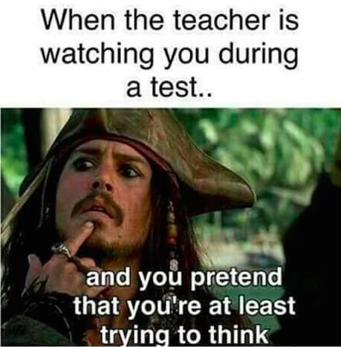
Question
What are the Definitions of Nation, State, vs. Tribe?
Notes:
Definition of Nation, State, vs. Tribe: (MPyAy!)
1. nation – a population with a shared culture, language, history, and possibly religion
2. state – a sovereign legal bureaucratic entity with a set territory over which it governs; can contain nations or tribes
3. tribe – a population grouped by shared race, ethnicity, or shared ancestral background; not recognized as a legal entity

Slide 13
Question
What are the Government functions under Keynesianism?
Notes:
keynesianism & Functions of Government: (Cthulhu)
Keynesianism noticed the failure of market, and it encouraged the country to develop an elaborate national planning system, through which government could partial manage the economy.
Government functions under Keynesianism:
Traditional – police and law and order.
National defense.
Social services – education, healthcare and welfare
Resource mobilization
Priming the pump – economic stimulus and control
Control of money flow during recession and inflation
Economic growth generation
Modernization – transferring from agricultural society to industrialized society

Slide 14
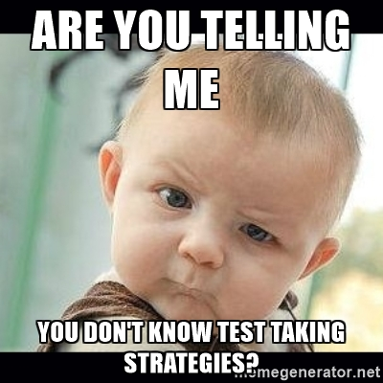
Question
What is Command Economics?
Notes:
Command Economics: (DDD)
A command economy is a system where the government, rather than the free market, determines what goods should be produced, how much should be produced and the price at which the goods are offered for sale. It can be argued that this type of economics maximizes social welfare as opposed to maximizing capital gains.

Slide 15
Question
What are Tasks of Policy-Making Support Mechanism?
Notes:
Tasks of Policy-Making Support Mechanism (SCM): (MPPM )
Designed to foster discipline, stability, and clarity while filtering out the unimportant. Needs to perform the following five tasks well:
Early Provision of Relevant Information
Adequate Consultation
Contestability
Recording and Dissemination
Monitoring Policy Implementation

Slide 16
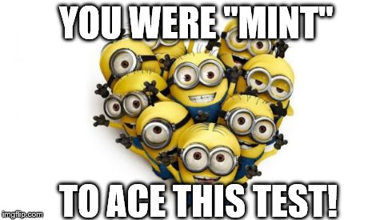
Question
What is the Asian Model and the Asian Tigers?
Notes:
Asian Tigers & Asia Model: (Cthulhu)
Asian Tigers: 4 countries in the 1970s and 1980s that went under rapid development based on the ‘Japan/Asian’ model of development. Republic of Korea, Taiwan (Republic of China), Hong Kong (at the time a British colony, not the SAR it is today), and Singapore.
Asian Model: Focused on corporatist intermeshing of state and private sector. Economics first, worry about the politics later. Important to note that these countries did not have proper democracy until the 1980s and 1990s and some were ruled by military dictatorships during the 1970s and 80s.

Slide 17
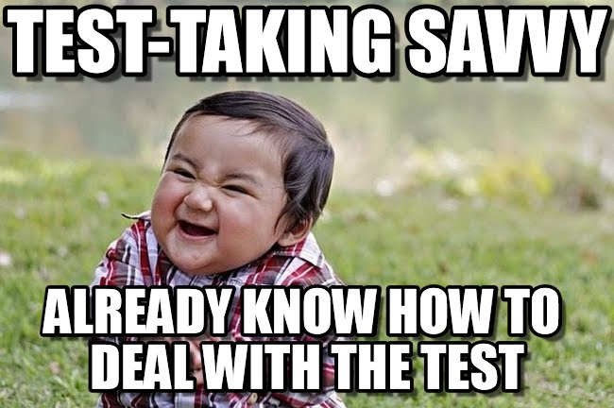
Discussion Points Completed
Please all teams must complete their discussion points by tomorrow at 9pm. No more changes will be accepted after that, so that everyone can use them to study with.
The information in each point will be used for the grading rubric. Those that are empty will be set by Dr. Picard based on the information from class and the material.
Teams that finish all their points get full participation credit.
If you are having difficulty with them, please see Jessi right after this session.
Great work!

Slide 18
Potential Essay Questions
What defines a good governance? Using Schiavo-Campo & McFerson’s description of ‘Good Governance’, choose one country of your choice and evaluate how this particular country would rank in terms of accountability, transparency, rule of law, and participation.
Using Schiavo-Campo & McFerson as a main reference, describe what is ‘Capacity Building/Development’ and what activities organizations should use to support it in the work place?
What have you specifically learnt from the core readings, degree readings and/or classical readings that apply to your field of study (MPA, MID, MPIA, MPPM)?

Slide 19
Potential Essay Questions
Does liberalization of a market inherently lead to democratization? Present the sides of this debate. Explain your answer with concrete examples and refer to specific economic and development theories that support your case.
What makes good verses a bad leader? Define both types of leadership and provide real world examples to support your cases.

