Slide 1
What Role Should Government Have in Society?
PIA 2020 – Administration of Public Affairs
Professor Jennifer Murtazashvili
University of Pittsburgh
Fall 2014
Lecture 3

Slide 2
Tale of Two Countries: Democratic Jamaica vs High QoG Singapore
Singapore and Jamaica may seem different today but this was not the case fifty years ago.
Most Social scientists in the early 1960s would have predicted Jamaica stood a better chance of fostering social well-being and economic prosperity than Singapore
Jamaica has been a democracy since independence.
Singapore is not considered a democracy and has not been since independence.

Slide 3
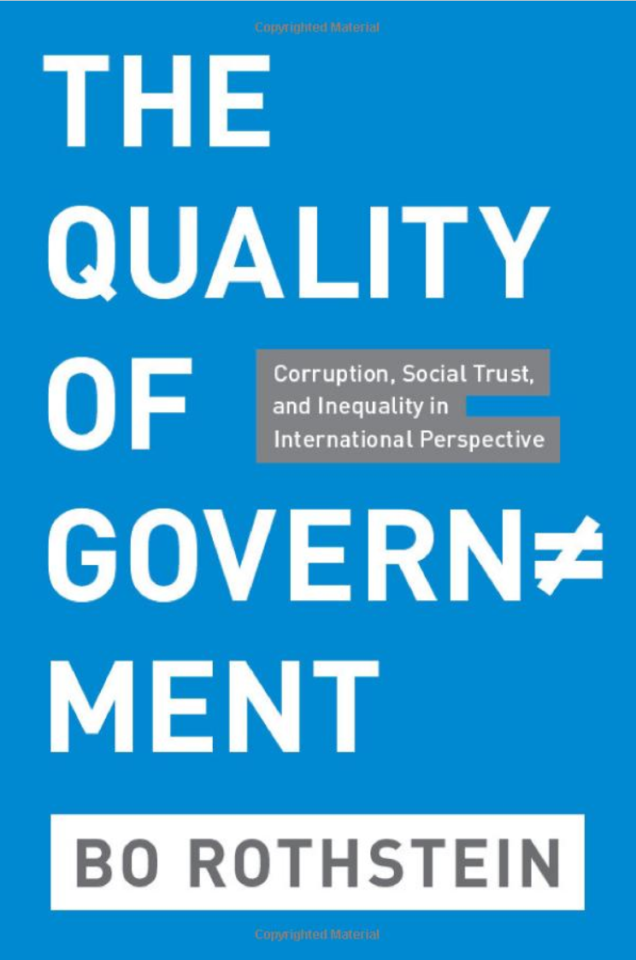
Quality of Government – Bo Rothstein

Slide 4
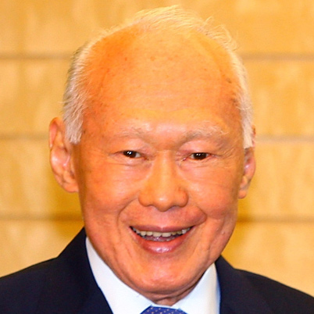
Explaining Divergence
Jamaica
Singapore
Democracy since independence
Between two competing political parties
Relationships are highly personalized
Bureaucracy has been source of patronage
Neither party has been able to dominate
Result is that citizen has lost trust in government
Scores high on democratic inputs but low on outputs
Lee Kuan Yew: never built his authority on personalist ties
Focus on meritocracy
Elitism and managerialism
System was corrupt in 1960
Yew believed in clean government; Professionalized the bureaucracy
Civil society and voluntary organizations are not flourishing
Not a democracy
Policy implication

Slide 5
Argument and Implications
The main argument: the quality of the institutions that exercise political power in a society is central to the social well-being of its population.
The causality is both direct from such formally established impartial institutions and indirect, since such impartial institutions increase social trust and social equality.
Why in some rich societies, elites usually manage to change institutions so that their societies will remain competitive in the globalized economy while poor societies seem stuck with formal as well as informal institutions that are fundamentally detrimental to their needs for economic growth and improvement of social well-being.
Formal and informal efficient institutions are mutually reinforcing entities in which causality operates with a considerable amount of feedback over time.

Slide 6
Rationale
“New institutional” approach in economic: efficient formal institutions are necessary for creating economic efficiency and economic growth, especially in poverty-stricken third world countries
The problem of supplying socially efficient institutions is often labeled as creating “credible commitments” between agents when they enter into contracts in a market
Without institutions establishing credible assurances agents who violate contracts will be punished, so as to establish a general belief among most agents that such behavior is uncommon, transaction costs will skyrocket and investments will not be made in physical or human capital.
The argument that markets will create efficiency if left to themselves
Only a number of special or exceptional circumstances call for government intervention.
Thus need more universalistic policies in countries seeking to emerge from social traps that give less discretion to self-serving authorities.
Because even if efficient institutions have been established, we should expect economic agents to try to make them redistributive

Slide 7
Critique
Fukuyama, Francis. “What Is Governance?” Governance 26, no. 3 (2013): 347–68.
Rothstein takes impartiality to be the core measure of the quality of government.
It could be entirely possible that a state could be highly impartial and still lack the capacity and/or autonomy to effectively deliver services.
Rothstein argues that impartiality implies the existence of sufficient capacity
This may be true but is something that needs to be tested rather than simply asserted
Need to separate impartiality from capacity
Can you have “good governance” in non-democratic countries?

Slide 8
Taxation as Measure of State Capacity
Problem:
There is a difference between extractive potential and extraction rates
Given level of taxation does not necessarily translate into efficient use of revenue
For many countries, government revenues are based on resource rents or international transfers rather than taxation.

Slide 9
Capacity Measures
Professionalization of the bureaucracy
There is variation across different sectors of government
It is a limited measure
Output Measures
We want government to do things – so we would look at literacy, secondary and primary education test sources, measures of health to get a sense of how governments perform.
These measures are the product, often, of how the public sector interacts with the environment around it.
Many measures are poor (education example, “teach to the test”)
Outcomes cannot be divorced from procedures

Slide 10
Alternative Conception
Bureaucratic Autonomy: refers to the manner in which the political principal issues mandates to the bureaucrats who act as it agent
No bureaucracy has the authority to define its own mandate, regardless of whether the regime is democratic or authoritarian.
Often principles issue several, overlapping mandates.
Autonomy is inversely related to the number and nature of mandates issued by the principal.
The fewer mandates, the more autonomy the bureaucracy possesses.
A completely autonomous bureaucracy gets not mandates at all but sets its own goals
A non-autonomous or subordinated bureaucracy is micromanaged by the principal, which established detailed rules that the agent must follow.

Slide 11
Alternative Conception: Autonomy
An appropriate degree of autonomy does not mean that bureaucrats should be isolated from societies or at odds with citizens
Would not exclude collaboration with private sector or CSOs.
Autonomy allows for innovation
Carpenter - USPS
Bureaucrats need to be shielded from certain influences of social actors but also subordinate to the society with regard to the larger goals (Evans 1995)
Recall: Rothstein’s notion of universality to curb corruption

Slide 12
Capacity and Autonomy
QoG is the result of capacity and autonomy.
More or less autonomy can be a good or bad thing depending on how much underlying capacity a bureaucracy has.
Want lower levels of autonomy for bureaucrats when they are in states with lower capacity
Transaction costs
Principal agent problems

Slide 13
Paths to reform: Move to capacity and move toward autonomy

Slide 14
Public versus Private
Is there a difference between public and private organizations?
Is there a difference between business administration and public administration?

Slide 15
Size of Government
Size of state is in the eye of the beholder
A philosophical question…
How can we measure the size of the state?
Typically measured as government activity as percentage of the country’s GDP (value of all goods and services produced in a year). (Used by Rothstein)
Remember Fukuyama’s critique of this definition…
Patterns of growth in government
2000: was on average on third of GDP in OECD countries
Increased to about 40 and 60%
Fell in developing world from 28% to 26%
Is size related to effectiveness?
Notes:
There is no optimal size of government
This is a normative question
Typically size of state is measured as government activity as percentage of the country’s GDP
GDP is the value of all goods and services produced In one year
Increase in government size seems to accompany economic growth.
Shrunk during 1980s, Grew during 1990s, today?

Slide 16
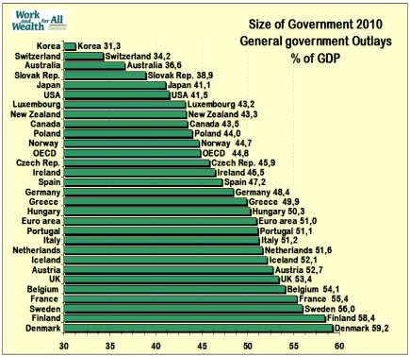
Size of Government in Comparative Perspective

Slide 17
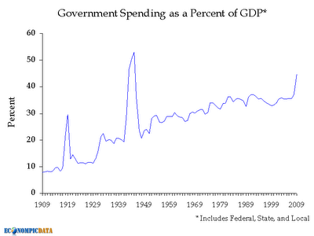
Trends in the United States

Slide 18
Markets or Governments?

Slide 19
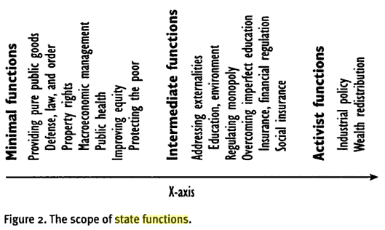
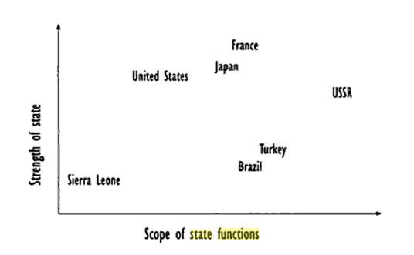
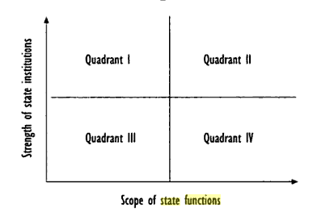
From: (Fukuyama 2004)

Slide 20
When Should Government Intervene?
Market Failure:
Market mechanism fails for some public goods that are non-rival and non-excludable
Clean air: there is no private incentive to provide clean air
Natural Monopolies (Increasing Returns):
Goods or services where the economies of large scale production are so high as to prevent any competitor from entering the market once the first company has begun production in large amounts.
Natural monopolies are completely insulated from competition
They under produce in order to keep prices at a profit maximizing level

Slide 21
Dynamic Nature of Government Intervention
Schiavo-Campo: Object of government intervention (should) not be to supplant the market mechanism but to remedy its failures and achieve the same outcomes that a competitive market would yield
Realize that production of public goods requires technology – and technology changes (the dynamic component)
A good or service that has the characteristic of a public good or of a natural monopoly may become suitable for the market mechanism as a result of technical or institutional changes – thus rendering government intervention unnecessary. (telecom)
Opposite is true: new public goods can emerge to justify new government role that did not previously exist (internet security)

Slide 22
Concern about Role of Government
Federalist 10
Federalist 51

Slide 23
Role of the Government in Society
John Kenneth Galbraith
Age of Uncertainty
Tradition of Schumpeter and Marx
Viewed government policy and intervention as essential to bringing about economic stability, efficiency, and enhanced social equity
Inspired by models of market failures – core of welfare economics
Milton Friedman
Free to Choose
Tradition of Smith: freely functioning market economy results in economic and technological progress, efficient utilization of resources, and a rising standard of living that—with exceptions—is distributed with reasonable equality
Society characterized by social mobility and political freedom
Expansion of government beyond minimal functions impairs economic progress and restricts social mobility and ultimately political freedom as well
Inspired by classical economics
Notes:
Galbraith: TV series Age of uncertainty in 1977
Shared schumperian and marxian view of the dramatic and technological achievements of capitalism and the market
Viewed government policy and intervention as essential to bringing about economic stability, efficiency, and enhanced social equity.
Based on an idealized model of an informed, efficient, and humane government able to identify and remedy failures of the market and to achieve national goals arrived at through democratic means
Welfare economics has produced rules and guidelines for government interventions to remedy imperfections of the market
Friedman: in tradition of Adam Smith. Competitive markets.

Slide 24
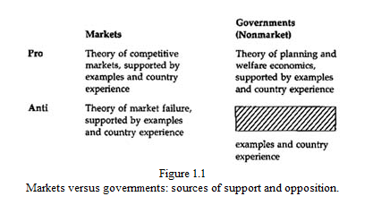
Market vs. Governments
We lack a theory of government shortcomings as a counterpart to the existing theory of market failures
We need a theory of non-market failures

Slide 25
Market vs. Nonmarket Failures
Public Choice Theory
Assumes self-interest of politicians and bureaucrats
Ignores things like organizational inertia, tradition, and standard operating procedures
Theory of non-market failures should apply not just to the public sector but to NGOs, foundations, universities, hospitals, etc.
Hayek and Von Mises – markets possess crucial advantages that government cannot match
Focus on markets and the price mechanism as a procedure for generating information as well as incentives
Oliver Williamson: Transaction cost approach – both market and nonmarket failures can be viewed as resulting from the particular transaction cost characteristics an burdens association with markets and governments.
Fundamental question of public administration and modern economics is choosing between imperfect alternatives
Not a choice between evils, but a choice between options that both have flaws
Notes:
We lack a theory of government shortcomings as a counterpart of the existing theory of market failures
Public choice theory: emphasizes the self-interest of politicians and bureaucrats as an important factor in understanding market nonmarket processes.
Public choice ignores the role of organizational inertia, traditional, and standard operating routines as contributors to nonmarket failures.
These factors are even more likely to be influential in organizations insulated from the discipline of the market than in organizations (firms) that are subject to that discipline.
The theory should embrace the wider range of activities, outputs, and failures covered by the nonmarket sector as a whole, rather than the public (government) sector alone. Although government is the largest member of the nonmarket sector, others such as NGOs, foundations, universities, hospitals are numerous. The behavior and deficiencies of those other nonmarket organizations should be included in a comprehensive theory of nonmarket failure that can highlight similarities and differences among them, as well as permit suitable comparisons to be made between the nonmarket sector and the market sector.
Austrian economic theory: van Hayek and von Mises – provides another element that is valuable. In their focus on market competition and the price mechanism as a procedure for generating information as well as the incentives providing by private ownership in motivating this procedure, they contend that markets possess crucial advantages that govern cannot match.
Williamson: transaction cost: both market and nonmarket failures can be viewed as resulting from the particular transaction cost characteristics and burdens associated with markets and governments as alternative “governance structures” for organization economic activities.

Slide 26
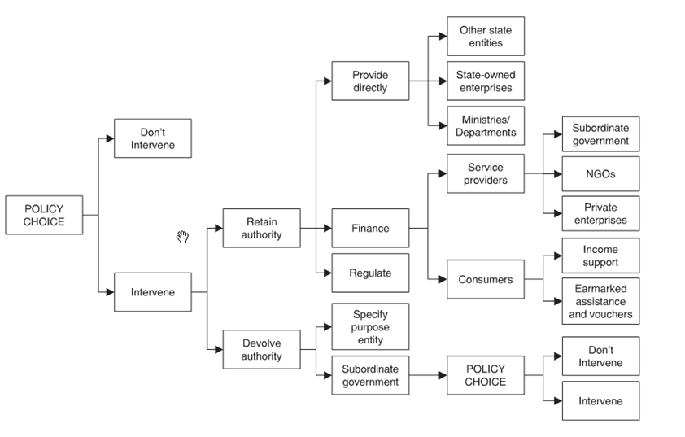
Decision Tree

Slide 27
Public Choice
Decision-making process is key:
Majority
Unanimity
Consensus
Every government decision has winners and losers
Pareto Optimality- Efficiency says nothing about fairness
Ending Programs (“Clearing the decks”)
Sunset provisions?
Zero-based budgeting
Notes:
The Worm in the Apple: Whose Ox is Being Gored?: Problem with decision trees is that it assumes away the impact on different groups. There will be winners and losers. Thus, overall efficiency of government is an important criterion, but it is certainly not the only one.
Majority
Unanimity
Consensus: does not require unanimity. Entails no significant segment of society is so strongly opposed to the decisions as to diminish its willing continued cooperation with he system as a whole and thus in time erode the system’s legitimacy.
Let Winners be Winners and Losers be Content: Every government decision entails winners and losers. Functioning democracy must have provisions to protect minority rights and the survival of the state requires its continued legitimacy.
If a sizeable group in society come to the conclusions that they will always and systematically be on the losing side, their adherence to the state will weaken, and in time, may threaten the common prosperity of the survival of the state.
Sustainability of the government decision-making process is key.
Pareto optimality: a situation cannot be improved upon if it impossible to make somebody better off without causing someone else to lose. Conversely, and economic state of affairs is suboptimal and a change is economically desirable, if it is possible to produce gains for the winners without making anyone else worse off (if it produces a net gain).
Economists are therefore satisfied if the change permits the lowers to be fully compensated while still producing gains for others—whether or not the compensation actually takes place.

Slide 28
Definitions
Market: Organizations that derive their principal revenues from prices charged for output sold in markets where buyers can choose what to buy as well as whether to buy
Nonmarket: organizations derive their principal revenues from taxes, donations, or other non-priced sources
Distinction can sometimes be unclear
Notes:
The Nonmarket: Demand and Supply Characteristics
The basis for distinguishing between the market and the nonmarket tis that organizations derive their principal revenues from prices charged for output sold in markets where buyers can choose what to buy as well as whether to buy, whereas nonmarket organizations derive their principal revenues from taxes, donations, or other nonpriced sources.

Slide 29
Inadequacies of Markets
Justification for public policy intervention lies in the frequent and numerous shortcomings of market outcomes
But this rationale is only a necessary, but not sufficient condition for policy formulation or government intervention
Why is it not sufficient?
Policy formulation requires that the shortcomings of market outcomes be compared with the potential shortcomings of nonmarket effort to provide remedies

Slide 30
Types of Market Failures
Justification for public policy intervention lies in understanding market failures
How to measures success or failure of market outcomes:
Efficiency: market outcomes can be termed efficient if the same level of total benefits that they generate cannot be obtained at a lower cost, or if greater benefits cannot ben generated at the same level of costs
In either case, the total benefits must exceed total costs if outcomes are to be deemed efficient
Distributional equity: Goes beyond economics. Many non-economists argue that distributional considerations should have more priority than efficiency.
They fault the market for its failure to provide equitable outcomes.
Notes:
How is the success or failure of market outcomes to be judged?
Efficiency: Market outcomes can be termed efficient if the same level of total benefits that they generate cannot be obtained at lower cost or, alternatively, if greater benefits cannot be generated at the samel level of costs; in either case, the resulting total benefits must exceed total costs if the outcomes are to be deemed efficiency.
Allocative efficiency
Distributional Equity: Goes beyond economics. Distributional issues tend to be more important. Many non-economists argue that distributional considerations should have more priority of efficiency, and they fault the market for its failure to accord this priority.

Slide 31
Public Goods
 | Excludable | Non-excludable
Rivalrous | Private Goods food, clothing, cars, personal electronics | Common Goods (Common Pool Resources) fish stocks, timber, coal, national health service
Non-rivalrous | Club Goods cinemas, private parks, satellite television | (Pure) Public goods free-to-air television, air, national defense

Slide 32
Types of Market Failure
Externalities – Spllilovers – can be positive and negative
Coase (1960): contends that externalities do not necessarily lead to market failure provided that a transaction or contract can be struck between the source and recipients that, in effect, brings externalities into the market.
Argues that those who are victims of external costs can make these costs tangible to their sources by offering to pay the latter or to desist or diminish culpable activities
Increasing Returns- Monopolies: where economic activities are subject to increasing returns and decreasing marginal costs, markets will fail to generate efficient outcomes
Under conditions of decreasing costs, the lowest cost mode of production would be achieved by a single producer
Dominant players can stifle innovation by locking people into inferior standards: VHS, QWERTY
Market Imperfections: Where price, information, and mobility characteristics of perfect markets depart significantly from those prevailing in actual markets, the outcomes resulting from those markets will not be efficient.
On the other hand: Patents create market imperfections
Distributional Equity
Notes:
Externalities and Public Goods: Where economic activities create spillovers, whether benefits or costs, that are not, respectively, appropriable by or collective from the producer, then market outcomes will not be efficient in the allocative sense defined previously. Since these external benefits or costs do not enter the calculations upon which production decisions are based, too little will tend to be produced where the externalities are (net) benefits, and too much where they are (net) costs, compared with socially efficient output levels . Education is an example – it benefits society and individuals. These externalities provide a justification for government intervention to compensate for the tendency of the market, if it is not prodded, to produce insufficient output. Technology investment. To the extent these benefits are external to and nonappropriable by the firms that bear the associated costs, these and other firms will invest too little in R&D.
Coase (1960) contends that externalities to not necessarily lead to market failure provided that a transaction or contract can be struck between the source and recipients, that, in effect, bring externalities into the market. He argues that those who are the victims of external costs can make these costs tangible to their sources by offering to pay the latter to desist or diminish the culpable activities.
Coase’s theorem runs into problems of implementation. Harder to bargain. Transaction costs are high.
Increasing Returns: Where economic activities are subject to increasing returns and decreasing marginal costs, markets will again fail to generate efficient outcomes. Under conditions of decreasing costs, the lowest cost mode of production would be achieved by a single producer. Consequently, a free market will result in monopoly. Assuming the monopolist cannot discriminate in the prices charged to different buyers and hence a single price prevails in the market, the outcome will be inefficient. It will produce lower quantities and the profit-maximizing price charged by the monopolist will be higher than warranted by the costs of production.
Market Imperfections: Where price, information, and mobility characteristics of perfect markets depart significantly from those prevailing in actual markets, the outcomes resulting from those markets will not be efficient. Once again a rationale arises for government intervention. These conditions abound in the economies of developing countries.
In developing country “big push” by government is presumed to be needed to compensate for the inadequacies of markets
Distributional Equity: Welfare economics typically discusses trade-offs in dealing with relative efficiency of various redistributive schemes. Income distribution is a type of public good. An equitable redistribution does not result from freely functioning markets because philanthropy and charity yield benefits that are external to, and not appropriable by, the donor, but are instead realized by society as a whole. Left to its own devices, the market will therefor produce less redistribution than is efficient (that is, socially desirable) because of the usual free rider problem associated with externalities, public goods, and incomplete markets.

Slide 33
Market Failure and Government Intervention
The absence of perfect and complete markets accounts for the various types of market failure.
Similarly, nonmarket failures are due to the absence of nonmarket mechanisms for reconciling calculations by decision makers of their private and organizational costs and benefits with the costs and benefits of society as a whole.
Public policies intended to compensate for market shortcomings generally take the form of legislative or administrative assignment of particular functions to one or another government agency to produce specified outputs that are expected to redress the market’s shortcomings
Notes:
The absence of perfect and complete markets accounts for the various types of market failure. Similarly, nonmarket failures are due to the absence of nonmarket mechanisms for reconciling calculations by decision makers of their private and organizational costs and benefits with the costs and benefits of society as a whole. Nor are the prospects for the invention of suitable nonmarket mechanisms that will avoid nonmarket failure notably brighter than for creating and perfecting suitable markets whose absence leads to market failures.
It is difficult to construct visible nonmarket hands that will turn public vices into public virtues

Slide 34
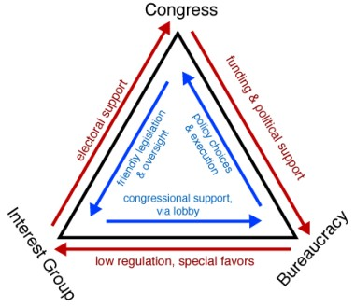
Iron Triangles

Slide 35
Nonmarket Solutions
Public policies intended to compensate for market shortcomings generally take the following forms:
Regulatory services (EPA, FDA)
Pure public goods (self-defense, space R&D)
Quasi public goods (education, postal services, health research)
Administering transfer payments (SS, welfare programs)
The value of these outputs is expressed in national accounts as exactly equal to the cost of the inputs used in producing them.
Says nothing about the efficiency or the social or economic value of the activities themselves.
Notes:
Public policies intended to compensate for market shortcomings generally take the form of legislative or administrative assignment of particular functions to one or another government agency to produce specified outputs that are expected to redress the market’s shortcomings.
These outputs or activities are of four types:
Regulatory services
Pure public goods (self defense, space R&D)
Quasi public goods (education, postal services, health research)
Administering transfer payments (SS, welfare programs)
The value of these outputs is expressed in national accounts as exactly equal to the cost of the inputs used in producing them. But it says nothing about the efficiency or the social or economic value of the activities themselves.

Slide 36
Conditions of Nonmarket Demand
When do we see demand for nonmarket goods and services?
Increased public awareness of market shortcomings
Political organization and enfranchisement - measured in social organizations
Structure of political rewards – rewards often accrue to legislators and officials who articulate and publicize problems and legislate proposed solutions, without assuming responsibility for implementing them
High time discount of political actors- Politicians value the present more than the future – hence all future costs and benefits tend to be heavily discounted or ignored while current or near term benefits and costs are magnified
Decoupling between burdens and benefit
The classic free rider problem is a special case of decoupling: benefits are extended to all or to specified groups regardless of whether any particular member pays. Beneficiaries have stronger incentives, and may make politically more effective effort to initiate, sustain or expand a particular program than the victims have, or make, to oppose it. The result may be a government program or regulation that is inefficient, or inequitable, or both.
Notes:
The conditions of demand may contribute to shortcomings in the delivery of government services by inflating the demand for such services. The demand conditions can be summarized under five headings:
Increased public awareness of market shortcomings: Especially from 1930s to 1980. Change due to the acknowledged failures of market outcomes to be socially optimal and to wider dissemination of information about these paese. Increased public awareness has led to reduced tolerance of them (environment, consumer organizations).
Political organization and enfranchisement: Public organization is reflected in numbers of social organizations.
Structure of political rewards: Rewards often accrue to legislators and governmental officials who articulate and publicize problems and legislate proposed solutions, without assuming responsibility for implementing them.
The high time-discount of political actors: Rate of the time discount of political actors may be higher than that of society. The result is often an appreciable disjuncture between the short time horizons of political actors and the longer time required to analyze, experiment with, and understand a particular problem or market shortcoming, in order to see whether a practical remedy exists at all. Hence, future costs and benefits tend to be heavily discounted or ignored, while current or near-term benefits and costs are magnified.
Decoupling between burdens and benefits: Decoupling between those who receive the benefits and those who party the costs of government programs. The classic free rider problem is a special case of decoupling: benefits are extended to all or to specified groups regardless of whether any particular member pays. Beneficiaries have stronger incentives, and may make politically more effective effort to initiate, sustain or expand a particular program than the victims have, or make, to oppose it. The result may be a government program or regulation that is inefficient, or inequitable, or both. Income of retirees through social security benefits is a good example. Decoupling may contribute to excess demand for government activities—excess either in the sense that they entail greater social costs than benefits, or that they are not sustainable because they diminish incentives for productivity and growth in the economy.

Slide 37
Perceptions and Nonmarket Demand
What drives nonmarket demand?
Public perception of inadequacies of the market tend to fuel demand
Special interests distort
Government tends to be “hypersensitive” to shortcomings in the belief it can remedy
If process that nurture perceptions of market failures yields distorted estimates then demand for non-market intervention can be excessive
This leads to nonmarket failures and gov’t deficiencies
Because government responds to public demands
Notes:
Perceptions and the Demand for Nonmarket Activities
The demand characteristics previously described relate to public perceptions of the inadequacies and shortcomings of market outcomes. The correspondence between these perceptions and the realities of market failure, inducing distributional failure may or may not be close.
Special interests groups distort
Government tends to be hypersensitive to market shortcomings in the optimistic belief that it possesses the means to remedy them.
Socialist legacy also is responsible for this in Europe.
Whether these changes in policy direction will be permanent remains to be seen. Even if they endure, the types of distorting influences described earlier sometimes result in presumptions that certain events are typical and frequent, when they are actually rare. They are outliers.
In sum, if the process that nurtures perceptions of market failures yields distorted estimates, then the demand for non-market intervention and activities can be excessive, thereby leading to various nonmarket failures and government deficiencies. Underlying this conclusion, of course, is the assumption that in democratic systems the political process generally responds to public perceptions. Consequently, if perceptions are distorted, the response of government will be accordingly deformed.

Slide 38
The Conditions of Nonmarket Supply
Nonmarket supply associated with several characteristics that distinguish it from market supply and contribute to nonmarket failures
Difficulty to define and measure output
Single source production
Uncertainty of production technology
The technology of producing nonmarket outputs is frequently unknown or if known is associated with considerable uncertainty and ambiguity What leads to better educational performance?
What leads to better national security? Limited understanding of the technical (production function) relationships between inputs and the intended final output of national security
Absence of bottom-line and termination mechanism
Notes:
The Conditions of Nonmarket Supply
Nonmarket supply is associated with several characteristics that distinguish it from market supply and contribute to nonmarket failures:
Difficulty in defining and measuring output: Nonmarket outputs are usually intermediate products that are, at best, only proxies for the intended final output. Quality is especially hard to ascertain. Measurement varies widely among nonmarket outputs.
Single Source production: they are usually produced by a single agency whose exclusive cognizance (monopoly) in a particular field is legislatively mandated, administratively accepted, or both. NASA. School systems.
Uncertainty of production technology: The technology of producing nonmarket outputs is frequently unknown or if known is associated with considerable uncertainty and ambiguity What leads to better educational performance? What leads to better national security. Limited understanding of the technical (production function) relationships between inputs and the intended final output of national security. More insubstantial is our understanding of the technologies associated with producing such other nonmarket outputs as social welfare through provision of welfare services and transfer payments.
Absence of bottom-line and termination mechanism:

Slide 39
Implications
Size of government always emanates from politics
Politics: system to make choices on the allocation of benefits and costs among different individuals and groups in society
Do we agree in this class about what the size of government should be?
Technical discussion should not obfuscate the politics behind these decisions
Notes:
Core functions of government are to protect the safety of citizens, defend the state, make and enforce laws and rules, assure public order, enable a favorable and stable economic environment, foster competitive markets, protect the physical environment. Some would argue for additional functions, but there is little argument about the above functions. There is plenty of argument about how far government should go in each of these roles and how it should exercise them, because different groups benefit from government exercise of those functions to a very different degree.
Politics is a system to make choices on the allocation of benefits and costs among different individuals and groups in society—underpinned by some notion of the common good—and public administration Is the machinery for operationalizing those choices, delivering the benefits and minimizing the costs.
The technical nature of the discussion should not be allowed to obscure the fundamentally political nature of the compact by which citizens surrender some freedom of individual action in exchange for certain protections and services which can only be provided on a collective basis.

