Slide 1
Dreamed, but failed, but still dreaming.
Book review of
“The Idealist : Jeffrey Sachs and The Quest to End Poverty”
Sekwen Kim

Slide 2
Life of Jeffrey Sachs
+
Mr. Shock !!
(Poland, Bolivia)
“End of Poverty”
MVP!
Harvard Professor
Harvard Diploma
MVP??
1985~1989
1976
1983
1990
2005
2005
0
Millennium Villages Project (MVP) :
Project launched by Jeffrey Sachs to eradicate extreme poverty in Africa by creating self-sufficient economic model for rural African villages.
-
Mr. Shock ??
(Russia)

Slide 3
Health and Development
“You can’t have development if everybody is sick all the time” (Jeffrey Sachs)
However, people were dying because they couldn’t afford 50 cents vaccine in Africa,
Sachs’ self sufficient model
Mosquito net
+
High yield seeds & Fertilizer
+
School
=
Millennium Village Project :
Self sufficient Sub Saharan rural village
Sachs’ economy of saving life
$ 66 billion investment a year
↓
8 Million lives
↓
$ 360 billion return a year
Notes:
However, in Africa, more than $700 billion in foreign aid has been poured into Sub-Saharan Africa… but nothing changed… people are still sick..
“Money down a rat hole” (Jesse Helms, former chairman of the Senate Foreign Relations Committee)
Jesse Helms dismissed foreign aid… so you know who is talking…
“It is because we haven’t spent enough money to get the result.” (Jeffrey Sachs)
Sachs’ estimate was $ 250 billion a year for eradicating extreme poverty by 2025.

Slide 4
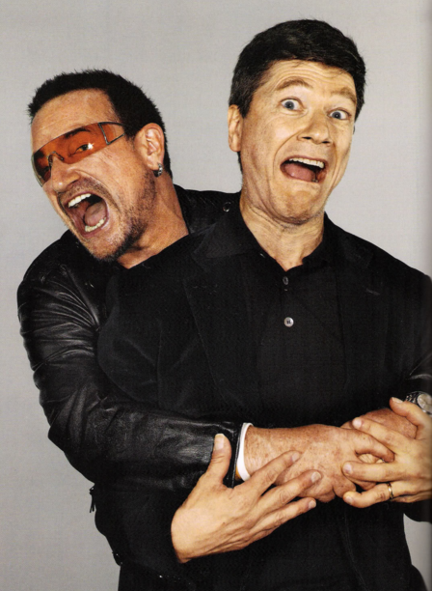
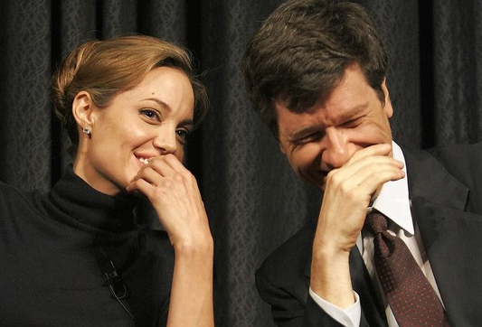
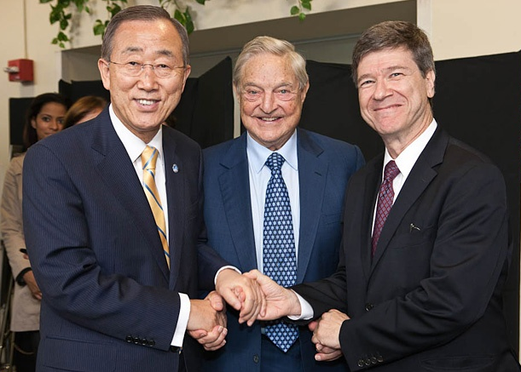
Bono! Glad to have you!
Jeffrey Sachs asked international donor for aid, but he also recognized the importance of private sectors and individual contribution… he called…
Bono brought attention, Angelina Jolie brought MTV, General Secretary Ban Ki Moon cherished the project and George Soros funded the project!!!
So as…. Following…

Slide 5
Pledge, Pledge, Pledge… But where is the money?
While, private sectors and individual were delivering what they promised to donate, but the donation, which was pledged during 2005 G8 Summit, were not fully delivered from countries, such aa France, Italy and Japan.
Italy pledged to donate, simply because France decided to donate. And Mr. Berlusconi gave his word to Sachs that Italy will donate more than France decided to donate.
After the pledges in G8 summit in 2005, there was a global economic (financial) crisis in 2008.
Notes:
However, in Africa, more than $700 billion in foreign aid has been poured into Sub-Saharan Africa… but nothing changed… people are still sick..
“Money down a rat hole” (Jesse Helms, former chairman of the Senate Foreign Relations Committee)
Jesse Helms dismissed foreign aid… so you know who is talking…
“It is because we haven’t spent enough money to get the result.” (Jeffrey Sachs)
Sachs’ estimate was $ 250 billion a year for eradicating extreme poverty by 2025.

Slide 6
But, Failed, Because,
But Dertu and Ruhirra, failed, because of;
Achievement for first 5 years in MPV
Failed
Micro financing
Infrastructure :
Clinic
& Dam & Pipi
Health :
Mosquito net
Economy :
Market
Corruption &
Ill-managed budget
Agriculture :
High Yield Product (Maize)
Dependency on Aid

Slide 7
Aid, Governance and culture
Sustainable management of development
Cultural understanding
Institution
In Sha Allah
Pastoralist Refugee
+
Agriculture
Informal institution
↓
incomplete governance system
↓
Corruption
Notes:
Culture
Net for lamb and camel and fishing

Slide 8
Questions
Question 1 - Ombudsmen
Question 2 - Adaptability
Would MVP worked, if NGO and Foreign Aid agencies were involved as ombudsmen and frequent evaluator?
If the success of development depends on institution to adopt the change, what can be done to increase the adaptability of under-developed countries?
Question 3 – Focus of development
Question 4 - Interests
Do people in under-developed countries really want a increase in productivity or do they just want to maintain their lives as either pastoralist or farmers?
Should individual interest be prioritized in development project? Or
Should communal interest be prioritized in development project?
Notes:
Most important of all, MVP did not have
Governing system and institution
Informal institution
Corruption
Understanding of culture
Pastoralist refugees
Diet

Slide 9
Most Important Question
Question 1 – Why “Idealist”
Why did Prof. Picard assign this book?
Notes:
Most important of all, MVP did not have
Governing system and institution
Informal institution
Corruption
Understanding of culture
Pastoralist refugees
Diet

