Slide 1
Business Development Plans
Researching and writing business plans for social entrepreneurism in Uganda
Lindsay Angelo, April 2018

Slide 2
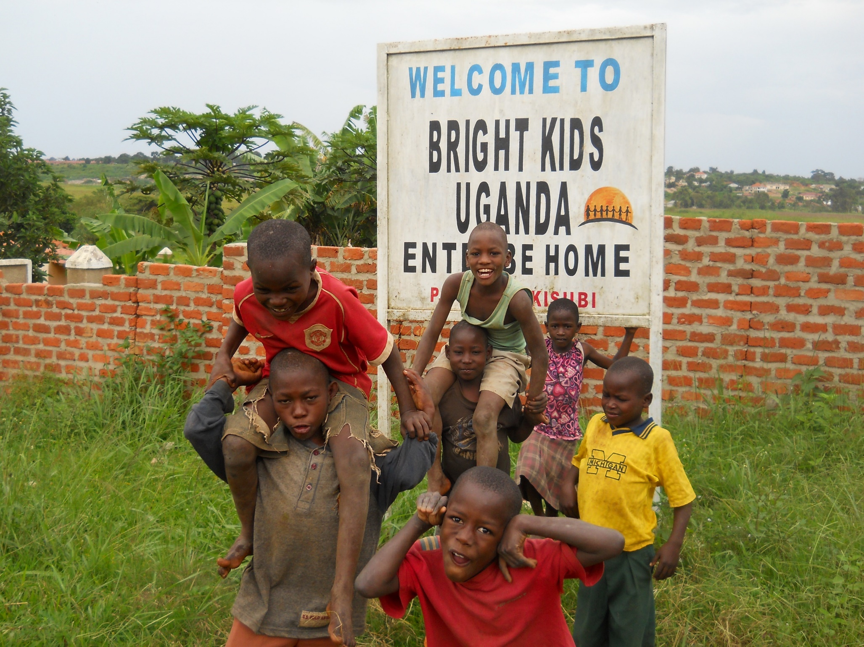
Agenda
Introductions (for me!)
Internship Background
Preparing for the Internship
Business Plan Framework
Field Research in Uganda
Putting it all together
----------------------------------------------------------------------------------------------------------------------------
What are each of your focus areas in Uganda?

Slide 3
Background: Social Enterprise Competition, 2014
Diehl Family Foundation - $50,000 competition to fund business plans for four organizations’ social enterprise projects
Bright Kids Uganda (BKU) – several projects, all needed revamped:
Poultry Project
Bed and Breakfast/Accommodations
Agriculture/Animal Husbandry
Mini-Supermarket (not started)
Whether or not BKU received funding, any NGO ought to have business plans for grant or donor funding!
Notes:
Define social enterprise: Organizations that address a basic unmet need or solve a social problem through a market-driven approach.
Each project tied to food security, and overall sustainability of kids
Explain Poultry Project- losing a lot of chickens due to mismanagement and lack of training
Bed and Breakfast- Had a couple rooms, needed improved, upgraded
Agriculture Context- some scattered land, not managed well, planted during wrong seasons for best harvest
Mini-Supermarket Idea, owned blighted building
Overview of what they needed: land, training, materials, capital/construction

Slide 4
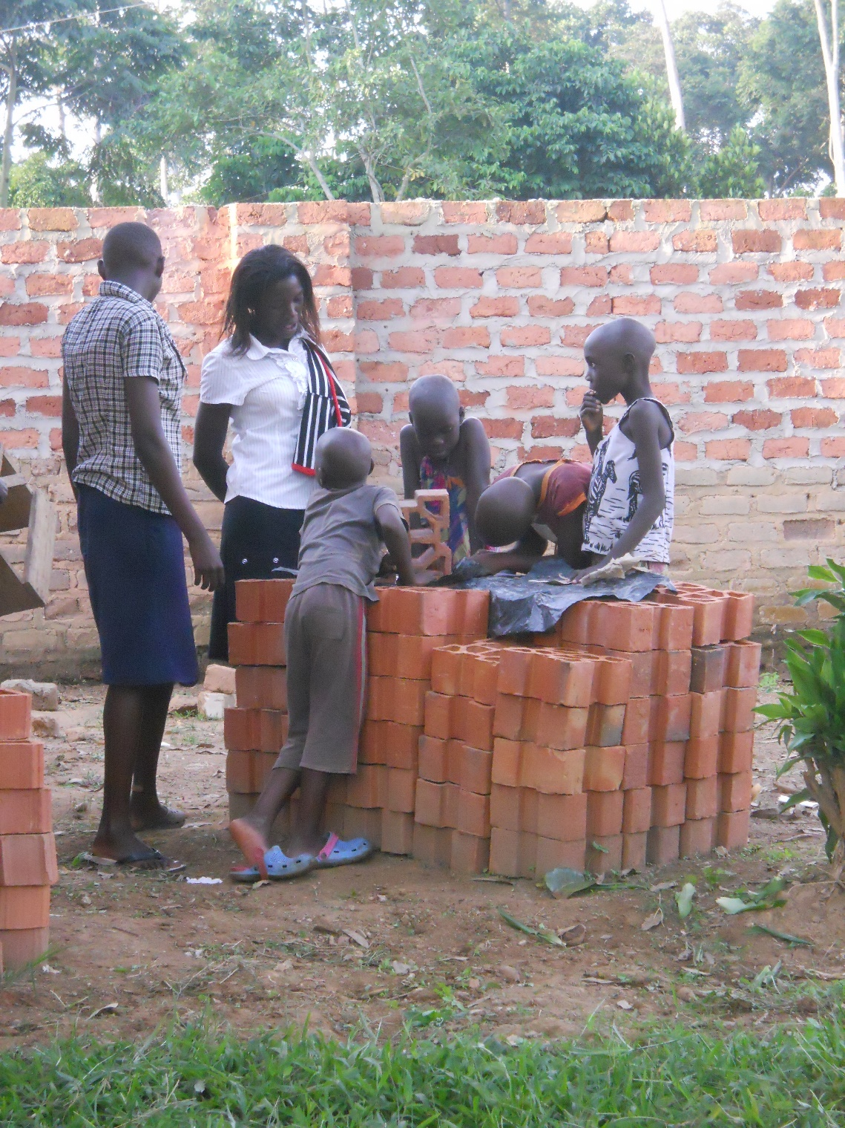
Preparing for your Internship/Field Research
What do you need to know before you go?
Researched business plan examples, requirements of competition, past intern evaluations at BKU
What information do you need while you’re in Uganda?
Fill in the gaps with more program or project evaluation
Who do you need to talk to? What questions do you need answered (or think you need answered)?
What can you do once you are back in the US?
Writing, external research
----------------------------------------------------------------------------------------------------------------------------
What are your goals while in Uganda?
Notes:
I had an assistant! Use each other to bounce ideas off of, adapt, grow your projects and research. Things change!

Slide 5
Business Plan Framework
For each of the four projects:
Significance of the Problem
Tangibility - project description, needs assessment
Feasibility and Implementation - action plan, operations/activities
Leveraging Potential - marketing plan, partnerships, network and support
Funding Sustainability - market research, customer base
Management Team
Notes:
Poultry- needed better training for manager, heat, capital, and more efficient use of materials. Researched and interviewed local experts. Consulted with BKU and put together a plan that made sense for them and incorporated a plan.
Agriculture- needed more land, would use food for kids rather than putting out emergency food appeal to donors every break and summer. Put together farming and harvesting plan, after interviewing experts and consulting with BKU.
Accommodations- cost analysis, showed profitability
Mini-supermarket- market research, capital costs, etc.
Agriculture-

Slide 6
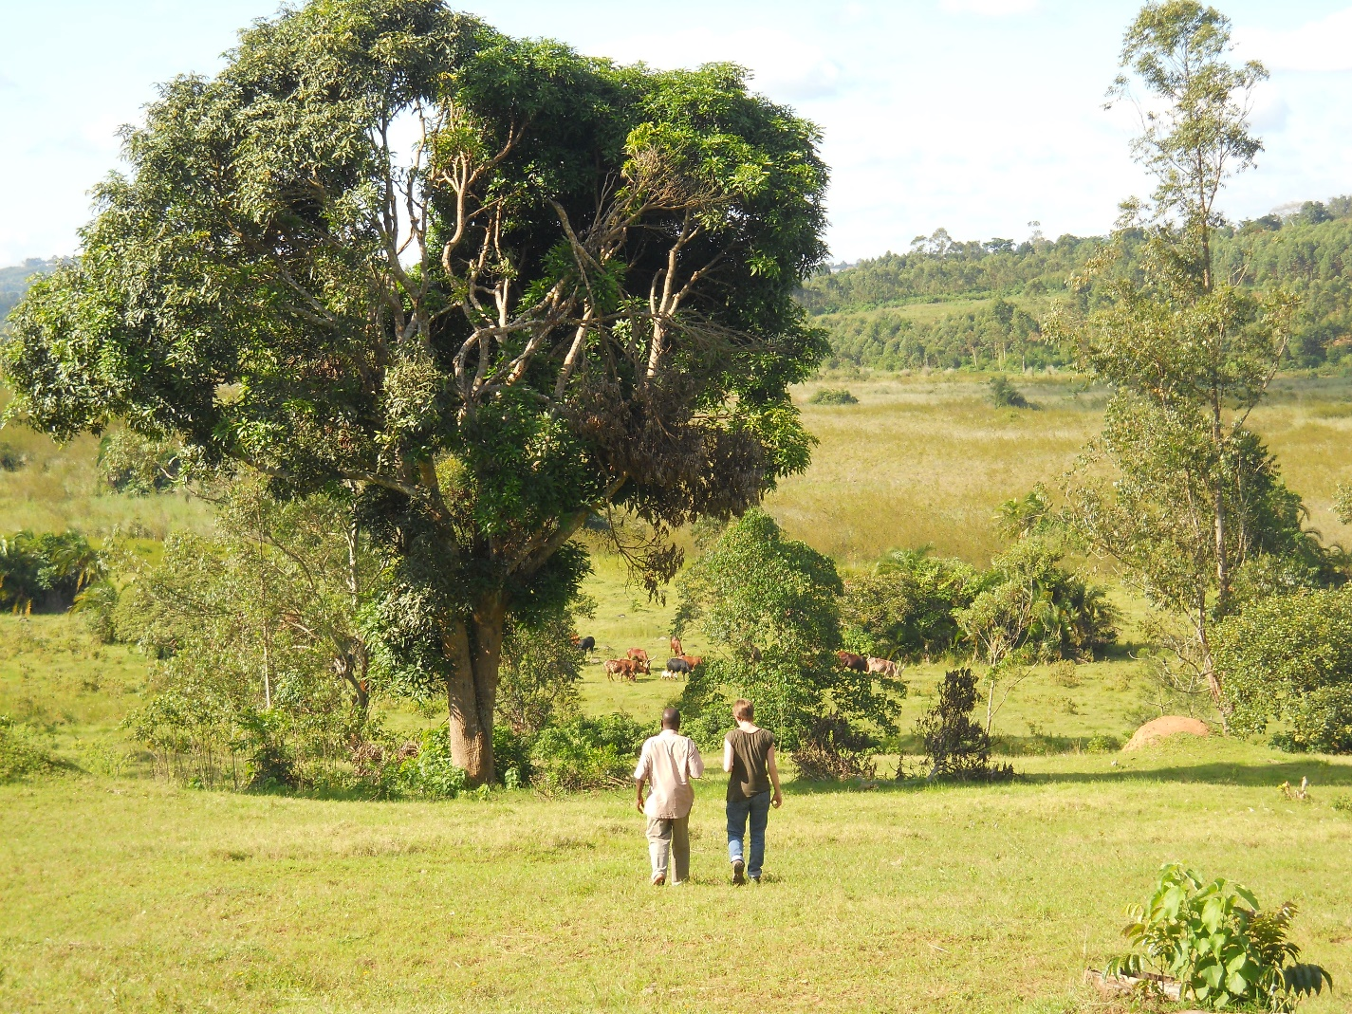
Field Research (cont’d)
Consulted with BKU!
Asked BKU their vision, plans, how & why
Interviewed outside experts in related fields
Take notes, take pictures, LISTEN
Balancing act of what you need for project, client’s needs, being accountable, and being adaptable
Research→Feedback→Revise→
Research→Feedback→Revise→

Slide 7
Putting it all together
Organized all my field notes
(regretted that I didn’t make some things more legible or organized, do that right after you’re done in the field!)
Put it together in an easy-to-read report for BKU and potential donors
Charts, pictures, quotes, timelines, maps, etc.
Cite everything
BKU’s Business Plans won $50,000!

Slide 8
Mini Supermarket: Before & After

Slide 9
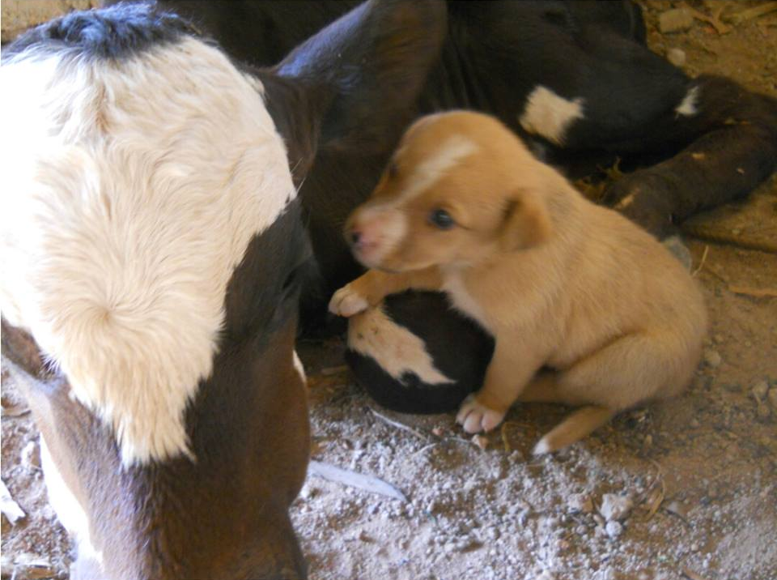
Accommodations: Before

Slide 10
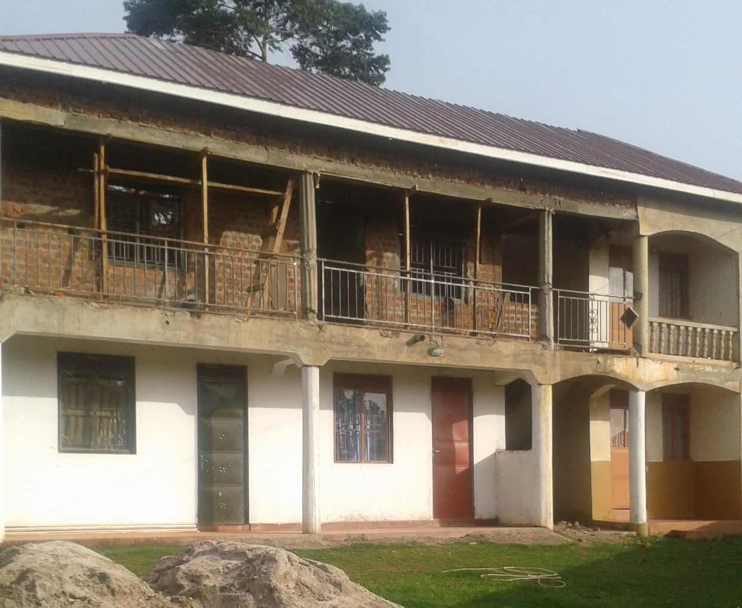
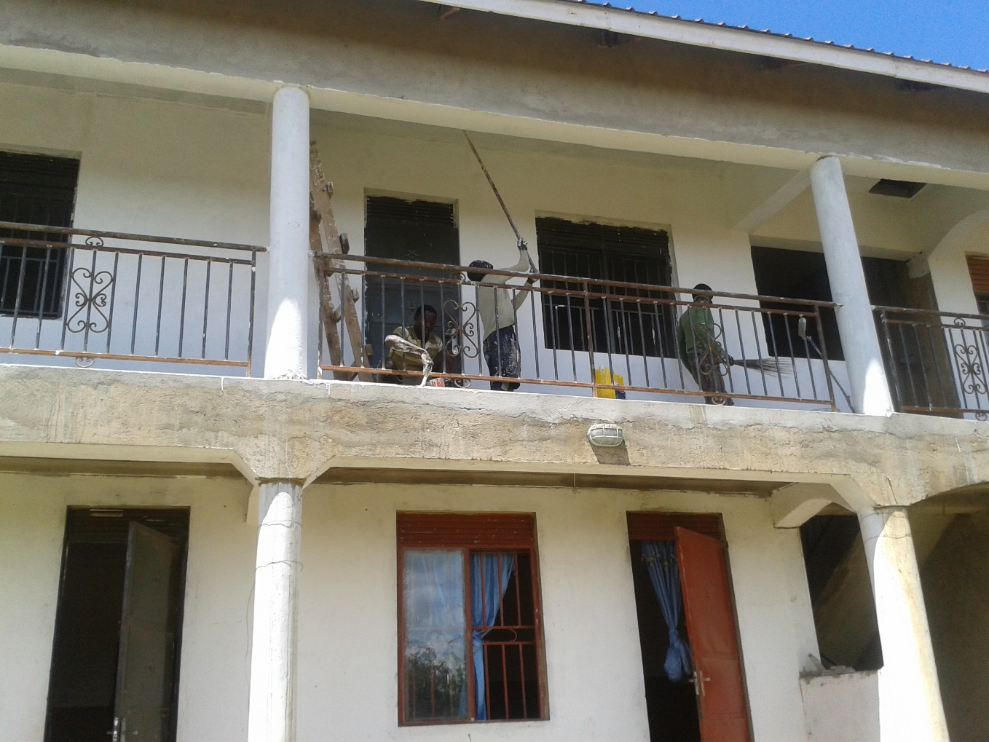
Accommodations: After

Slide 11
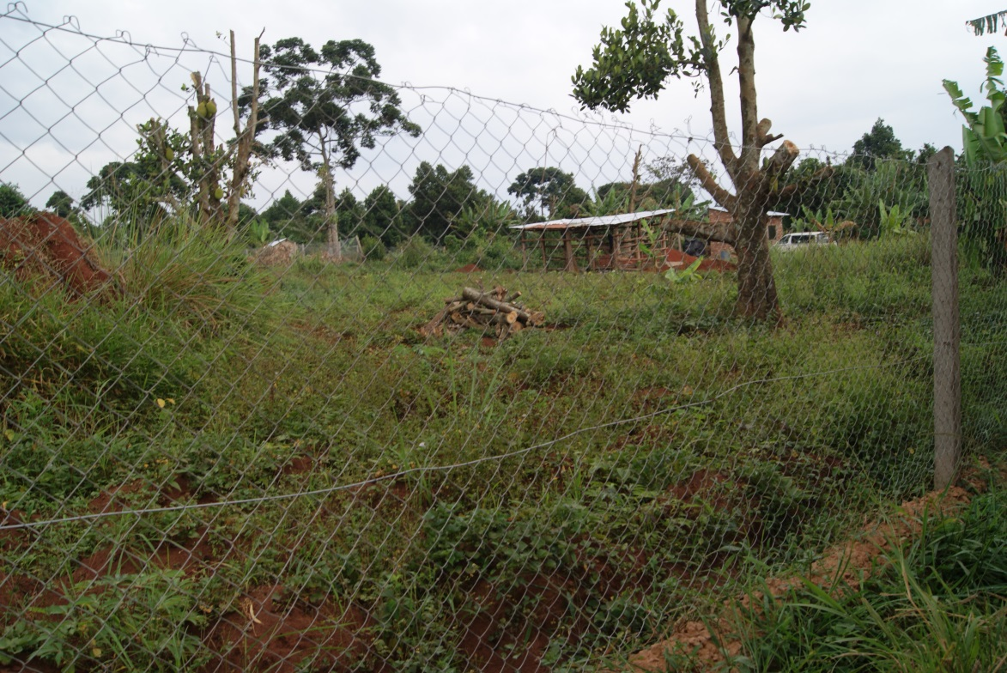
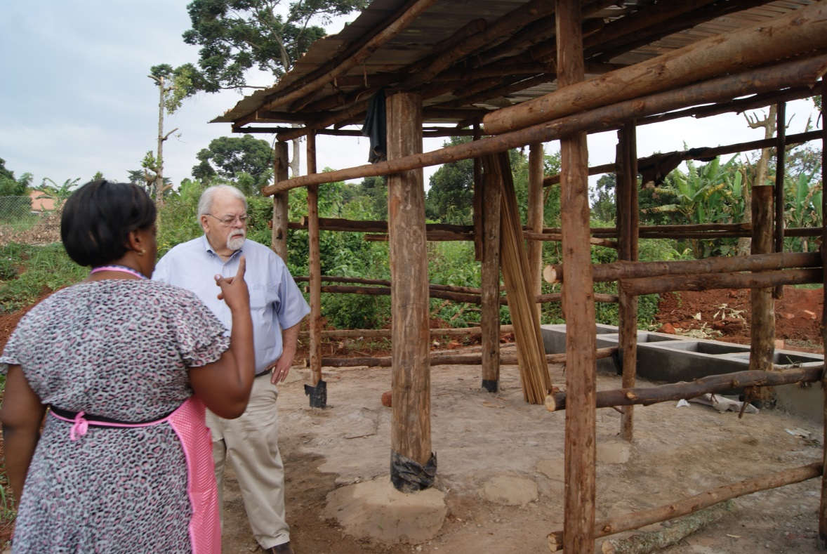
Agriculture/Animal Husbandry

Slide 12
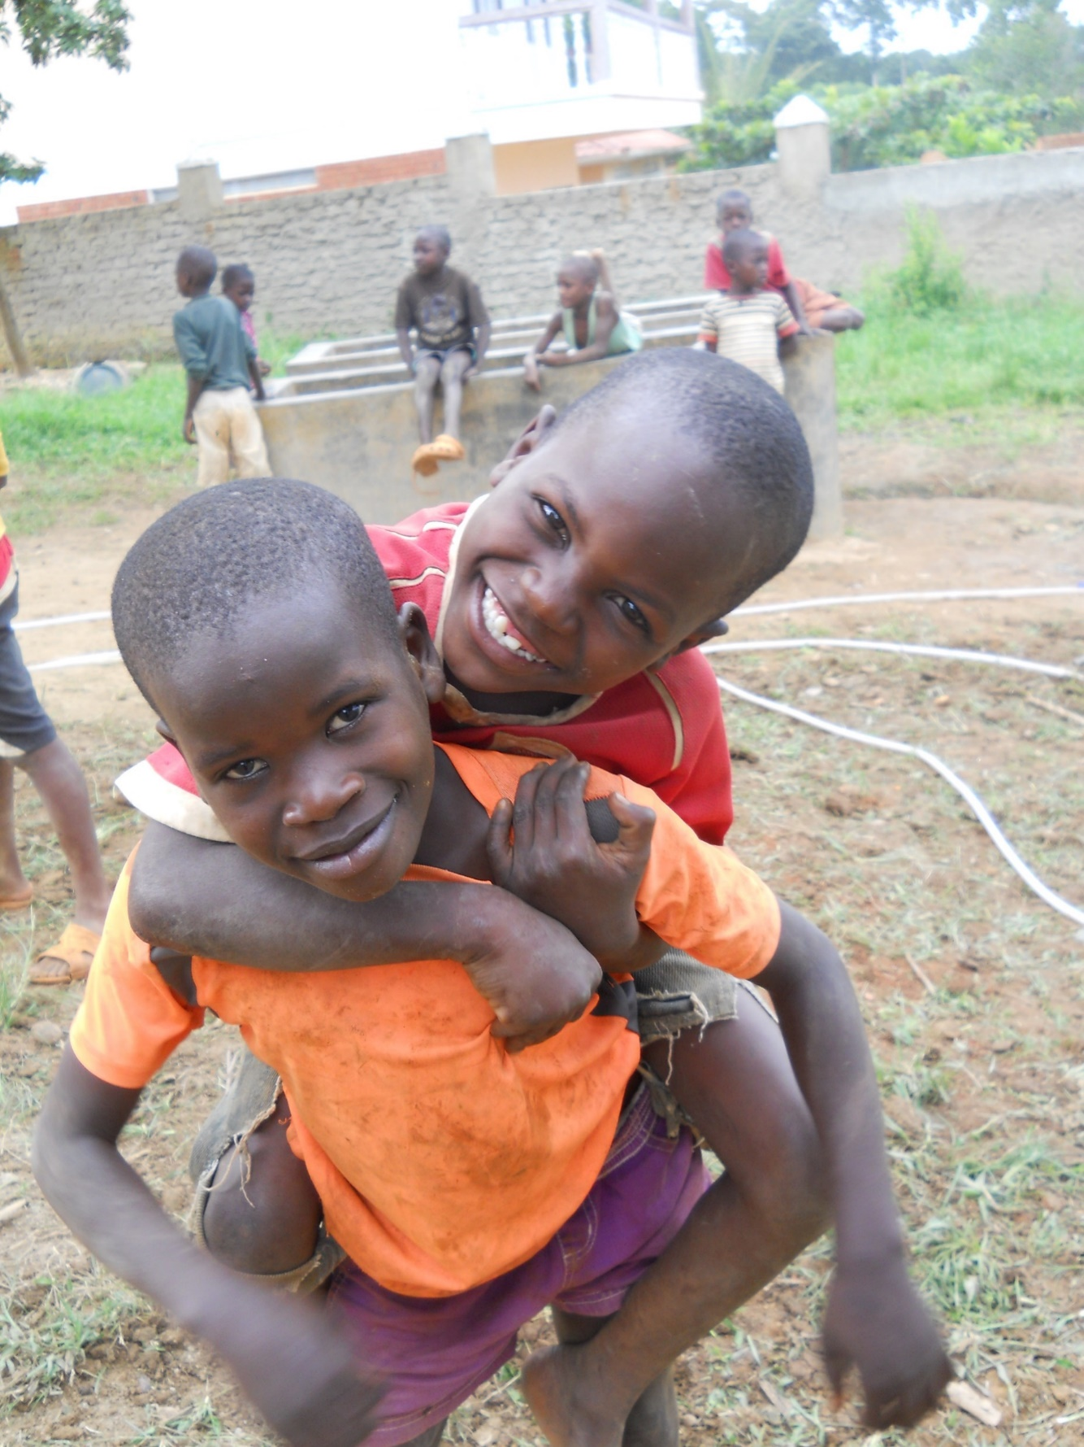
Questions or concerns?
Thank you! You’ll do great!

