Slide 1
PIA 3395
Development Theories

Slide 2
Week Nine
Development Planning, Theory and Economics

Slide 3
I. Literary Map
II. Golden Oldies
III. Synthesis

Slide 4
Definition
Planning is the application of rational ordered choice to social and economic affairs.
Note: For more on Planning see material in Picard’s course, PIA 2501- Development Policy and Management

Slide 5
Classic Planning Model

Slide 6
"How Rational is Rational Planning Choice?”

Slide 7
Goals of Development Planning- One
Foster economic growth
Strengthen human and organizational capacities
Plan and develop physical infrastructure (roads, dams, railways, buildings, etc.)
Establish priorities in the use of scarce resources

Slide 8
Regional Planning Processes

Slide 9
Goals of Development Planning- Two
Promotion greater equality in the distribution of opportunities income and power
Provide a framework for wider participation in the economic system
Support social capital development, in the form of stronger families, communities, interest associations and grass-root institutions

Slide 10
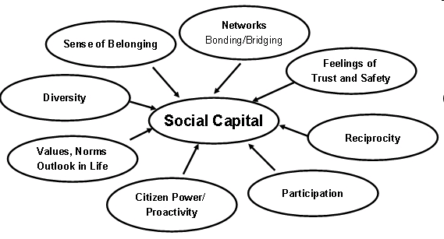

Slide 11
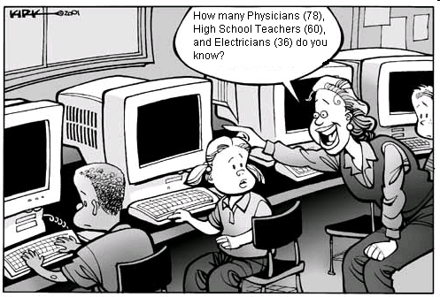

Slide 12
Planning Growth Models- One
1. Unbalanced Growth
2. Unbalanced growth and Distribution
3. Balanced Growth
4. Capital accumulation and Balanced Growth

Slide 13
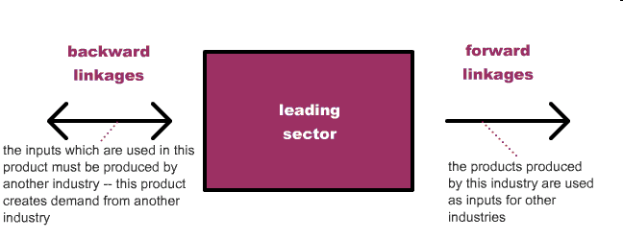
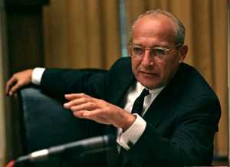
Unbalanced Growth
Walt Rostow
Leading Sector Theory

Slide 14
Planning Growth Models-Two
5. Growth Poles
6. Project Planning
7. Rapid Appraisal and people centered development
8. Human Resource Planning

Slide 15
Growth Pole Model

Slide 16
Problems with Planning- One
Bureaucratic inefficiency, Administrative and Political Constraints constitute a major limitation on development planning;
The political Problem-1 development strategies often parallel but ignore political realities. There are limits on political compromise and local level autonomy;

Slide 17
“Some inefficiency may be inevitable in a post-disaster climate of confusion”

Slide 18
Problems with Planning- Two
Issue of planning vs. ways in which budget priorities are set. The recurrent budget problem and incrementalism. Planning is an allocation process that contradicts budget allocations (Planning vs. Budgeting issue).
Political Problem-2- Definition of politics as the “Authoritative Allocation of Values.” Pluralist Politics vs. central direction are conceptually in conflict (Criticism of slowness of process)

Slide 19
Snail’s Pace

Slide 20
Problems with Planning- Three
It became almost a magic term. Five year plans of over 1500 pages for a country of less than a million people
Part of the unfulfilled rhetoric of development

Slide 21
The Classic Picture

Slide 22
Problems with Planning- Four
Mandated by technical assistance. Planning became the mechanism for donor involvement via projects: limits money and time commitment
Expanded government meant specialized planning organizations and the rise of development economics as a discipline. The Failure of development and the limits of the econometric model

Slide 23
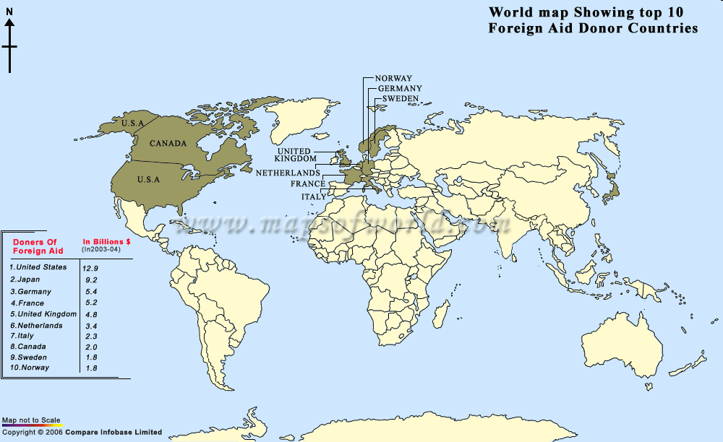

Slide 24
Another View

Slide 25
Problems with Planning- Five
The issue of growth vs. distribution: traditional goals industrialization and aim of high and growing GNP per capita income vs. quality indicators (social development) of life
Problem: Failure of planning blamed on weak planning and administrative capacity. The separation of and the lack of implementation was often ignored by planners

Slide 26
Problems with Planning- Five
11. The Issue of grass roots participation must be raised-Bottom up Planning
12. There was rhetoric of a command economy as opposed to a market economy with two extremes and the soft state in-between. Planning suffers from this rhetoric.

Slide 27
Problems with Planning- Six
13. Debate about the coordination of Planning Voluntary vs. hierarchical authority- The Social Engineering Problem
14. Planning was a shopping list

Slide 28
Command vs. Grassroots Planning

Slide 29
The Human Resource Development Strategy
Strategy to focus on Education and Capacity Building as the basic Development strategy
Basic Thrust of Rockefeller Foundation 1960s and 1970s
See Picard and Buss, Chapter 11

Slide 30
HRD Issues
Debate about Doctrine vs. Interpretation (Augustine vs. Luther)
Private vs. Public (Dewey)
Role of Secularism (John Locke)
Literacy (Primary) vs. Higher (Intellectual) Education Development (Piaget’s Stages)
Bounded Knowledge vs. the Synthetic (unbounded) mode of Thought (Picard)
The Empirical focus?
HRD vs. Keynesianism (James S. Coleman and Robert J.Berg)

Slide 31
Application of HRD
Focus on Management Development Rather than Development Management
Debates about the Role of Professional and Technical vs. Management
“Which comes first, the chicken or the Egg?”
See John E. Kerrigan and Jeff S. Luke, Management Training Strategies for Developing Countries (Boulder, CO: Lynne Rienner, 1987).

Slide 32
A Mock Exam Question:
To what extent, is the state planning approach possible? (eg. balanced regional development). What role is there in the early 21st century for national as opposed to regional, sectoral or project planning?

Slide 33
Deconstruction Exercise
Each Group will break down the question and include at least ten planning references

