Slide 1
Development Economics- History, Discourse and the Environment (From a non-Economist)
PIA 3395- Development Theories
Week Eight

Slide 2
I. Golden Oldies
II. Literary Map
III. Synthesis

Slide 3
Dedicated to Prof. Robert B. Pettengill’s Introduction to Economics Course Fall, 1962

Slide 4
Pettengill, 1904-1997 Prof. of Economics, State University of New York at Albany
“It was Good but not that good”

Slide 5
Goal: With Apologies to Economists
Some Basics for Non-Economists
Summary of Themes
See Prof. Annemie Maertens or Prof. Shanti Gamper-Rabindran if you plan to write an economics question!

Slide 6
The Nature of the Debates
I. Mercantilism and Industrialization- British Origins (Dudley Dillard)
a. From Slavery to Feudalism
b. Nature of Royal Monopolies- King vs. State
c. Linked to Overseas Empires- especially in England

Slide 7
United Kingdom Royal Coat of Arms

Slide 8
Mercentilism, Continued
d. Royal Monopolies- on trade, extraction, production and land
e. Agricultural Production based systems in England and Overseas
f. Accumulation of Wealth: Silver and Gold

Slide 9
South African Gold

Slide 10
II. Orthodoxy- Classical Liberalism
a. Hidden Hand- Adam Smith and the Rationalists (Mill, Ricardo)
b. Market and Free Trade stimulate the accumulation of capital
c. Ending of subsidies, monopolies and commons- Cottage industry and the factory system

Slide 11
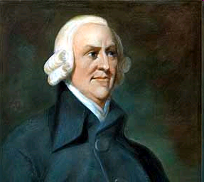
Links to British Rationalism and Masonry?
Adam Smith
Hidden Hand

Slide 12
Orthodoxy- Classical Liberalism, Continued
d. Technical and commercial transitions
e. Supply and Demand and the Miracle of the Market
f. St. Simonism, physical infrastructure and Intervention (Continental Europe)

Slide 13
Claude Henri de Rouvroy, Comte de Saint-Simon
Focus on Scientific Discovery, Building (Roads, Railways and Bridges) and on Industrial Development
State Led Development

Slide 14
III. Keynesianism: Still on Top
Keynes: The Rise of Keynesianism as a dominant economic principal, that is government had a role in the management of the economy. The origins of development theory lie in the late colonial period

Slide 15
John Maynard Keynes- 1883-1946
British Economist who worked several years in the British India Office and spent World War Two in Government Service
John Rapley: “Keynes had no problem with the market economy. He liked the machine but judged it to be in need of improvement if it was to operate well.”

Slide 16
Lord Keynes Addressing Bretton Woods Meeting. — July 1944

Slide 17
Keynes-1
1. Keynes’s goal was to influence the
market and not replace it.
2. He Influenced the U.S. New Deal and the thinking of the Labour Party in England
3. He had an important influence on
the social democratic parties in
Western Europe
4. His ideas suggested that European mixed economies could be replicated in LDCs

Slide 18
Keynes-2
There are a number of components to Development Theory as it links to Keynesianism. KEY: Faith in the State

Slide 19
Keynes-3: Components and Debates
1. Physical development (roads and dams) and Economic Growth
2. Physical and Mental Change or Social Development
3. Human Resource Development vs. Social and Economic Change
4. Proposed a Mixed Economy- public and private
5. At questions the relationship between ESD and Political Change

Slide 20
Keynes-4
Critics suggest that Keynes promoted “Big Government”

Slide 22
Keynes-5
Techniques:
1. Fiscal Policy
2. Monetary Policy
3. Wage and Price Controls

Slide 23
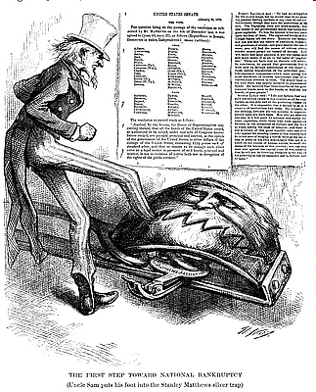
Early Anti-Silver Cartoon

Slide 24
Keynes-6: Criticism (Isbister)
1. Economic vs. Social Development- the Role of HRD vs. Growth and Distribution
2. False Path of Political Independence vs. Political Development
3. Keynesian as Commandism? Socialism vs. Keynes
4. Industrialization vs. Private Sector Tracks (The goal of capital formation)

Slide 25
The Logical End Point for Keynes?

Slide 26
IV. Neo-Orthodoxy
Public Choice (Social Choice and Rational Choice)
Irrationality of Collective Choice
Tragedy of the Commons
Free Rider Problem
Development plus Economics equals Oxymoron

Slide 28
Neo-Orthodoxy, Continued
Trade not Aid- Lord Bauer
a. Globalization
b. Internationalization of Capital
c. Modes of Production and International Economy
d. Information Technology
e. Institutional Economics (Douglass North)

Slide 29
Nobel Laureate Douglass North chats with Estomih Nkya (GSPIA PhD 1994)

Slide 30
Critiques of Neo-Orthodoxy on the Left (|Escobar)
a. Rationality vs. Irrationality of
workers and peasants
b. Fordism vs. Post-Fordist situations
c. Critics of Globalization, IMF and World Bank
d. Development Economics as a mask for underdevelopment

Slide 31
Dependency Theory and Globalization- Leys
Key: Domestic Capitalists and Slack (areas of economy that can be locally influenced)
Sometimes Labeled Dependent Development
Real Capitalists vs. Crony Capitalists

Slide 32
Worshop Exercise: PhD Questions (Any Topic)
Group 1 Write a PhD Question for Group 2
Group 3 Write a PhD Question for Group 1
Group 2 Write a PhD Question for Group 3
Send to your group by the end of the week.
Each Group outline an Answer plus 12 references for presentation to the groups in two weeks.

