Slide 1
PIA 3395
Development Theory

Slide 2
Reports
I. Literary Map
II. Golden Oldies of the Week
III. Synthesis

Slide 3
Systems Theory and Structural Functionalism- Classic Political Science Theories
Systems Theory (David Easton) and Structural Functionalism (Almond and Verba, The Civic Culture (1957)
Origins of contemporary Civil Society Model:
“There is a ‘civic culture’ which is the most developed political form.”
Gabriel Almond and Sidney Verba

Slide 4
General Systems Theory

Slide 5
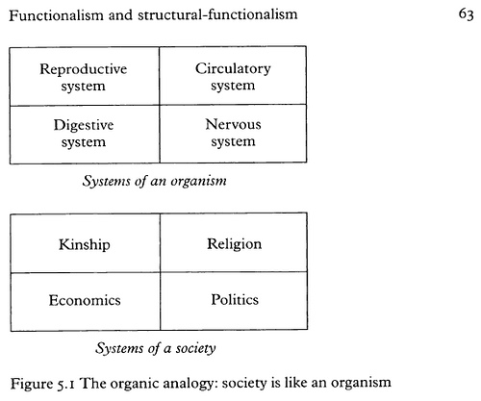
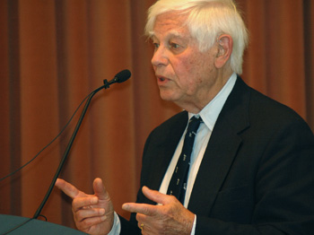
Systems Theory (David Easton. Born June 24, 1917 (age 95)

Slide 6
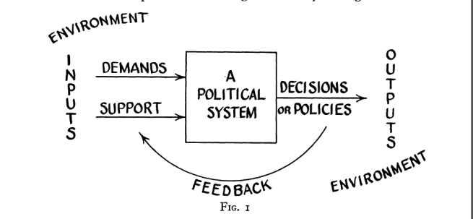
Structural Functionalism: Gabriel Almond
Inputs:
interest articulation
Interest aggregation
The Black Box (With-inputs)
Outputs- Policies
Feedback

Slide 7
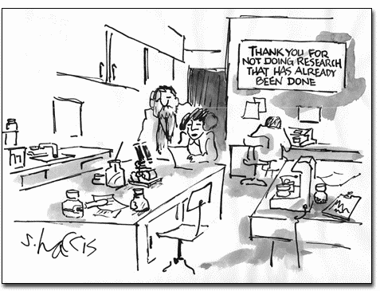

Slide 8
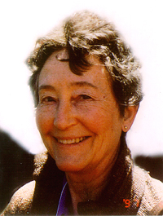
Cultural Debates and the Bureaucracy: A Reminder
Disjointed Modernization (Joseph R. Gusfield, University of California at San Diego and Susanne Rudolph, University of Chicago)
Misplaced Polarities Theory

Slide 9
Problems with Bureaucracy
Crawford Young
Civil Society Collapse and the Impact of (Result of?) Colonialism (Crawford Young)
The Administrative State (Picard)
And the Organizational Bourgeoisie (Leonard Markovitz)
Markovitz Book

Slide 10
M. Crawford Young, Born 1931- University of Wisconsin
Worked on the Colonial state and on the politics of cultural identity in the third world, and presaged the contemporary "instrumentalist" and "constructivist" approaches to political identity.

Slide 11
Debates About Bureaucracy
State centric vs. social centric Development
The importance of bureaucracies and Institutional Change (Esman and Staudt)
Strong State vs. Strong Bureaucracy: Which should dominate
Weak State but Strong Society
Weak State but strong (Praetorian) Bureaucracy

Slide 13
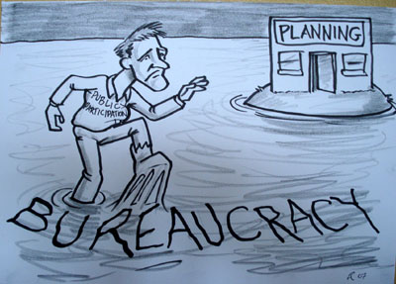

Slide 14
Group Representation Models
Pluralism or Polyarchy
Corporatism and the Scandinavian Model:
Social Corporatism VS. Polyarchy (Dahl)
Fascism
Military Corporatism
Religious Corporatism

Slide 15
What is Fascism?

Slide 16
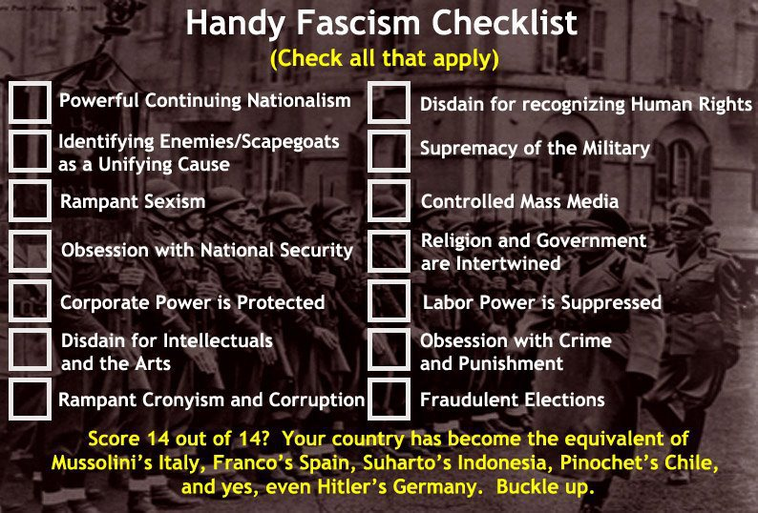
Integration of State and Society

Slide 17
Critique of Corporatism

Slide 18
Class Analysis- Debates About Social Class
Class Analysis: (Marx and his Successors)
Rural vs. Urban
Agricultural vs. Industrial collectivization
Conservative Critique of Class War

Slide 19
Class Analysis
Is Class Important?
Marx and Class
How does it impact Development?

Slide 20
Discussion of Counter-Dependency
Are We All Modernizers?

Slide 21
Development Studies Seminar
Counter-Dependency
Social Development and Human Resources

Slide 22
Human Resource Development

Slide 24
Focus of the Week
Counter-Dependency Strategies - Policy prescriptions of dependency theory and the Millennium Development Goals

Slide 25
Is This What we Are Talking About? Mini-Discussion

Slide 26
Agricultural promotion: Basic Needs and HRD

Slide 27
Counter-Dependency Strategies- Take One
1. World Systems Transformation (Wallerstein)
2. World Redistribution (Brandt Commission NIEO)
3. Social Systems Transformation (Myrdal)
4. Regional Cooperation (producer cartels)

Slide 28
Gunnar Myrdal (1897-1987)
An American Dilemma: The Negro Problem and Modern Democracy (1944)
Asian Drama: An inquiry into the Poverty of Nations (1968)

Slide 29
Counter-Dependency Strategies- Take Two
5. Self-sufficiency (autarky)
6. Delinking (or partial self-sufficiency)
7. Dependency avoidance
8. Dependency reversal
9. Dependent Development (Cardozo and Evans in Munoz)

Slide 30
Delinkage- Autarky- 18th Century Style

Slide 31
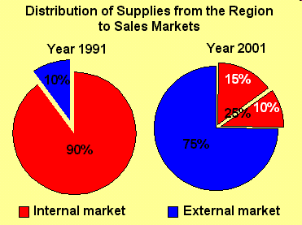

Slide 32
The Counter Dependency Synthesis: Development Management
Strategies for government action not that much different.
eg. Import substitution. Planning, basic needs and capital accumulation

Slide 33
Key: Internal Capacity Building
Counter-Dependency Framework for analysis:
Social Development, Human Capital and Social Capital
Millennium Development Goals

Slide 34
Unpaid non-political announcement: Again
On Counter-dependency strategies see Louis A. picard, "Self-Sufficiency, Delinkage, and Food Production: Limits on Agricultural Development in Africa," in World Food policies: Toward Agricultural Interdependence , William P. Browne and Don F. Hadwiger, eds. (Boulder: Lynne Rienner Publishers, 1986), pp. 121-136 and Louis A. Picard and Michele Garrity, "Dependency Avoidance, Dependency reversal and economic development: Cases from the nineteenth-century periphery," Africanus: Journal of Development Alternatives, vol. 23, nos. 1 and 2 (1993), pp. 13-29. Public Domain: On line

Slide 35
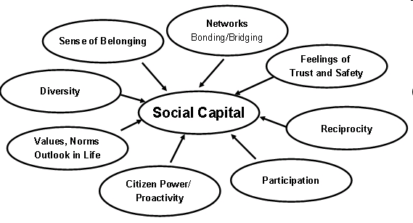

Slide 36
HRD Concepts
1. Socialization and self awareness
2. Status vs. Role
3. Counter-Roles
4. Role Theory
5. Elite Theory

Slide 37
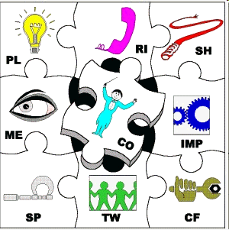
“Self awareness – give feedback on how one sees oneself, and how the rest of the team view each other”

Slide 38
World View: Status and Recruitment of Administrative Elites
a. Maximum Deferred Achievement-equitable (French revolutionary and Soviet ideal, and Jacksonian Democracy- Late Decision)
b. Maximum Ascriptive- Western European model
c. Progressive Equal Attrition- U.S. and Russian reality and aspects of German system. Partly open. Fairness depends on lateral entry (in and out)
d. Patronage and Clientalism

Slide 40
Strategy of Human Development
Understand Concepts explaining transformation
Combinations of social welfare and human resource development

Slide 41
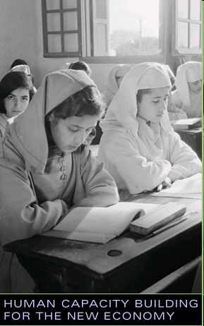
World Bank Institute

Slide 42
Alternative Choices-1
1. Human Resource Development (Skills development and Labor productivity)
2. Social Development: Health, Education and Community
3. Societal Development and Environmental Analysis (Turner and Hulme)
4. Basic Needs

Slide 43
Societal Development- A Macro-Approach

Slide 44
Alternative Choices-2
5. Management Development
6. Issues of Poverty and Redistribution (Isbister) Is there a Moral Argument?
7. Civil Society- Is this an HRD issue?

Slide 45
The Nature of Moral Arguments

Slide 46
Alternative Choices-3
8. NGOs and Development:
a. Social Development or left wing privatization?
b. Scaling-up and self-spreading
9. Social liberalism vs. social democracy (John Stuart Mills)
10. Women and Development vs. Gender and Development. What is the difference?

Slide 47
John Stuart Mills (20 May 1806 – 8 May 1873)
Liberal Thinker
The Subjection of Women (1869)
Argument in favor of equality between the sexes.

Slide 48
Discussion of Comprehensives
Reasons and Strategies?

Slide 49
Overall Question:
LDCs- Weak states vs. Strong societies or weak states vs. weak societies?
(State vs. Nation or Community vs. Society)

Slide 50
Quotes of the Week: Deconstruct Each- Quote 1
“Which comes first, the chicken or the egg?”
An Old Philosopher
Artist: Jusepe de Ribera (baptized in 1591, died, 1652)

Slide 52
Quote 2
“gemeinschaft vs. gesellschaft”
(Communal-organic vs. associational-instrumental)
German Dichotomy

Slide 53
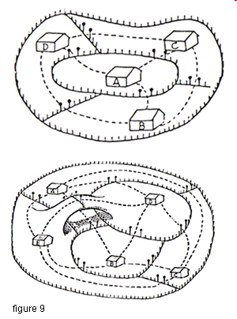
Industria vs. Agraria
A. Individualist
and secular
B. Organic and
Communal

Slide 54
Quote 3
“I discuss only those bodies of theory that can be understood within the framework of Western rationalism with roots at the philosophies of European enlightenment, with its main emphasis on interpretation and explanation, rather than normative and utopian.”
John Martinussen

Slide 55
Quote 4
“They believe that the state is part of the problem and should therefore be avoided as much as possible.”
John Martinussen

Slide 56
Quote 5
“The Third World is the creation of foreign aid; without foreign aid there is no third world.” (Look to the Market)
Lord (Peter Thomas) Bauer- 1915-2002

Slide 57
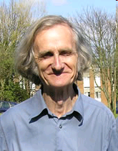
Quote 6
Rural poverty is "unperceived."
Robert Chambers
Robert Chambers
Opening speech at the Farmer First Revisited workshop held at IDS 12-14 December 2007

Slide 58
Mock Comprehensive Question for Next Week
To what extent should political issues be addressed within a developmental context? Why is political development seen to be a pre-requisite for social and economic development? What are the counter-arguments? Are there alternative models for a developed polity than the "representative democracy" model? Refer specifically to the literature on development in your response.

Slide 59
Mock Comprehensive Question:
What comes first, the chicken or the egg? Is human resource development different from economic development within a social development framework, what differences can be found? What criticism can be made of social development approaches? What are the other chicken and egg problems of development studies?

Slide 60
Workshop Exercise: Next Week as Part of Presention
Deconstruct Questions (Group One)
Provide ten references for Questions (Group Two)
Write Questions from Quotes 2-4 (Group Three)
Write Questions From Quotes 5-6 (All)

