Slide 1
PIA 3395
Development Theory

Slide 2
RED Group
Completion of Synthesis Report

Slide 3
Mock Comprehensive Question- Part of Weekly Presentation
How are theories of development related to the concepts related of dependency and modernization theories? What does each say about strategies of development management To what extent do these concepts prescribe different development policies to national level policy makers? Where does orthodox Marxism fit into the above dichotomy? Defend your views by specific reference to the literature in the field.

Slide 4
Development Policy: Discussion
Deconstruction Exercise
Comprehensive Exam
Groups:
Do deconstruction- Brief, two minute presentation

Slide 5
Reports
I. Literary Map
II. Golden Oldies of the Week
III. Synthesis

Slide 6
Development Studies Seminar
Counter-Dependency
Social Development and Human Resources

Slide 7
Human Resource Development

Slide 8
Focus of the Week
Counter-Dependency Strategies Policy prescriptions of dependency theory and the Millennium Development Goals

Slide 9
Is This What we Are Talking About? Mini-Discussion

Slide 10
Unpaid non-political announcement: Again
On Counter-dependency strategies see Louis A. picard, "Self-Sufficiency, Delinkage, and Food Production: Limits on Agricultural Development in Africa," in World Food policies: Toward Agricultural Interdependence , William P. Browne and Don F. Hadwiger, eds. (Boulder: Lynne Rienner Publishers, 1986), pp. 121-136 and Louis A. Picard and Michele Garrity, "Dependency Avoidance, Dependency reversal and economic development: Cases from the nineteenth-century periphery," Africanus: Journal of Development Alternatives, vol. 23, nos. 1 and 2 (1993), pp. 13-29. Public Domain: On line

Slide 11
Agricultural promotion

Slide 12
Counter-Dependency Strategies- Take One
1. World Systems Transformation (Wallerstein)
2. World Redistribution (Brandt Commission NIEO)
3. Social Systems Transformation (Myrdal)
4. Regional Cooperation (producer cartels)

Slide 13
Gunnar Myrdal (1897-1987)
An American Dilemma: The Negro Problem and Modern Democracy (1944)
Asian Drama: An inquiry into the Poverty of Nations (1968)

Slide 14
Counter-Dependency Strategies- Take Two
5. Self-sufficiency (autarky)
6. Delinking (or partial self-sufficiency)
7. Dependency avoidance
8. Dependency reversal
9. Dependent Development (Cardozo and Evans in Munoz)

Slide 15
Delinkage- Autarky- 18th Century Style

Slide 16
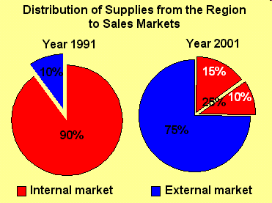

Slide 17
The Counter Dependency Synthesis: Development Management
Strategies for government action not that much different.
eg. Import substitution. Planning, basic needs and capital accumulation

Slide 18
Key: Internal Capacity Building
Counter-Dependency Framework for analysis:
Social Development, Human Capital and Social Capital
Millennium Development Goals

Slide 19
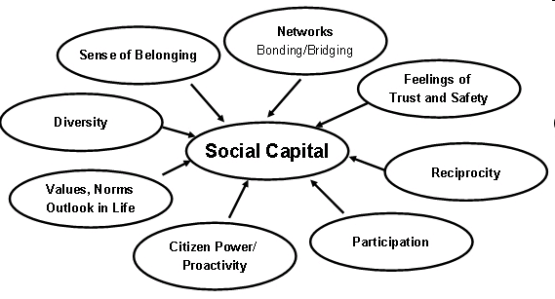

Slide 21
HRD Concepts
1. Socialization and self awareness
2. Status vs. Role
3. Counter-Roles
4. Role Theory
5. Elite Theory

Slide 22
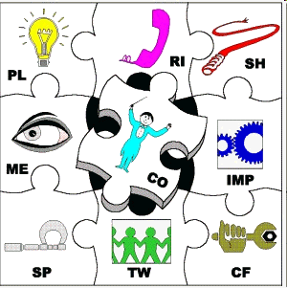
“Self awareness – give feedback on how one sees oneself, and how the rest of the team view each other”

Slide 23
World View: Status and Recruitment of Administrative Elites
a. Maximum Deferred Achievement-equitable (French revolutionary and Soviet ideal, and Jacksonian Democracy- Late Decision)
b. Maximum Ascriptive- Western European model
c. Progressive Equal Attrition- U.S. and Russian reality and aspects of German system. Partly open. Fairness depends on lateral entry (in and out)
d. Patronage and Clientalism

Slide 25
Strategy of Human Development
Understand Concepts explaining transformation
Combinations of social welfare and human resource development

Slide 26
World Bank Institute

Slide 27
Alternative Choices-1
1. Human Resource Development (Skills development and Labor productivity)
2. Social Development: Health, Education and Community
3. Societal Development and Environmental Analysis (Turner and Hulme)
4. Basic Needs

Slide 28
Societal Development- A Macro-Approach

Slide 29
Alternative Choices-2
5. Management Development
6. Issues of Poverty and Redistribution (Isbister) Is there a Moral Argument?
7. Civil Society- Is this an HRD issue?

Slide 30
The Nature of Moral Arguments

Slide 31
Alternative Choices-3
8. NGOs and Development:
a. Social Development or left wing privatization?
b. Scaling-up and self-spreading
9. Social liberalism vs. social democracy (John Stuart Mills)
10. Women and Development vs. Gender and Development. What is the difference?

Slide 32
John Stuart Mills ((20 May 1806 – 8 May 1873)
Liberal Thinker
The Subjection of Women (1869)
Argument in favor of equality between the sexes.

Slide 33
Overall Question:
LDCs- Weak states vs. Strong societies or weak states vs. weak societies?
(State vs. Nation or Community vs. Society)

Slide 34
Quotes of the Week: Deconstruct Each- Quote 1
“Which comes first, the chicken or the egg?”
An Old Philosopher
Artist: Jusepe de Ribera (baptized in 1591, died 1652)

Slide 36
Quote 2
“gemeinschaft vs. gesellschaft”
(Communal-organic vs. associational-instrumental)
German Dichotomy

Slide 37
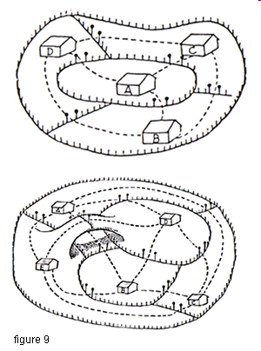
Industria vs. Agraria
A. Individualist
and secular
B. Organic and
Communal

Slide 38
Quote 3
“I discuss only those bodies of theory that can be understood within the framework of Western rationalism with roots at the philosophies of European enlightenment, with its main emphasis on interpretation and explanation, rather than normative and utopian.”
John Martinussen

Slide 39
Quote 4
“They believe that the state is part of the problem and should therefore be avoided as much as possible.”
John Martinussen

Slide 40
Quote 5
“The Third World is the creation of foreign aid; without foreign aid there is no third world.” (Look to the Market)
Lord (Peter Thomas) Bauer- 1915-2002

Slide 41
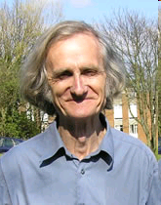
Quote 6
Rural poverty is "unperceived."
Robert Chambers
Robert Chambers
Opening speech at the Farmer First Revisited workshop held at IDS 12-14 December 2007

Slide 42
Mock Comprehensive Question:
What comes first, the chicken or the egg? Is human resource development different from economic development within a social development framework, what differences can be found? What criticism can be made of social development approaches? What are the other chicken and egg problems of development studies?

Slide 43
Workshop Exercise: Next Week as Part of Presention
Deconstruct Question (Group One)
Provide ten references for Question (Group Two)
Write Questions from Quotes 2-4 (Group Three)
Write Questions From Quotes 5-6 (All)

