Slide 1
PIA 3395
Development studies

Slide 2
Week Eleven
Decentralized Governance, NGOs and Civil Society

Slide 3
Decentralized Governance
Historical Patterns of Control: AT ISSUE is the Location of ultimate power
Definition of Power: the authoritative allocation of values
David Easton

Slide 4
Michel de Montaigne (1533-1592)
“What do I Know?”

Slide 5
Fundamental Issue
TYPES OF INTER-GOVERNMENTAL RELATIONS

Slide 6
Confederation and loose confederal relationships
Power lies with the sub-units
U.S. Articles of Confederation
European Union
Mercesor
ASEAN
Southern African Development Council (SADC)
Economic Council of West African States (ECOWAS)

Slide 7
Articles of Confederation

Slide 8
Federal Relationship
Some power lies with the National Unit
Some power lies with lower units Federalism
Can transfer additional authority back to the sub-units but not take power away from the federated governments

Slide 9
Federal Relationship Two
This is the key Distinction:
1. Lower units cannot break away from the National
Unit
2. National Unit cannot take power away from the lower units

Slide 10
Layer Cake vs. Marble Cake
Iraq?

Slide 11
Federal Relationships Three
Examples:
USA
Mexico
Canada
Germany - Federal Republic
Nigeria
Brazil
India
Russian Federation
Austria
Switzerland

Slide 12
Unitary Systems
All power ultimately lies at the national level
What power the local level has, is given to it by the national level
The power that the national unit has given to the local level can also be taken away from it

Slide 13
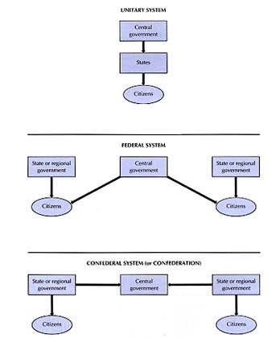

Slide 14
Unitary Systems Two
Examples:
United Kingdom
France
Denmark
Costa Rica
Thailand
Kenya
Ivory Coast
South Africa? (Unitary or Quasi- Federal)
Hungary

Slide 15
Decentralization
Forms of Decentralization
Concept: Transfer of authority to a lower level of government
Primary Unit of Government: Lowest level that carries a bureaucracy with it
Subsidiarity- Transfer authority to the lowest level of government that can handle it (European Union)

Slide 16
“Subsidiarity” in Health Care

Slide 17
Devolution: Transfer to a non-Federal political body
e.g. Budget and personnel authority to district, city and town councils (some times referred to as fiscal and administrative decentralization but really forms of devolution).
Key- political power lies with lower level politicians
Lower levels have capacity to determine and implement their decisions

Slide 18
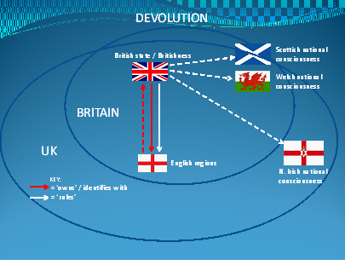
Proposed Devolution in U.K.

Slide 19
Deconcentration
Transfer of authority to administrators at lower level within the administrative system
Functional
Integrated Prefectoral
Unintegrated Prefectoral

Slide 20
Control Systems
Functional
Home Affairs
Local Govt.
Public Works
Agriculture
Education
Labor
Council
Public Works
Office
District Ag.
Office
District Ed.
Office
District
Labor
Office

Slide 21
Prefectoral – Integrated: The Hourglass
Interior
Local Govt.
Public Works
Agriculture
Education
Labor
District
Office
Council/Chief
Public Works
Office
District Ag.
Office
District Ed.
Office
District
Labor
Office

Slide 22
Prefectoral - Unintegrated
Interior
Local Govt.
Public Works
Agriculture
Education
Labor
Police
District
Office
Police
Council/
Chief
Public Works
Office
District Ag.
Office
District Ed.
Office
District
Labor
Office

Slide 23
Colonial District Commissioner

Slide 24
Other Forms
Delegation - Public Corporations or parastatals (AMTRAK)
Privatization
Program and Project Decentralization

Slide 26
Sectoral - By regular line or agency within a Ministry
E.g. Focused activity - seed production (Green Revolution)
Agricultural experiments
Education- No Child Left Behind

Slide 27
Use of Special Units
Deconcentration or Transfer of authority to central level special unit
E.g. Water, health or education projects or activities to subordinate admini-strative or council structures
PAT Buses
Board of Education

Slide 28
PAT of Pittsburgh (Allegheny County)

Slide 29
Inter-Ministerial/Departmental Committees or Units
Sometimes called “Whole of Government” Approach
Obama’s Use of Task Forces
Planning supervision
Overlapping committee memberships, e.g. Land Use Planning Committees

Slide 30
Whole of Government Approach

Slide 31
Field Level Units
Creation of field level Special Project Units with semi-autonomous status
E.g.A Range management project; or
Integrated Rural Development - Most well known type of special project
Special designated geographical areas
Multitude of project activity in different sectors that may overlap or compliment.

Slide 32
Extension Services

Slide 33
Governance and Civil Society: A Review
Networks of organizations, groups and individuals pursuing socio-economic interests

Slide 34
Various Definitions
"Beyond the family but short of the state" (Hegel)
"Human Rights, Basic Needs and the Stuff of Citizenship" (Anonymous)
Issue- (First vs. Second and Third generation Human Rights and Civil Society)

Slide 35
Georg Wilhelm Friedrich Hegel August 27, 1770 – November 14, 1831)

Slide 36
Types of Organizations
The Nature of the Beast:
Non-Profits
Not for Profits
PVOs
CBOs
CSOs
Civics (South Africa)
Foundations
Associations
Interest Groups
Quangos

Slide 37
United Democratic Front

Slide 38
Five Caveats
1. Usually excludes “for profits”- issue of contractors
2. Both International and Local
3. Internationals are not universally loved
4. Very often internationals are religious or charity based
5. Focus has been primarily on relief than development or civil society goals

Slide 39
Types of “Development” NGOs
1. Philanthropy
2. Relief and Welfare Societies
3. Public Service Contractors
4. Populist based development agencies (national)
5. Grassroots associations (local or village based)
6. Advocacy groups
7. Public Service Contractors

Slide 40
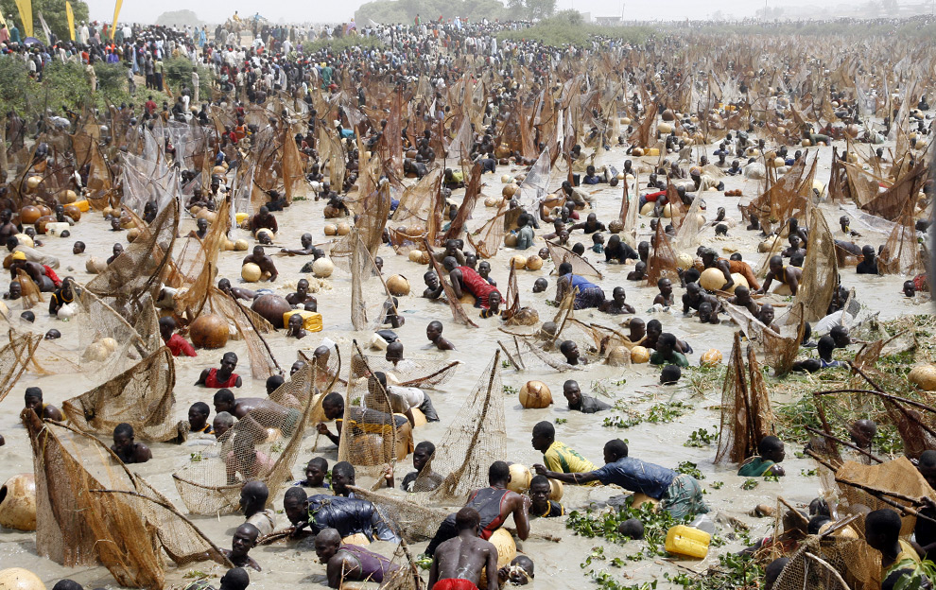
Giving Fish or Teaching Fishing

Slide 41
Traditional Focus
Disaster- Humanitarian Assistance
War, Drought, Agricultural Failure
Focus on Rural Areas
Some Have partly shifted to Developments

Slide 42
“Herbert Hoover's food relief efforts during World War I saved between 15 and 20 million European children”

Slide 43
NGOs- Areas of perceived advantage
1. Links with poor
2. Image of populism
3. Cost-effective- small but efficient
4. Innovative
5. Staff loyalty and commitment

Slide 45
International Humanitarian NGOs- Weaknesses
1. Lack of local legitimacy
2. Donor driven
3. Inefficiency
4. Amateurism- leadership and continuity problems
5. Staffing problems
6. Self-serving- own objectives: Faith Based
7. Fixation on projects- problems of replication
8. Lack of perceived accountability
9. Learning problems/lack of institutional memory
10.Tensions with government institutions- Politically threatening
11. Ties with existing local elites
12. Inability of humanitarian organizations to transfer to new development orientation

Slide 46
NGOs, Local Government, Civil Society and Democracy: A Review
1. Madison and Democracy:
a. The problem with majorities
b. Tyranny
c. Factions

Slide 47
2. Direct Democracy vs. Representative Democracy
a. Populism
b. Minority rights
c. Shifting majorities
d. Problem with Plebiscites

Slide 48
3. Polyarchy Needs
a. Interest Group Liberalism
b. Problem of zero-sum game
c. Civil Society as organizational not individual or the mass
d. The need for apathy
e. Institutional structures: Checks and balances
f. Constitutional vs. social stability

Slide 49
Where do we go from here?

Slide 50
4. Democracy focuses on:
a. Governance
b. Local Government
c. Civil Society
Unpaid Non-Political Advertisement:
PIA 2528- GOVERNANCE, LOCAL GOVERNMENT AND CIVIL SOCIETY IN ASIA, LATIN AMERICA, EASTERN EUROPE AND AFRICA

