Slide 1
PIA 3395
Development studies

Slide 2
Week Ten
Debates about Rural Development

Slide 3
Presentations
I. Synthesis
II. Literary Map
III. Golden Oldies

Slide 4
Agriculture vs. Rural Development
A. Agricultural Development
Hunting and Gathering
Subsistence Agriculture- Food
Livestock
Commercial

Slide 5
Hunting and Gathering

Slide 6
B. Rural Development
Land Use and Land Tenure
Water Points
Rural Industrialization
Micro-Credit
Integrated Development: Social and Economic

Slide 7
Land Use

Slide 8
Theories of agricultural development: Issue- Peasant farmer as decision-maker
1. Moral Economy- social and family obligations predominate
2. Rational Economy- peasants are economically rational- self serving
3. Patronage and Exchange Theory-rural dwellers seek protection in Zero Sum political Games (James Scott)

Slide 9
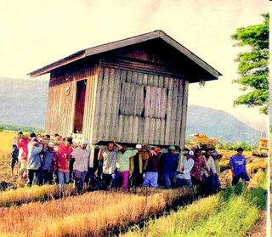
Moral Economy

Slide 10
Role of Agriculture in development- (Martinussen) (1)
a. Source of economic surplus
b. Obstacle to growth
c. Necessary pre-requisite to modernization
d. Key to development but suffers from urban bias

Slide 11
Lack of Economic Surplus

Slide 12
Role of Agriculture in development- (Martinussen) (2)
e. Potentially leading sector- eg. France and Denmark
f. Related to environmental degradation- problems of resource consumption -re. population
g. Controversy sustainable development and "ecological
balance

Slide 13
Lurpak- Danish Dairy Production
1880-2013

Slide 14
Service Delivery: NGOs, agriculture and the Private Sector (Staudt)
a. The role of government vs. the role of private sector, cooperatives and NGOs
b. Agriculture the cornerstone of rural areas
c. Issue: subsistence agriculture, little income generation or job creation
d. Controversy over export based agriculture. Add on value external to the country

Slide 15
Tea Plantation

Slide 16
Service Delivery- Two
e. Women and the effect of subsistence vs. cash crops
f. Land reform, land tenure and usufruct- The failure of Land Tenure Changes
g. Government: (Bates) Marketing Boards, prices and urban bias and the exploitation of Farmers
h. The faded glory of integrated rural development. From Social Development to Social Funds

Slide 17
Usufrict Defined
Usufruct is the legal right to use and derive profit or benefit from property (often land)that belongs to another person, as long as the property has not been not damaged or degradated.

Slide 18
Land Tenure
Usufruct
Legal Ownership
Individual Access but no ownership
Common Access

Slide 19
Models of Agriculture and private and non-profit sector (Bebbington and Farmington in Edwards and Hume)
a. Public-Private partnerships (collaboration)
b. Associations as local appointed agents of peasants- not directly representative in a self- governance sense

Slide 20
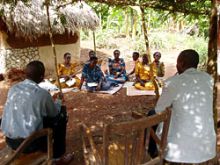
Community Based Rural Association

Slide 21
Models- Two
c. Direct involvement
(eg. water groups, producers cooperatives)
Issue: Representation and problems of scale (eg. Ostrom)

Slide 22
Direct Self Governance

Slide 23
Models- Three
d. Issue of service delivery which is non-hierarchical
i. Need to adapt to the field
ii. The Farms systems research and training and visit (T & V) techniques (Staudt)

Slide 24
Training and Visit (T&V)

Slide 25
Models- Four
e. The role of incentives for farmers: self-organization, self-management, and its alternatives
f. NGOs as contractors (Beltway Bandits)

Slide 27
Quotes- Discuss each. One:
“Agriculture is about ‘getting the prices right’“
A Public Choice Mantra

Slide 28
Two:
"Collective self-management of the resources is a socially and culturally embedded institutional arrangement..."
Martinussen on Ostrom

Slide 29
Three:
"The patron-client relationship [is] an exchange relationship between roles."
James C. Scott

Slide 30
Mock Comprehensive Question
Mock Comprehensive Question. How is development theory impacted by the debate over agricultural and rural development? What are the practical implications of the different "theories" of agriculture on farmers, governments and NGOs? Critique the literature on rural transformation, agricultural development and management.

Slide 31
Exercise
Each Group:
Deconstruct Question with ten references
Write questions for each quote

