Slide 1
PIA 2501
Development Policy and Management
WEEK SIX

Slide 2
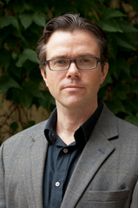
Who are the authors?
Paul A. Haslam, Jessica Schafer and Pierre Beaudet
Introduction to International Development: Approaches Actors and Issues (Oxford, UK: Oxford University Press, 2009).
Paul A. Haslam, University of Ottawa

Slide 3
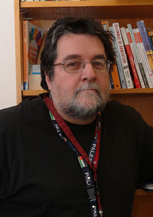
Both from the University of Ottawa
Pierre Beaudet
Jessica Schafer

Slide 4
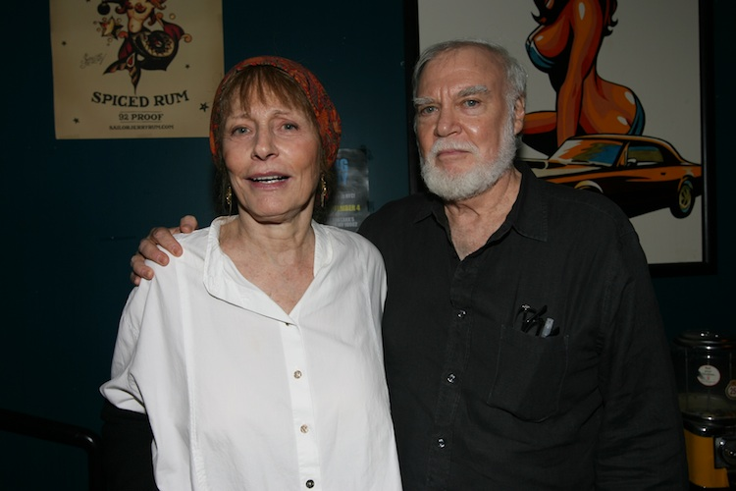
Case Studies: Norman and Elsa Rush, Co-Directors, Peace Corps Botswana, 1978 to 1983

Slide 5
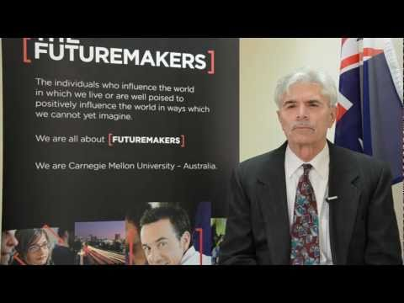
Terry Buss, Director Carnegie Mellon Heinz School in Australia

Slide 6
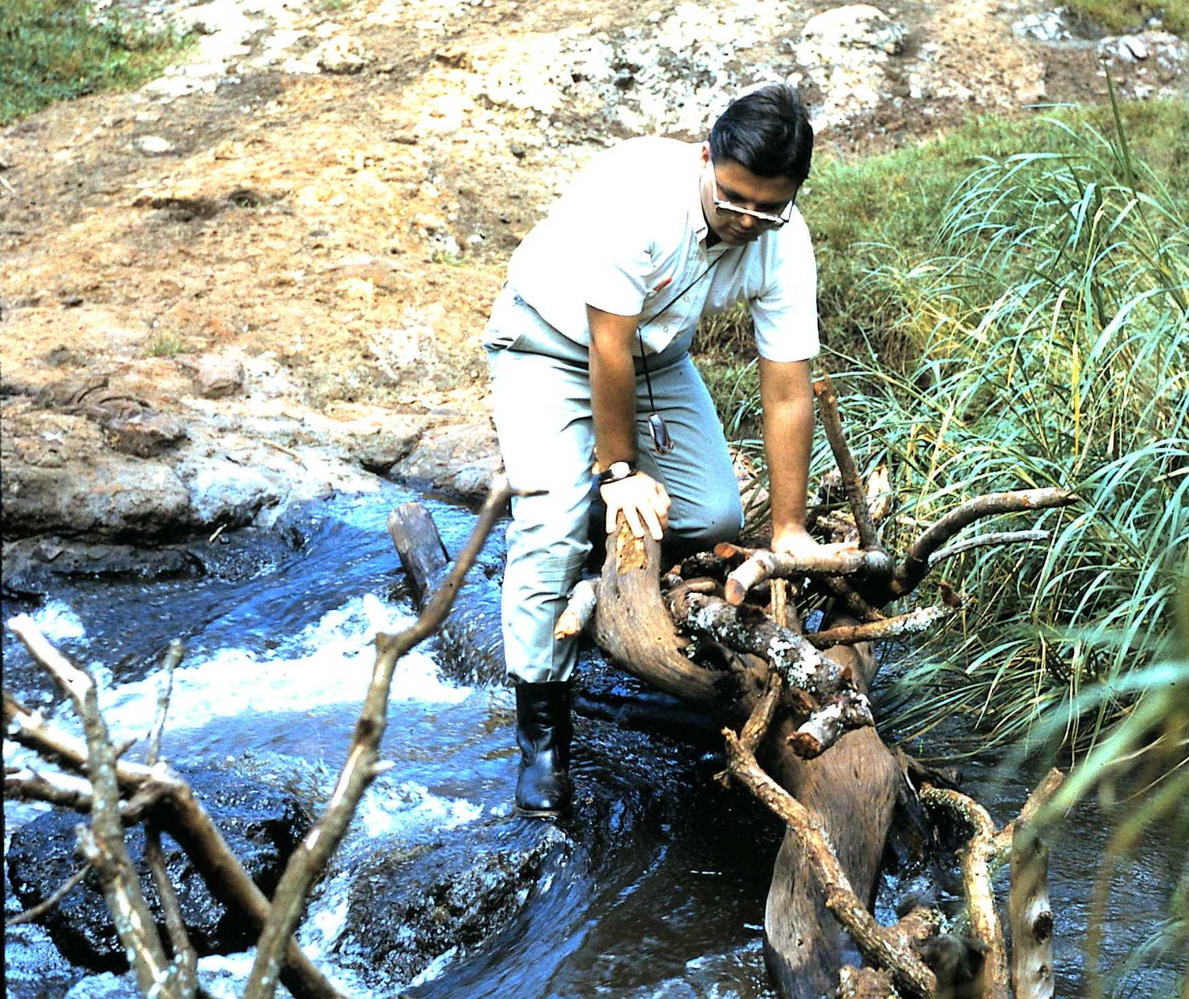
The Socialist, 1967

Slide 7
Discussion
Picard "Socialism and the Field Administrator."
Haslam, et. al., Chapters 8 and 9
Picard and Buss, Fragile Balance
Norman Rush, "Alone in Africa and
Rush, "Near Pala" both from from Norman Rush, Whites

Slide 8
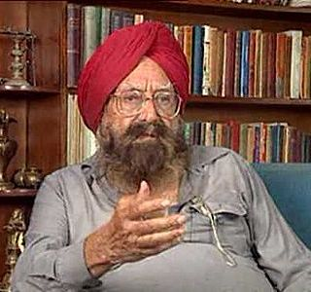
Books of the Week
Kurban Said, Ali and Nino
Kushwant Singh, Train to Pakistan
Kushwant Singh, (born 2 February 1915)

Slide 9
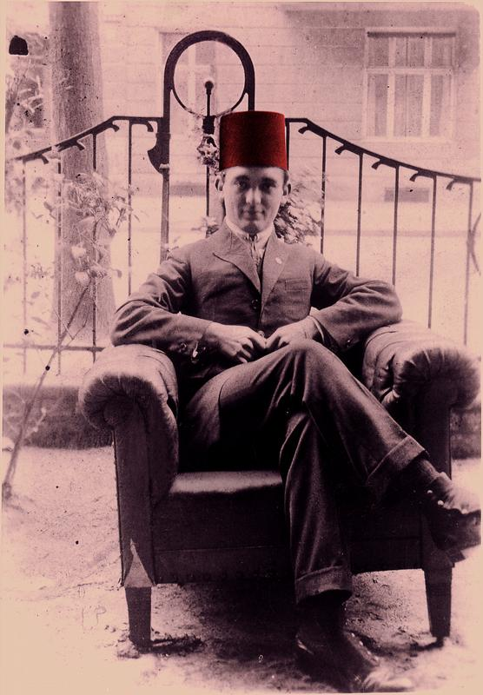
Kurban Said
Said to be Lev Nussimbaum (Kiev, 1905 – Positano, 1942), who also wrote under the name Mohammad Essad Bey, was a writer and journalist, born in Kiev to a Jewish family.

Slide 10
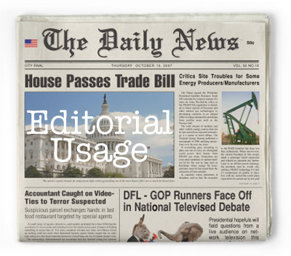
PICARD
“Unpaid Editorial”

Slide 11
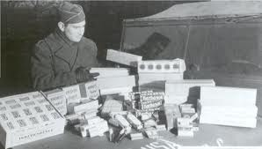
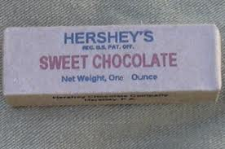
Theme Seven: Foreign Aid Debates

Slide 12
The Problem (1): Bad Planning and Foreign Aid
1. Bureaucrats/practitioners ignored development theories & ideas
2. LDC Development Institutes were largely irrelevant as training centers--donors used overseas training
3. International Organizations (UNDP, IMF and World Bank) promoted Programs that were unworkable.

Slide 13
The Foreign Aid Meeting

Slide 14
The Problem (2)
Development administration did little to deal with issues of population control, food production and rural development
Foreign aid was seen as little more than a front for foreign policy
Failure to address issues of Health and Education

Slide 15
But….
Donors Need Planning Skills (Still)
“National Program Support Office, Afghanistan” (October, 2005)
Project Management Unit (PMU)

Slide 16
Autonomous Work Packaging Model

Slide 17
Planning Became Project Planning
“End of Editorial”

Slide 18
What is the Answer?

Slide 19
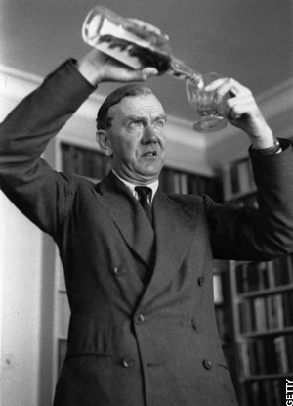
The Problems of Foreign Aid and Development Management
Quote of the Week: The Quiet American- An Alternative to expatriate involvement?
Non-Involvement?
"The Human Condition being
what it was, let them fight, let
them love, let them murder,
I would not be involved.“
Graham Greene

Slide 20
Late Colonial Philippines

Slide 21
Discussion: Stanley Karnow: “In Our Image?”
In Our Image (France, U.S., Portugal)
Is assimilation the answer?
In the Philippines, South East Asia, Middle East /Africa?
Latin America: Just Spain?
Died January 27, 2013 (87Years old )
Notes:
21

Slide 22
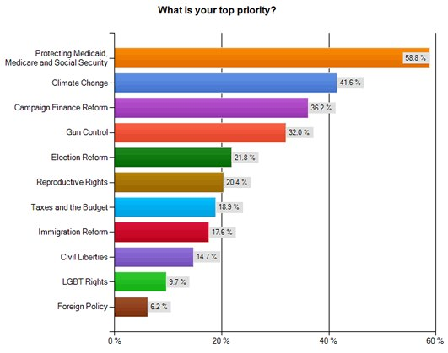
How Important is Foreign Aid?

Slide 23
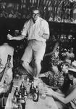
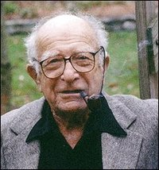
William J. Lederer and Eugene L. Burdick- The Origin
(March 31, 1912 to December 05, 2009)
(December 12, 1918–July 26, 1965)

Slide 24
“ “The Book of the Week Club” A Book Worth Reading
William Lederer and Eugene Burdick, The Ugly American
What message do these give us about foreigners in Asia and Africa
What message do the books give us about “development” or the lack of it.
What criticism would you make of the books?

Slide 25
Who is the Ugly American?
Background: Origins of U.S. Foreign Aid Policy
Marshall Plan and Point Four Program
Agricultural College Bias
Ugly American and the Peace Corps (and the other “peace corps”)
Technical Assistance in Vietnam
Models of Malaya and Kenya
“Hearts and Minds” (French term, taken to Viet Nam, later used in South Africa, Iraq)

Slide 26
Vietnam

Slide 27
Authors of the Week
U.S. Administrators and the “official U.S.” Need to outwit the communists; find the “decent Asian”
American compound mentality: the “overseas American” sees unusual and unorthodox as “threatening”
Basic ideology of the 1950s—Image of Russian officials: cultural and linguistic sensitivity
U.S. Press—seldom writes about foreign policy and when they do, focus is on those who are “threatening” U.S. interests
Religion: able to penetrate LDCs, and recruit indigenous allies

Slide 28
William Lederer and Eugene Burdick, The Ugly American
Major Themes
Various meanings of the term, “ugly american”
Types of Americans overseas
The U.S. Foreign Service in 1958
Midwestern Salt of the Earth
“Hearts and Minds”

Slide 29
From the Authors
William Lederer and Eugene Burdick- Journalists- Say Non-Fiction
Characters—their significance
Development Officials
Communist “followers”
Dairy Specialists and “Engineers”
Priests
Secretaries as Lacking in Sensitivity

Slide 31
Millennium Development Goals: Eight Goals for 2015

Slide 32
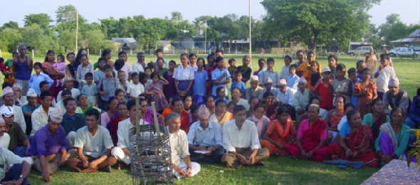
Social Mobilization Training Still Around

Slide 33
The Middle View
The Moderate Interpretation of Development Administration Failures
Goal: Realistic Decision-Making based on sufficient knowledge (strategic planning) “Mixed Scanning”
Balance Public-Private Partnerships

Slide 34
The Twenty-First Century Model Redux

Slide 35
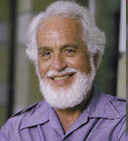
Denis A. Goulet, 75, died December 26, 2006: Appropriate Theory and Practice

