Slide 1
PIA 2501
Development Policy
And Management
Week Three

Slide 2
IMAGES Are Important
Where we have been and Where we are going.

Slide 3
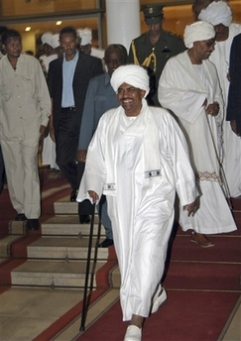
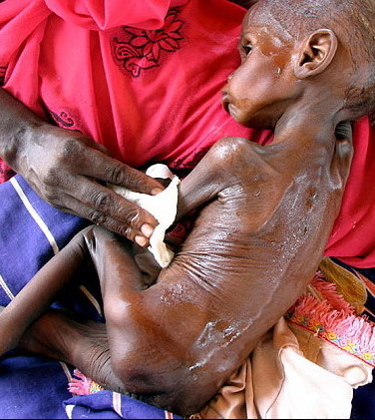
Sudan: A Case Study
President Omar al-Bashir
“Sleepless in Sudan”

Slide 4
The Sudan Legacy
Update on South Sudan Video
New York Times, January 13, 2012
Close to 60,000 Deaths Since July, 2011

Slide 5
This week’s Themes

Slide 6
Overview of Course Themes: From Your Readings
Links with (and Legacy of) Colonialism
Theories of Modernization
The End of the Cold War
Debates About Donors
The Focus on Governance
Critiques of Modernization
Underdevelopment and Dependency

Slide 7
PIA 2501: Development Policy and Management
1. The Legacy of Colonialism: The Anthropologists? Discussion Last Week.

Slide 8
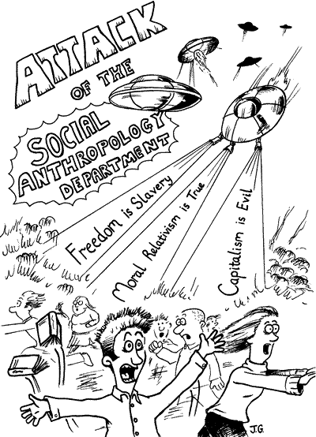

Slide 9
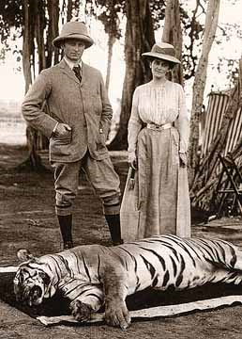
The Impact of Colonialism and Imperialism on Development Theories
Note: Colonial Origins-
Anthropology- “Primativism”
Colonial Mission
was Modernization,
Nationalism
and Development
Anthropology Traced
Patterns of Change
Traditional vs. Modern

Slide 10
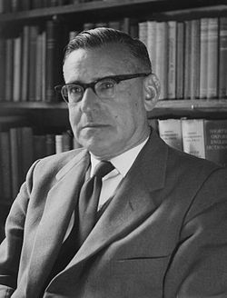
Development Theory Review
In 1950, There existed…
Colonial Anthropological Theories
Rhetoric of Nationalism throughout world
Political change and independence
The Rhetoric contrasts with public sector continuity and debate about its role in economic development
Beginnings of Cold War
Picture Above: Isaac Schapera (23 June 1905 Garies, South Africa – 26 June 2003 London, England), was a social anthropologist at the London School of Economics

Slide 11
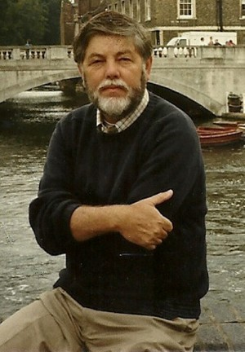
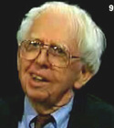
The Rising Sun- The Decline and Fall of the Japanese Empire
THE IMPACT OF EMPIRE
Joseph N. Weatherby had been Professor of political science at Howard Payne University (1936-12010),
The Other World
John Toland, Historian and Journalist,
World War II Specialist, (1912-2004)

Slide 12
"The good life" for Rhodesian whites, taken from Rhodesian government booklet promoting white immigration, 1970

Slide 13
Meet Some of the Anti-Colonial Authors

Slide 14
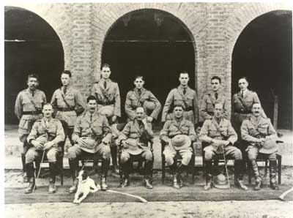
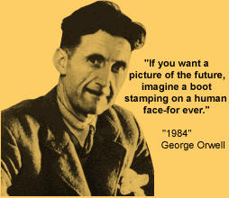
George Orwell (1903-1950)
1984, Animal Farm. A Democratic Socialist and anti-totalitarian (Stands Third from Left in Burma in 1923)

Slide 15
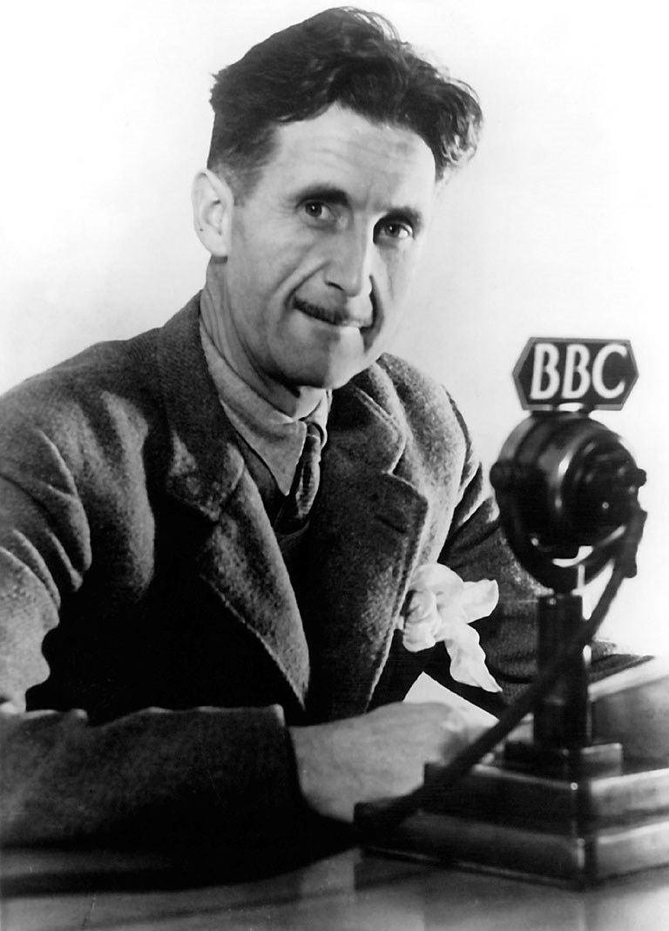
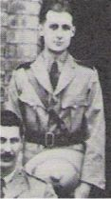
George Orwell,
Anti-Colonial Critic 1903-1949
Below in Burma

Slide 16
Nyasaland- March 1959

Slide 17
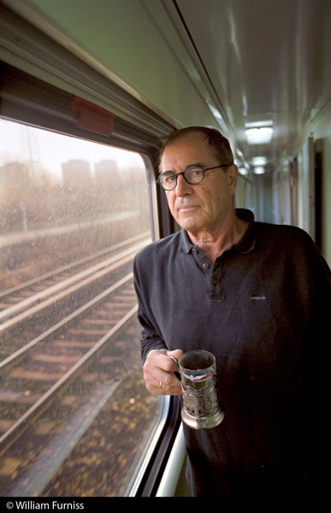
Influence: Transition Authors
Paul Theroux- “Tarzan as an Expatriate”
Peace Corps, 1963-1965
Born | 10 April 1941 (age 71) Medford, Massachusetts
Occupation | Peace Corps Volunteer, Malawi Novelist, Travel writer, short story writer, literary critic
Nationality | American
Started Writing | 1967

Slide 18
2. Theories of Modernization
MODERNIZATION: Major Theme

Slide 19
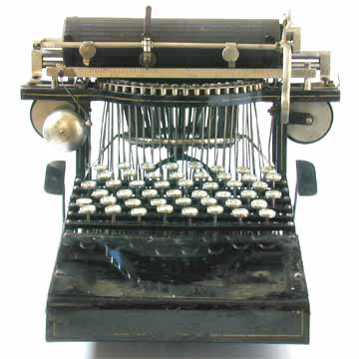
Modernization

Slide 20
Modernization, Development Theory, and its Critics
A. Agraria vs. Industria

Slide 21
Development: The Modernization Definition
Agraria
Attitudes: parochial – fixed rules
Customs: particularistic / inherited
Status: ascriptive
Functionally: diffuse
Holistic Change
Lack of Specialized Roles
Result
Agricultural, rural, poor
Oral / illiterate
Authoritarian instability
Subsistence – non-monetary
Revolution and violence
Occupation fixed
Industria
Universalistic
Legal / Rational
Achievement Oriented
Roles Functionally Specific
High Degree of Technology
Manufacturing and Production
Oriented
Result
Commercial
Democratic / Peaceful
Occupational mobility
Literate
Urban, Rich
Incrementalism, Stability and Gradual Change

Slide 22
Beginnings of Development Theory- 1950s
There existed…Many terms
Division of the world in the 1950s and after
Non-Western Colonial Dichotomy
Third World—West, East and "Non-West"
Developing States and Modernization
North vs. South states
More Developed vs. Lesser Developed Countries—LDCs
Keynesianism

Slide 23
John Rapley, Caribbean Specialist University of Mona, Kingston Jamaica
Keynesian
Research Associate -International Growth Centre, London School of Economics and Political Science

Slide 24
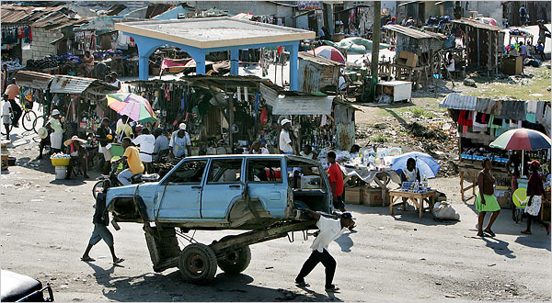
C. Concept of Modernization, Continued
Haiti: City Image
Dual Society / Dual Economy: Characteristics:
Tradition is source of poverty and underdevelopment
Modernization assumes dual economy with an enclave modern sector

Slide 25
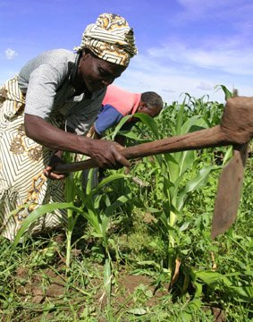
Concept of Modernization, Continued
Characteristics:
Concept of Empathy
putting oneself in the position of others, according to Daniel Lerner in The Passing of Traditional Society
Mobile personality or acceptance of new ideas
Series of individual changes affect society, including secularism, literacy, and urbanization
Society changed by mass based communications

Slide 26
Empathy?

Slide 27
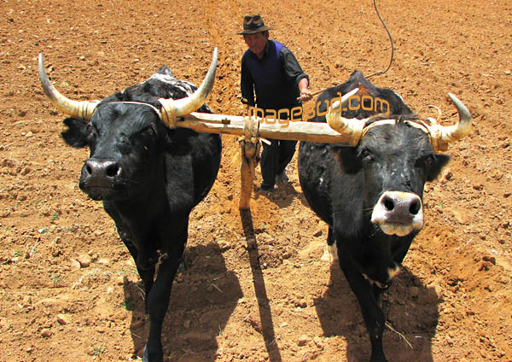
Modernization, Continued
Movement from traditional to modern (and rural to urban) in all societies
The “West” has distinguishing characteristics which distinguish it from Third World
Result is an assumption of Dichotomy
(references include writing by Talcott Parsons, Marian Levy, Frank Sutton and in modified form Fred Riggs)

Slide 28
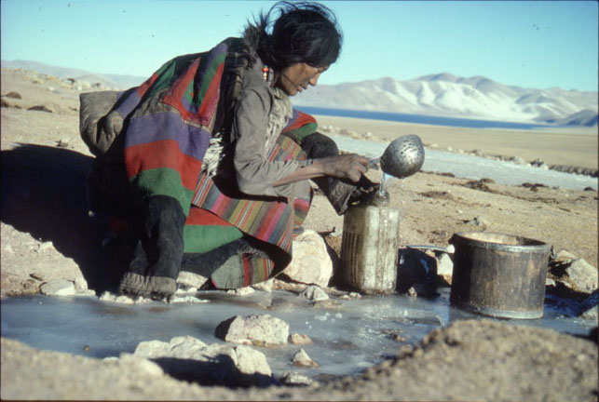
Concept of Modernization
Characteristics:
Social Mobilization (focus on value change)
Defined the process in which old social, economic and psychological commitments are “shaken off”
Social mobilization, and for some, forced value change was the key to modernization
Social Engineering

Slide 29
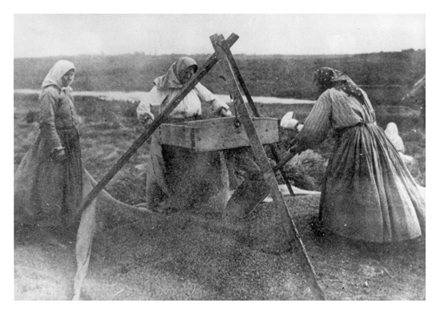
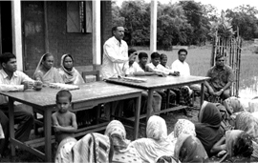
Social Mobilization- Continued
Advocates call for use of the mobilizing party for social engineering purposes
Goal became the use of the state to break down personal (organic) values and integrate modern values into a common political and socio-economic change system

Slide 30
AUTHOR OF THE DAY
Kathleen Staudt: Author, Professor of Political Science, University of Texas at El Paso
Peace Corps Volunteer in the Philippines (1966-1968) Researcher in Kenya- 1970s. Current focus, Mexico and U.S. Border issues
Raised Questions- Is there a grass-roots perspective? Role of Gender?
Why or Why not?

Slide 31
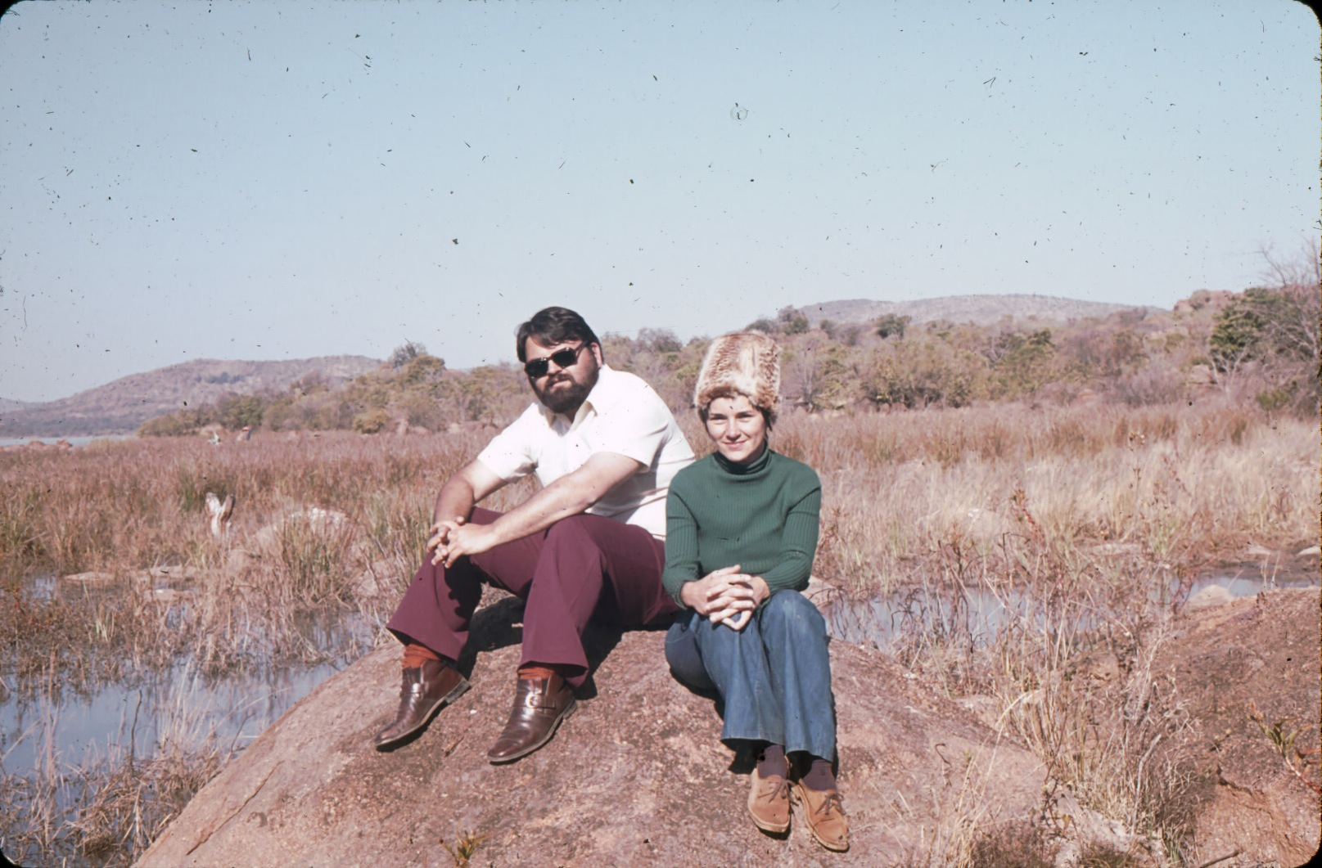
Staudt in Botswana, 1975

Slide 32
Gender and Development: Modernization vs. Traditionalism
Sue Ellen M. Charlton
Is gender discrimination a product of colonialism or traditionalism?
Is Gender different in developing societies?
How are women under counted?
Is it a gender issue or a women’s issue?

Slide 33
Sue Ellen M. Charlton

Slide 34
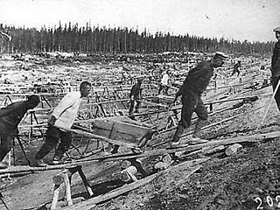
3. The Impact and End of the the Cold War
Dates: 1948-1991
Impact of Soviet Union on the Development Debate
Heavy Industrialization

Slide 35
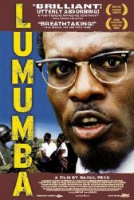
The Cold War
Proxy Wars
New and Old

Slide 36
There Existed…The World Between 1950 and 1989
North America, Antipodes, Western Europe and Japan (First World)
The self-described socialist states—Eastern Europe, Soviet Union, China, most of South East Asia and Cuba (Second World)
Africa, most of Asia, Latin America, Middle East and Caribbean (Third World)

Slide 37
The Arms Race

Slide 38
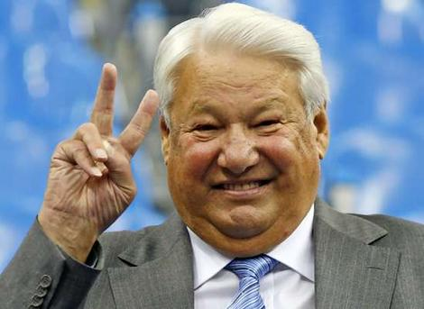
The Development Period
Begins with Arms Race of 1950s and ends with civil society and the collapse of the Soviet Union (1991)
Out of this comes the Transitional states as part of the developing world.
Ten Year Interregnum
to September 11.
Three “Ds”

Slide 39
The End of the Cold War: 1991-2001
An expansion of the “concept” of developing and transitional states
Were also called “Newly Industrializing” or “Newly Emerging” or Transitional States
Impact of End of Socialism
Eastern Europe, Balkans, Turkic and Asian States, Russia, Ukraine and Belarus
Impact on “third world socialism” in Latin America, Africa and Asia

Slide 40
Ethiopia, 1991

Slide 41
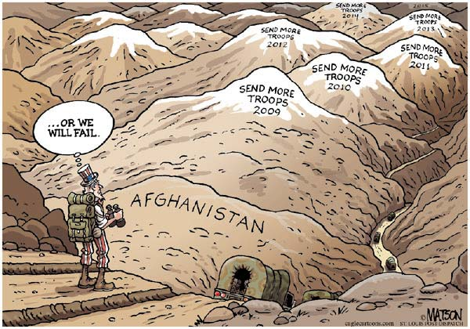
War in Afghanistan?

Slide 42
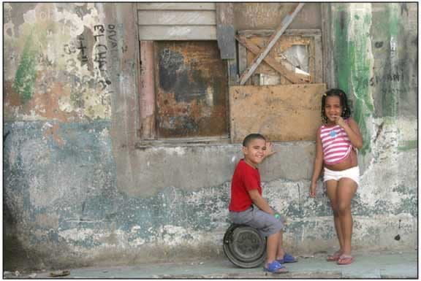
Poverty in Cuba

Slide 43
Development
4. Debates About Donors

Slide 44
Author and Donor Critic
Norman Rush:
Whites
“Alone in Africa”
“Near Pala”
Rush is the Author of two other books on Botswana
Mating
Mortals

Slide 45
The U.S. Peace Corps
Are Peace Corps volunteers “Modernizers?”
Are Peace Corps volunteers and other development workers like colonial agents?
Empathy and the foreign worker?
Norman and Elsa Rush—Co-Directors of the U.S. Peace Corps in Botswana from 1978 to 1983

Slide 46
Patronage in Mongolia

Slide 47
Break Time
TEN MINUTE BREAK

Slide 48
Political Development
5. The Focus on Governance
The Importance of Satire

Slide 49
Democracy and Governance
Model became western parliamentary (representative), the rule of law and political systems based on democracy and Governance Principles
At issue: Which comes first, political or economic development?
Role of Civil Society- Pluralism

Slide 50
Part of Concept of Modernization
Political Development
Two Themes- Monte Palmer
The Governance Perspective
Political Development is a prerequisite to social and economic development
Traditional society and modern society is a dichotomy

Slide 51
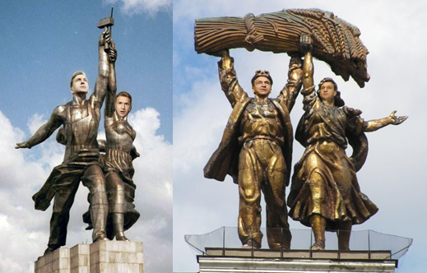
Concept of Modernization- Political Development
Governance Argument (political development as key)
Characteristics: Democracy and Governance vs. Bureaucracy
Bureaucratic Class (according to Manfred Halpern) are “modernizers” since only bureaucracy can penetrate rural areas
What is needed is a coalition between government leaders, the bureaucracy and industry (John Kautsky)
Russian State Heroes- 2007

Slide 52
The Problems of Development Management
Quote of the Week:
"...political systems in the developing areas must bear increasing responsibility for mobilizing the state's human and material resources in support of the objectives of economic and social mobilization."
Monte Palmer

Slide 53
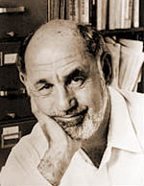
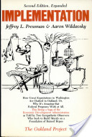
AUTHORS’ Themes-
Jennifer Brinkerhoff, Professor, Elliott School, George Washington University- Public-Private Partnerships- The use of Grants (Born,
Jeffery Pressman (Died in 1977) and Aaron Wildavsky (1930-1993- Implementation: Why plans do not become reality (Oakland, California)

Slide 54
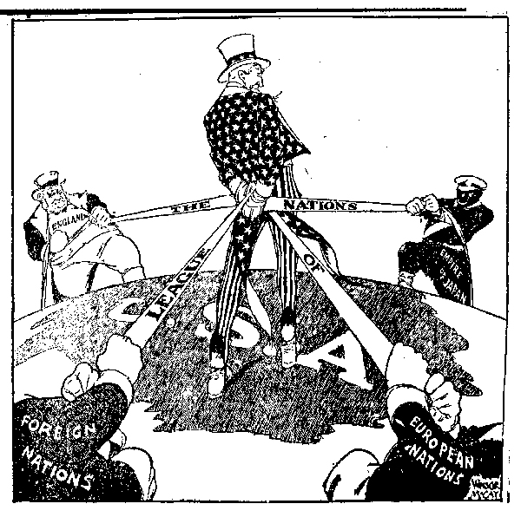
Debates: An Isolationist Cartoon, 1930s
6. Critiques of Modernization

Slide 55
Critiques of Modernization Theory- 1
Interpretations of Pre-Colonial Society
The heart of the matter: Pre-colonial and pre-modern society is characterized by violence, poverty and "Primitivism”
Modernization theory is based on this assumption (Joseph Conrad, Heart of Darkness Image)
The ecological approach and dependency theorists reject this
At issue is the idea of “balance”
Individuals and social groups were in balance with their physical environment

Slide 56
Joseph Conrad

Slide 57
Critiques of Modernization- 2
Ecological View: Characteristics
People lived in "Primitive" communism and were hunter/gatherers
Subsistence farmers, grew grains and forged metals- They were in balance with environment
“Praxis” allowed individuals to control their interaction with nature

Slide 58
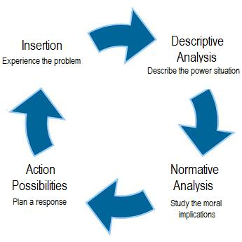
System in Balance

Slide 59
Ecological View
Direct creative activity was used to procure food and shelter, through the use of own tools. Natural Life
This was the Rousseauian Natural “Man.”
Jean-Jacques Rousseau
(28 June 1712 – 2 July 1778)

Slide 60
The Ideal?

Slide 61
Ecological View
Change came with the development of excessive surplus, imbalanced trade, the creation of elites, domestic rule and then international empires.
Rome, China, and the land based Empires in Europe ending with Sea-Based Empires

Slide 62
A Natural Balance?

Slide 63
Critiques of Modernization Theory-3
Colonial Underdevelopment Argument: The Psychological Dimension
Focus of the debate—resistance vs. collaboration and its impact upon post-colonial society
Colonizer has an inferiority complex (Minnoni)
Colonial vs. colonized: (Memmi) colonized peoples have a dependency relationship with the West. It is based on the colonizer’s search for economic gain
Revolution as a cleansing process (Franz Fanon)

Slide 64
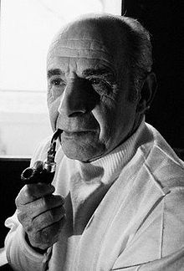
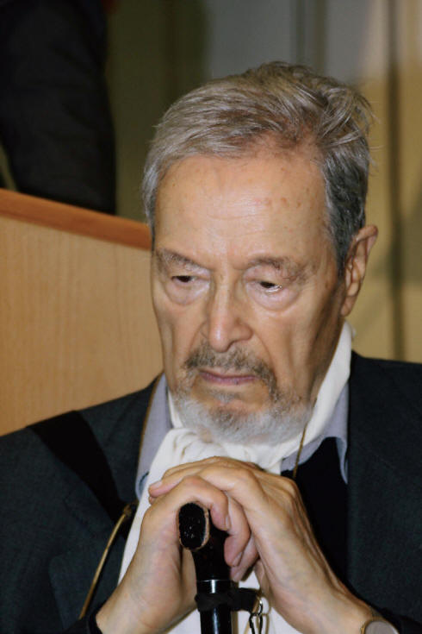
Octave Mannoni and Albert Memmi

Slide 65
Prospero vs. Caliban
Prospero—In exile, isolated and inferior
Caliban—Dependence and the Fear of Abandonment
Further Reading:
Franz Fanon, Wretched of the Earth (New York: Grove Press, 1963).
O. Mannoni, Prospero and Caliban: The Psychology of Colonization (New York: Praeger, 1964)
Albert Memmi, The Colonizer and the Colonized (New York: Orion Press, 1965)

Slide 66
CALIBAN
The Half Human Offspring of the Devil and a Witch who is a Servant of Prospero
in “The Tempest”

Slide 67
Critiques of Modernization Theory
Colonial Underdevelopment Argument
Seeds of Violence and
Cognitive Dissonance
Role conflict (Robert Merton)
Indirect rule vs. assimilation
Role set (conflict between
colonial officials and Religious
or traditional leaders)

Slide 68
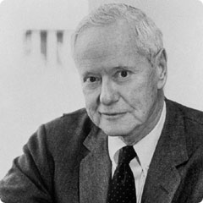
Robert Merton and Cognitive Dissonance

Slide 69
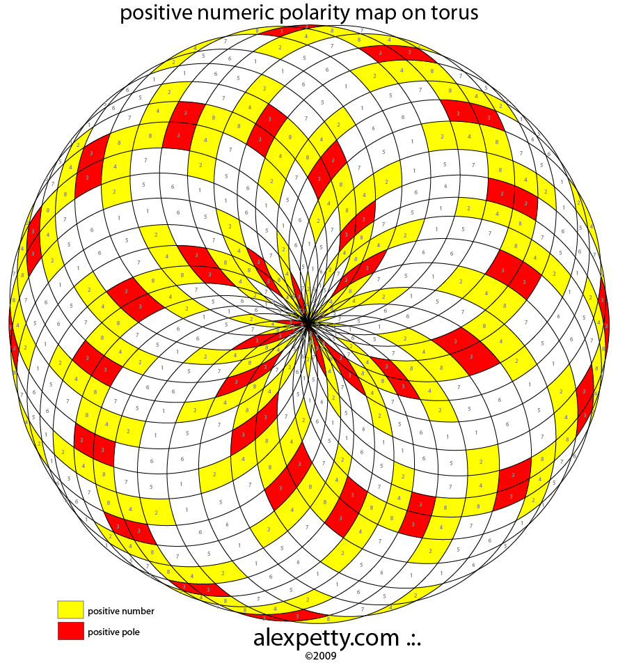
Critiques of Modernization Theory
Colonial Underdevelopment Argument
Traditionalism: Dichotomy or misplaced polarity (Gusfield)
Co-existence in Saudi Arabia and Japan
Modernization of Tradition in Swaziland
Secularization of tradition in Mexico

Slide 70
Critiques of Modernization Theory
Interpretations of Underdevelopment and “Third Worldism”
Underdevelopment theorists critiqued Modernization Theory:
Modernization theory had its origins in Colonial ideology and the anthropological ideas that supported it.

Slide 71
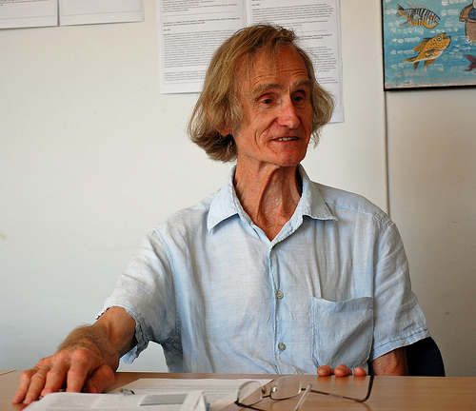
Interview Robert Chambers Research Associate at the Institute of Development Studies, University of Sussex, United Kingdom
He was born in 1932 and is an academic and development practitioner
Equity not Growth
Advocate of the
“participatory“
approach to
development

Slide 72
7. Underdevelopment and Dependency
Structuralism
Biology in the Tropics
Inelasticity of Tropical Products
Rigidity of Extractive goods

Slide 73
“Underdevelopment in History”
Rejects Dualism and “stage theories” of development (Keith Griffin)
Africa, Asia, Latin America not historically under-developed
European nations took slaves, metals and raw materials to build industrialization and grow their economies between 1500 and 1900
Empty Bucket- Full Bucket

Slide 74
Dependency Theory
and the beginnings of Dependency theory
Structuralism and
Interpretations of Underdevelopment and “Third Worldism”
In the beginning (1500) LDCs were self-sufficient at low level
Argument: Europe used its empire to market surplus goods and pay sub-economic costs for raw materials, agricultural products and minerals

Slide 75
FINAL CRITIQUE: Development Tourism?

Slide 76
Dependency Theory
During 500 Years of colonialism Northern Tier states used colonialism to extract from LDCs
Result often was the destruction of local production, agriculture and food production
The colonial government supported export import trade and where possible, SETTLERS
Europe became dependent on extraction from the “third world”

Slide 77
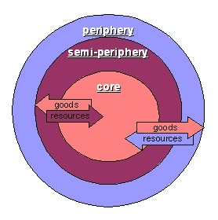
Dependency Theory VIDEO
Debates
About Chile

Slide 78
NEXT WEEK
THE LIMITS OF DEVELOPMENT MANAGEMENT: The Bureaucracy and the Post-Colonial State
“The Chicago Boys”

