Slide 1
PIA 2501
Development Policy and Management

Slide 2
Teaching and Training
A 21st Century Image?

Slide 3
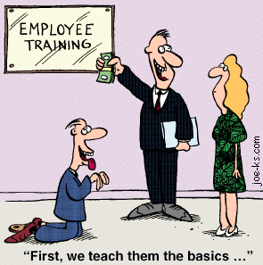
Human Resource Development: Return to the Issue
HRD/Training

Slide 4
Education and Training: Bounded Knowledge vs. the Synthetic Mode of Thought
Knowledge Base
  The problem of bounded knowledge: no short cuts to education
  The key to the short-term experience: designer training
  Organizational Development
  Public Sector Higher Education System

Slide 5

Public or Private: Does it Make a Difference?

Slide 6
Temptations of “Bridging” Training
Short 3-6 Week Training Program, in-country or overseas
Can substitute for the Experience of a University Education
Training best focused on skills not complex systems and knowledge

Slide 7
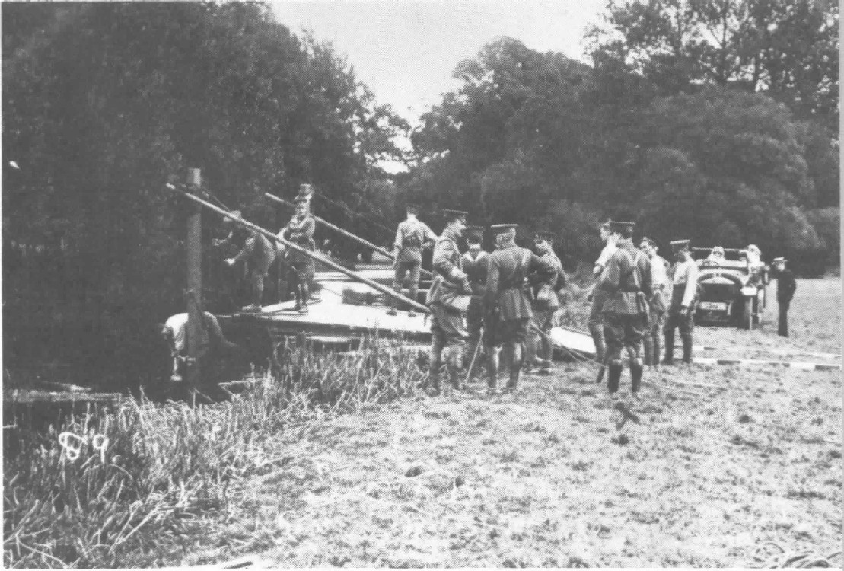

Slide 8
Temptations of “Bridging” Training
Extent to which the administrative culture reflects a high degree of paternalism
One needs flexible people, with flexible minds

Slide 9
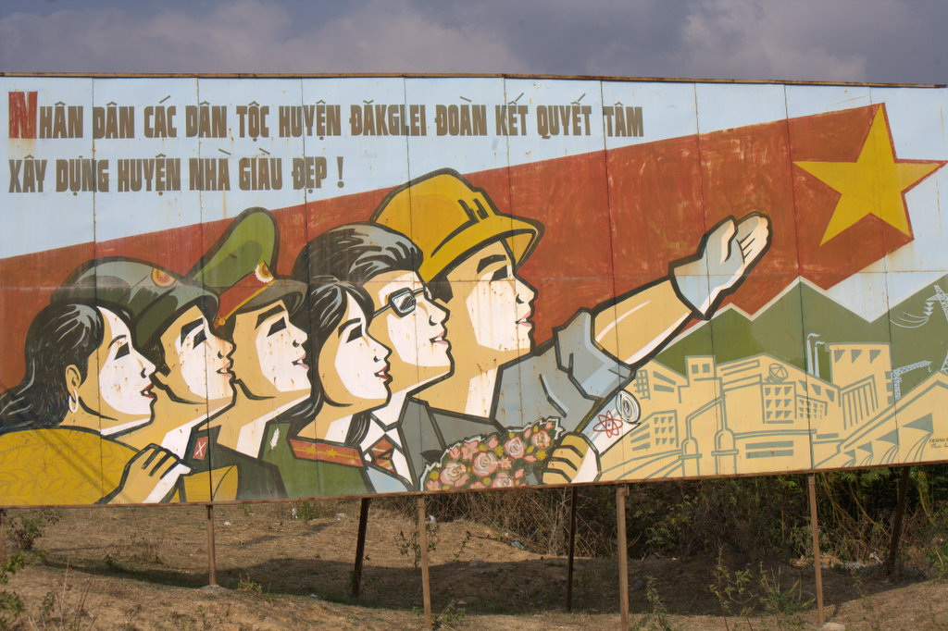
The Vietnam Bureaucratic Apparatus

Slide 10
Temptations of Bridging Training
The new administrators in Transitional states
First vs. second generation: The bridging generation can block the next generations

Slide 11
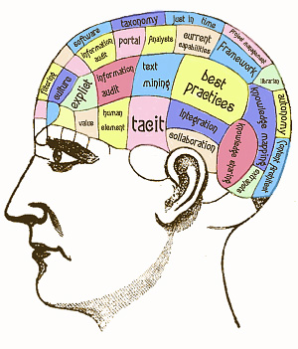
Problem of Bounded Knowledge
The Concept: Don’t know what you don’t know
Need for gradual retirement of existing Politicians Administrators and a staggered bridge
Most Stay On.

Slide 12
Problem of Bounded Knowledge
The time factor
  Professional and technical skills and "the art of management“
Administrative culture
  Issue of debate and discussion within the public service or private/NGO sector(problem of conformity)
Criticism of tunnel vision
  Mentality of the old nuts and bolts mechanisms within the context of a centralized state

Slide 13
Education and Training:
Education:
  Entry Requirements The MPA style degree?
  The role of University programs
  Is Education Important?

Slide 14

What does it Mean? Discussion

Slide 15
The Synthetic Mode of Thought
Unstructured Skills of judgment and management
Meets the need for creative thinking in sciences, Mathematics and Humanities
Bottom line: Creativity
Is there a need for a University Education- Professional Education vs. PhD?

Slide 16
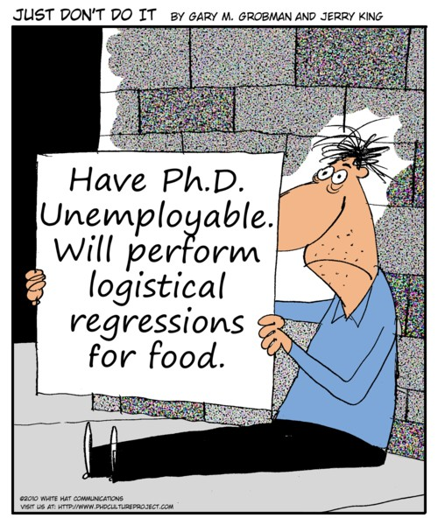

Slide 17
Education and Training
  The Prospects and Limits of training: Problems of management skills
    Basic Techniques and Processes (e.g. Computers and Quantitative Skills)
    How much Consciousness Raising?
  Development Management vs. Management Development
    The debate over Human Resource Development
    Chicken and Egg Redux

Slide 18
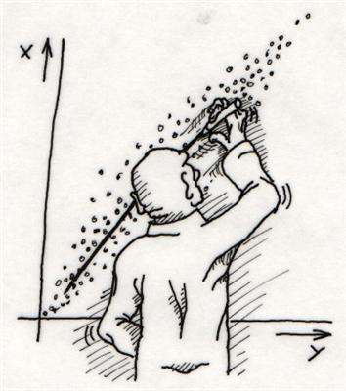

Slide 19
Education and Training:
Education in Public Management, Personnel, Financial Management, Management Information Systems (Masters Degree as a Professional Degree)
  Public Policy Analysis and Issue Areas
  Public Administration
  Political Institutions and Processes
  Macro and Micro Economics
  Development Policy and Management (NGOs)

Slide 20


Slide 21
Training and Education
The role of overseas training and education: Problems of technical assistance
  Role of donors and the policy process
  Donor provision of planners and administrators
  The attractiveness of Bridging Training
  The Brain Drain Issue

Slide 22
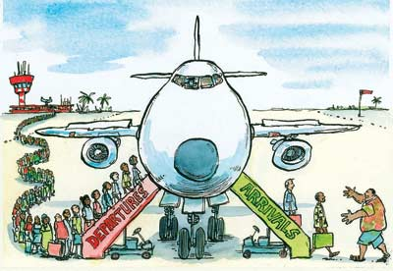
The LDC Problem

Slide 23
Human Resource Development Background
The Problem- Nature of the “promote socio-economic change bureaucracy” Can it?
Legacy: The nature of the stratified Civil Service
  Segregated or class based systems
  Elitist
  Generalist, legal or technical
  Extractive?
  Law and Order

Slide 24
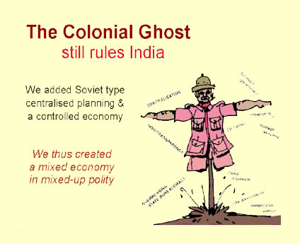
Indian Cartoon

Slide 25
Human Resource Development
Role of the state in economic development
  Nature of the mixed economy
  Management of public corporations
  Role of regulation trust busting
  Reputation of the African economic model
    Asian, European and Latin American comparisons (South Africa as a NIC)

Slide 26
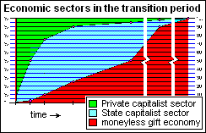
Growth of State Led Economy

Slide 27
The Transformation
Management Systems: Definitions and Types
  Routine administration
  Praetorian administration
  Scaffolding Administration
  Development mobilization Administration
    non-routine

Slide 28
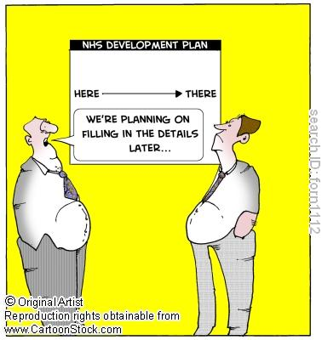
Human Resource Development, Development Management, Planning and Policy
The nature of the state decision-making process: planning (and = Planning vs. budgets)
Debate about Public Sector Personnel
  Privatization: administration and contracts management
  Deconcentration vs.
  devolution national vs. local
    National
    Regional
    Local

Slide 29
Human Resource Development- Issue
Institutional Development, The Weberian model- Fit of existing institutions for development (Non-hierarchical Model?)
  Mass of Regulations, routines and the hierarchy: SOPs
  Absence of judgment, discretion and creativity
  How suitable for Development

Slide 30
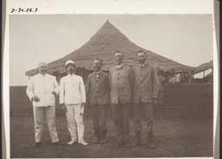
Human Resource Development Background in LDCs
The bureaucratic "spirit”; problems of morale
  Pattern of indigenization, localization and equal access
  Replacement of long service, old regime or expatriates with inexperienced, untrained, often "clerical" assistants or politicos with no professional skills
  Eg. French Colonial
  Officers in West Africa

Slide 31
Human Resource Development Background
The civil service "spirit”; problems of morale
    Role of the graduates
    Issue of equating authority with age
    Experience vs. the young's feeling of blockage from rapid promotion next generation of University

Slide 32
Human Resource Development Background Issues
Negative image of Government Administration
  Need to shift from law and order administration to development values
Willingness to accept non-governmental and civil society organizations
Question:
  Use of bureaucracy development to mobilize people for economic change and provide for socio-activist, "organic" civil service, not a hierarchical, mechanistic one?

Slide 33

Sensitivity to Expatriates and Foreign Aid
    Sensitivity to continuing influence of foreign “expatriates” in technical assistance and international organizations
    Symbols of Colonialism or Dependence
    Expatriate mentality and tendency to outside of the formal chain of command
    “Dead Aid” Arguments?

Slide 34
Human Resource Development: An Example?
L. Picard- Botswana Study

Slide 35
The Problem
Planning for Local Government and Rural Development (Picard USAID OPEX 1980-1982)
Need Local Government Institutions
  1. District Administration: D.C.
  2. Traditional Leaders-Kgotla
  3. District Councils
  4, Land Boards
  5. District Development Committees

Slide 36
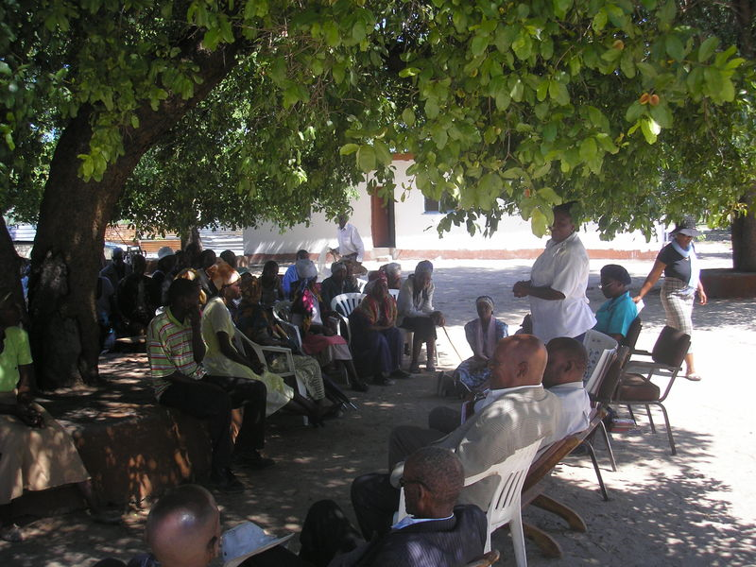
Kgotla- Traditional Assembly

Slide 37

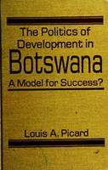


Local Government Training Plan

Slide 38
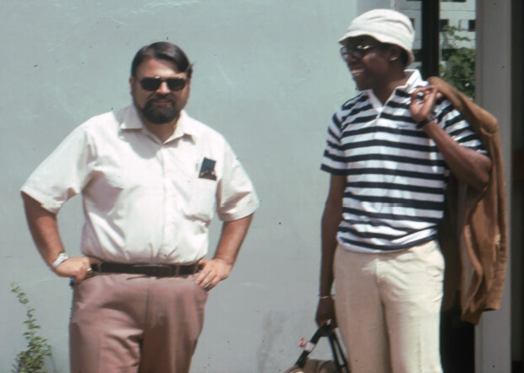

The Author in 1982

Slide 39
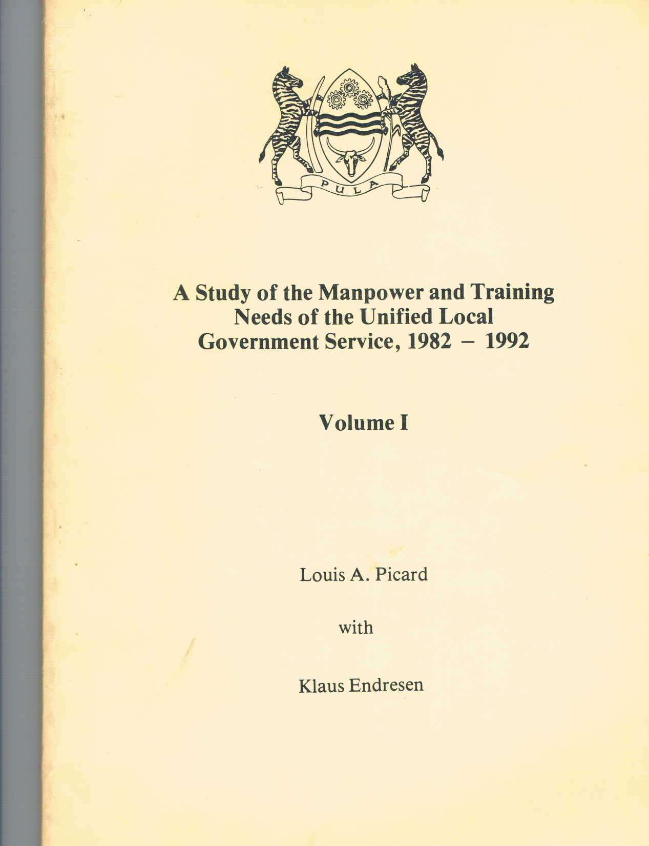

Slide 40
Local Government Structure in Botswana
Approved by the National Assembly in December 1981
GOVERNMENT PAPER NO. 1 OF 1981
Gaborone, Republic of Botswana
“Proof of Government's concern is shown by a recently commissioned study of Manpower and Training Needs of the unified local government Service, 1982-1992) by Dr. Louis A. Picard of the Institute of Development Management (I.D.M).”

Slide 41
Table 1: Education and Training Needs of Unified Local Government Service – Summary by Position Classification of Those in Post, February, 1981
* Vacancies include expatriates in position

Slide 42
Table 2: Sample Table of Cadre Manpower and Training Positions*
* Footnotes to be provided for explanation of assumptions

Slide 43
Table 3: Summary of Manpower and Training Needs, 1982 – 1992, by ‘A’ and ‘B’ Posts

Slide 44
Table 4a: Proposed Training Programme:Treasury/Revenue Cadre

Slide 45
Table 4b: Proposed Training Programme:Treasury/Revenue Cadre, cont.

Slide 46
Table 5: Sample of a Cadre Training Scheme

Slide 47
Table 6: Summary, Student/Week to be Trained
Summary of Student Weeks to be Trained for all Institutions, 1982 – 1986

Slide 48
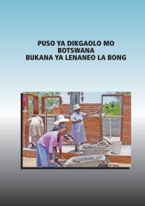
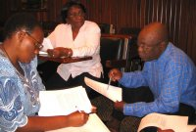
Local Government in Action, 2012

Slide 49

PICARD
    “Unpaid Editorial”

Slide 50
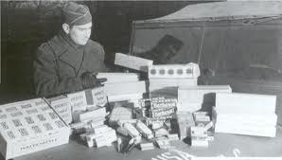

Theme Seven: Foreign Aid Debates

Slide 51
The Problem (1): Bad Planning and Foreign Aid
    1. Bureaucrats/practitioners ignored development theories & ideas
    2. LDC Development Institutes were largely irrelevant as training centers--donors used overseas training
    3. International Organizations (UNDP, IMF and World Bank) promoted Programs that were unworkable.

Slide 52
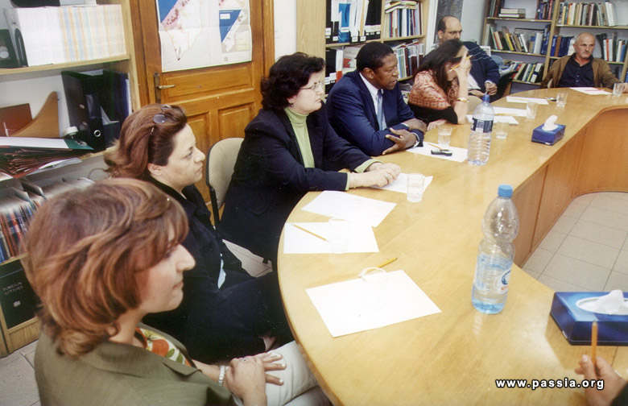
The Foreign Aid Meeting

Slide 53

The Problem (2)
    Development administration did little to deal with issues of population control, food production and rural development
    Foreign aid was seen as little more than a front for foreign policy
    Failure to address issues of Health and Education
    Goal of Washington Consensus: Eliminate Planning

Slide 54
But….
Donors Need Planning Skills (Still)
“National Program Support Office, Afghanistan” (October, 2005)
Project Management Unit (PMU)

Slide 55
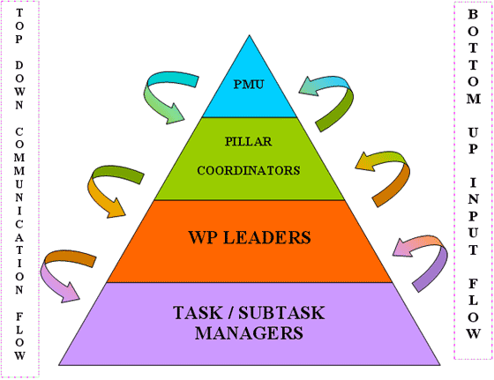
Autonomous Work Packaging Model

Slide 56

Planning Became Project Planning
“End of Editorial”

Slide 57

What is the Answer?

Slide 58
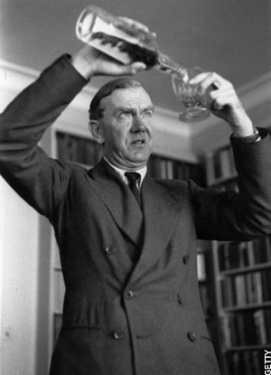
The Problems of Foreign Aid and Development Management
  Quote of the Week: The Quiet American- An Alternative to expatriate involvement?
Non-Involvement?
"The Human Condition being
what it was, let them fight, let
them love, let them murder,
I would not be involved.“
Graham Greene

Slide 59
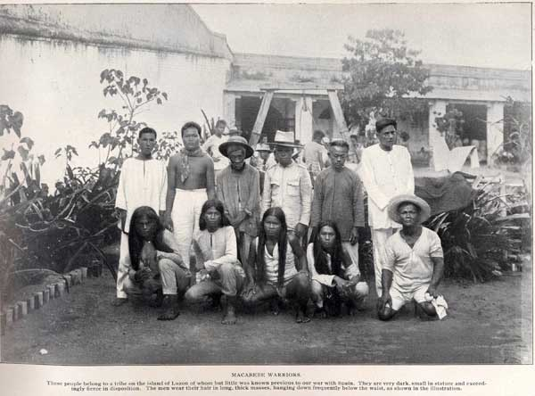
Late Colonial Philippines

Slide 60

Discussion: Stanley Karnow: “In Our Image?”
In Our Image (France, U.S., Portugal)
  Is assimilation the answer?
  In the Philippines, South East Asia, Middle East /Africa?
  Latin America: Just Spain?
Died January 27, 2013 (87Years old )
Notes:
60

Slide 61
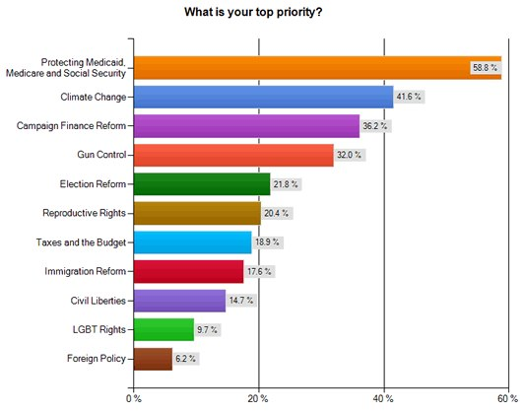
How Important is Foreign Aid?

Slide 62

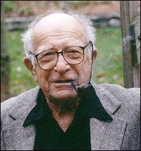
William J. Lederer and Eugene L. Burdick- The Origin
(March 31, 1912 to December 05, 2009)
(December 12, 1918–July 26, 1965)

Slide 63
“
“The Book of the Week Club” A Book Worth Reading
William Lederer and Eugene Burdick, The Ugly American
What message do these give us about foreigners in Asia and Africa
What message do the books give us about “development” or the lack of it.
What criticism would you make of the books?

Slide 64
Who is the Ugly American?
  Background: Origins of U.S. Foreign Aid Policy
    Marshall Plan and Point Four Program
    Agricultural College Bias
    Ugly American and the Peace Corps (and the other “peace corps”)
    Technical Assistance in Vietnam
    Models of Malaya and Kenya
    “Hearts and Minds” (French term, taken to Viet Nam, later used in South Africa, Iraq)

Slide 65

Vietnam

Slide 66
Authors of the Week
    U.S. Administrators and the “official U.S.” Need to outwit the communists; find the “decent Asian”
    American compound mentality: the “overseas American” sees unusual and unorthodox as “threatening”
    Basic ideology of the 1950s—Image of Russian officials: cultural and linguistic sensitivity
    U.S. Press—seldom writes about foreign policy and when they do, focus is on those who are “threatening” U.S. interests
    Religion: able to penetrate LDCs, and recruit indigenous allies

Slide 67
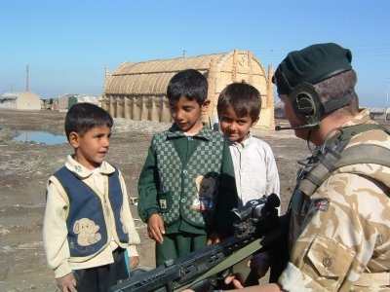
William Lederer and Eugene Burdick, The Ugly American
  Major Themes
    Various meanings of the term, “ugly american”
    Types of Americans overseas
    The U.S. Foreign Service in 1958
    Midwestern Salt of the Earth
    “Hearts and Minds”

Slide 68
From the Authors
William Lederer and Eugene Burdick- Journalists- Say Non-Fiction
  Characters—their significance
    Development Officials
    Communist “followers”
    Dairy Specialists and “Engineers”
    Priests
    Secretaries as Lacking in Sensitivity

Slide 69
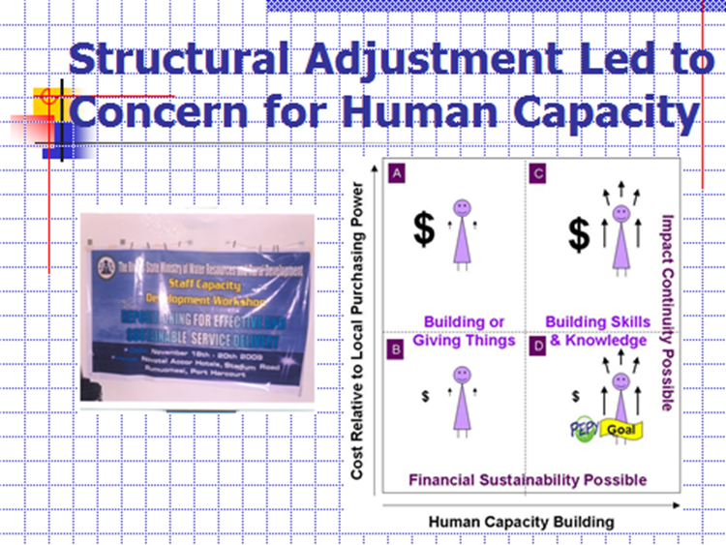

Slide 70

Millennium Development Goals: Eight Goals for 2015

Slide 71
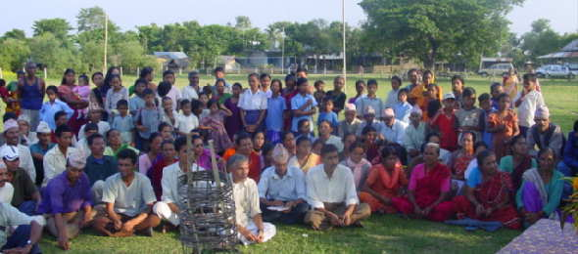
Social Mobilization Training Still Around

Slide 72
The Middle View
The Moderate Interpretation of Development Administration Failures
Goal: Realistic Decision-Making based on sufficient knowledge (strategic planning) “Mixed Scanning”
Balance Public-Private Partnerships

Slide 73

The Twenty-First Century Model Redux

Slide 74
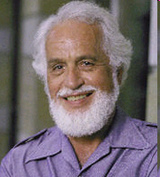
Denis A. Goulet, 75, died December 26, 2006: Appropriate Theory, Technology and Practice

Slide 75
Foreign Aid
The New Charity?

Slide 76

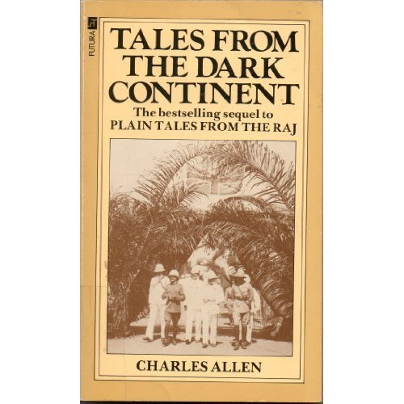
Book Discussion
Tales from the Dark Continent by Charles Allen (Born in 1940)
A Singular Woman, by Janny Scott

