Slide 1
PIA 2501
Development Policy and Management

Slide 2
Discussion: What is the role of management in development? How has it failed?
Readings:
1. Picard, “Internal Capacity and Overload in Guinea and Niger”
2. Haslam, et. al., chapter 13
3. Picard, Fragile Balance, Chapter 12
4. Chinua Achebe, “Civil Peace”

Slide 3
DEVELOPMENT PLANNING and Social Development
Problems and Issues,
2001-2012
The Problem: Quiet Corruption and the Public Sector VIDE0
Notes:
3

Slide 4
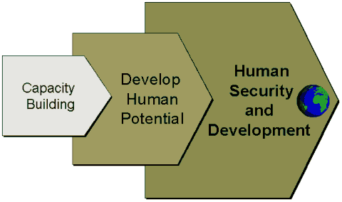
FROM PLANNING TO HUMAN RESOURCE DEVELOPMENT Part II: Building Capacity
Notes:
4

Slide 5
The Problem: Public Corruption and Loss of Faith in State social action

Slide 6
Development Planning as Socialization
Primary—Family; before school
Secondary--Primary and Secondary Education
Tertiary--Adult (including Higher education and On the Job)
Problem: Social Engineering
Notes:
6

Slide 7
Primary Socialization in Lithuania

Slide 8
Development Planning and Social Change: Overall Assumption
Classical Assumption
Role of the government agent is:
ACT AS A CHANGE AGENT
and Provide necessary stimulation to society to ensure social change
Key: Focus is on Human Behavior
Notes:
8

Slide 9
Young Pioneers Kazakh S.S.R.

Slide 10
Social Development Assumptions
1. Assumes that there can be state managed social mobilization
Basic premise: planning is setting of priorities for use of scarce resources through use of rational rather than political processes for family support, education and health
Notes:
10

Slide 11
The Assumption: Development Planning as Socialization
2. Planning includes secondary and tertiary socialization, but not primary socialization
Eg. Social Engineering
Why is Primary Socialization so powerful?
Notes:
11

Slide 12
Development Planning and Human Capacity: Assumptions
3. Development Planning as a Concept
State will serve as engine of development
Goal will be to change society, economy and political structures
Controversy not over physical planning but social change and economic behavior
Notes:
12

Slide 13
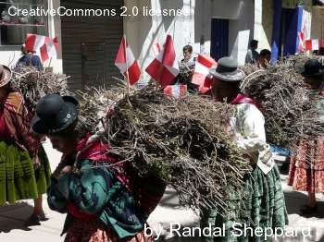
Traditional Gender Roles in Peru

Slide 14
Development Planning Assumptions- Continued
4. Development Planning accepts premises of Development Administration:
5. State bureaucracy should take major role in social mobilization, economic transformation and increases in productivity; define policy goals for society
6. Rejected by some advocates of Development Management
Notes:
14

Slide 15
Heavy Industry Focus

Slide 16
Development Planning Assumptions
7. Assumes that development occurs because of planned change
8. Originally, Keynesian planners saw state taking a major role in providing leadership to improve standards of living in LDCs
Key: Change Socialization Patterns (Agraria vs. Industria)
Notes:
16

Slide 17
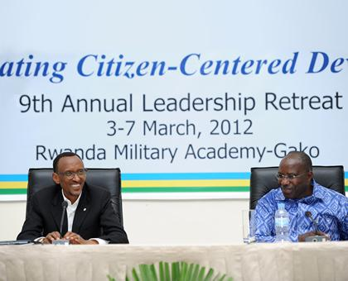
Strong Leadership to Change Social Patterns?
President Paul Kagame of Rwanda

Slide 18
Political Assumptions with Development Planning, Continued
9. Assumes political and administrative leadership have made the decision to effect changes in the system
10. This is a meeting point of both counter-dependency strategy and modernization (Keynesianism)
11. Need to strengthen administrative capacity for social change in development economics and planning area
Notes:
18

Slide 19
Development and Social Planning
“The Devil is in the Details”
An Old Philosopher
Notes:
19

Slide 20
Problem: The Lack of Administrative Skills
Human Development depends upon “administrative capacity”
Institutional arrangements for planning, planning agencies, management systems and processes that are innovative
Human behavior is complex. It involves:
Networks,
Organizations and
Institutions
Technology
Notes:
20

Slide 21
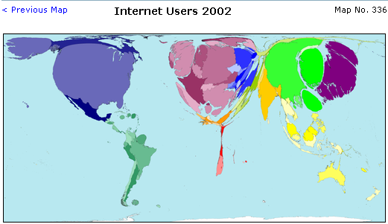

Slide 22
The Implementation Problem
Major responsibility for implementation lies with Planning official at the local level
Development change occurs because of planned action
Assumes political and administrative leadership have made decision to effect improvement in the social system
Local level capacity often non-existent
Notes:
22

Slide 23
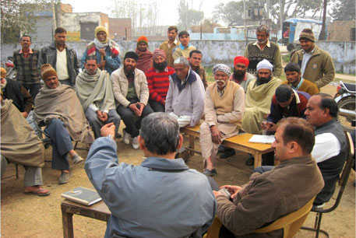
Farmers at a crop planning meeting at an extension service stations in Haryana, India.

Slide 24
The International Dimension
The End of the Cold War, the World Bank and the Reagan/Thatcher changes
Review of Context

Slide 25
End of assumption- Progress is inevitable: Rejection of Social Change Models
1983- Robert McNamara resigns from World Bank- New and Different Demands
Institutions, social change and basic needs abandoned
Export Economies--Minerals, agricultural commodities and livestock: Orthodoxy
Back to the Future- The key to growth is Structural Adjustment, privatization and market growth
Notes:
25

Slide 26
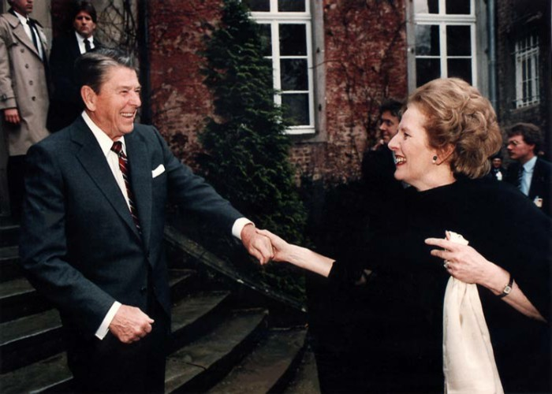

Slide 27
1985: Bad Planning Discovered
Illness and death of Brezhnev in Soviet Union
The Change: Russia and Structural Adjustment
Planning- The “Ivory Tower” problem
Ronald Reagan and Margaret Thatcher at height of their power
Problems of Second World Applied to “Third World”
Notes:
27

Slide 28
A Forgotten Question: Who were Brezhnev and Andropov

Slide 29
Perception of Development Problems- Planning Bad- 1991 to Financial Crisis, 2009 (Summary)
The Change: End of Cold War
Structural Adjustment- 1989-2001
International conflict shifts from East-West rivalry and cold war to ethnic, regional and internal conflicts culminating in September 11, 2001
Now is Economic and Social Planning and State Building Back with Millennium Development Goals?
Notes:
29

Slide 30
Bad Planning Discovered
Ethiopia- Mengistu Haile Mariam declares a Leninist state in 1983
13 million face starvation in Horn of Africa
"We are the World" leads to Donor Fatigue
and the conclusion that development is private
From Program to Project Planning: Failure in Africa
Notes:
30

Slide 31
The Reagan/Thatcher Mantra: Development Planning: Failure and Future of Command Economies?
Transitional conflicts in Angola, Mozambique- Cold War Proxies
CIS and Central Europe become part of development portfolio
Cambodia, Nicaragua (Central America)
Bosnia, Somalia, Rwanda, Kosovo,
Notes:
31

Slide 32
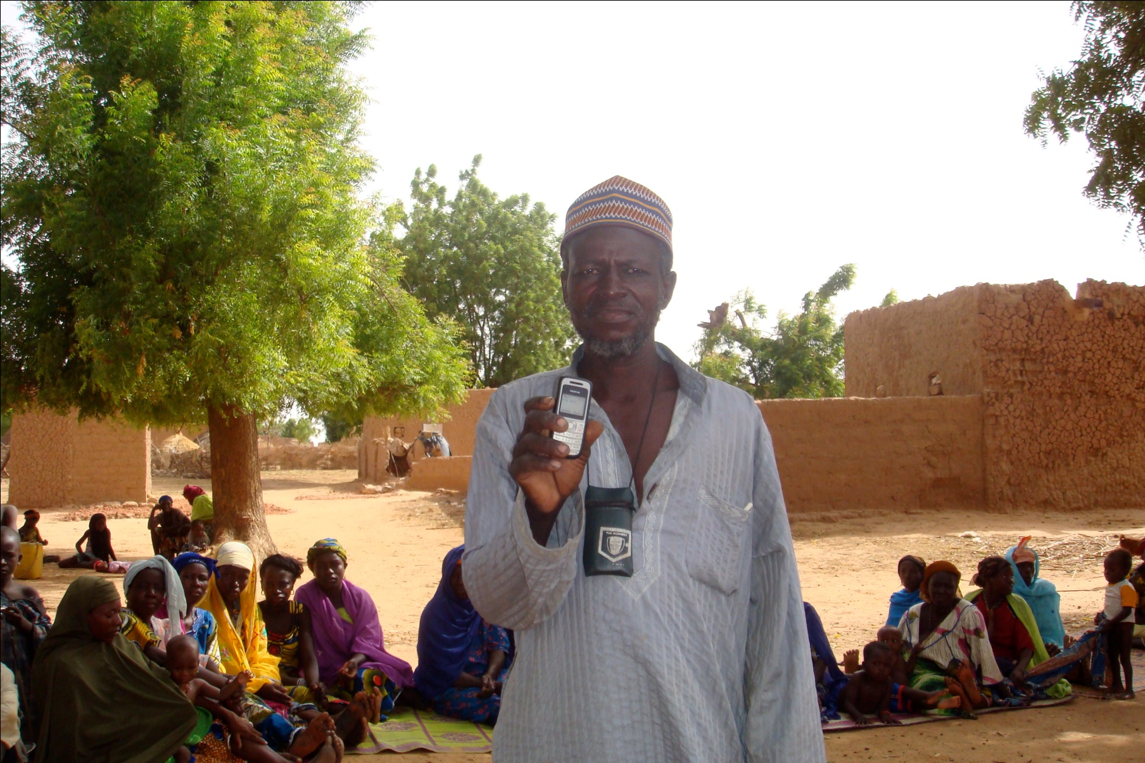
Technology Plays a Role

Slide 33
Failure of Command Economies, the End of a Century and new focus on HRD
Afghanistan and Iraq in the 1990s
Sudan: A Thirty Years War and Two failed states
Terrorism and the Failure of Development
Venezuela and Nicaragua , the fall and rise of the Sandinistas
Notes:
33

Slide 34
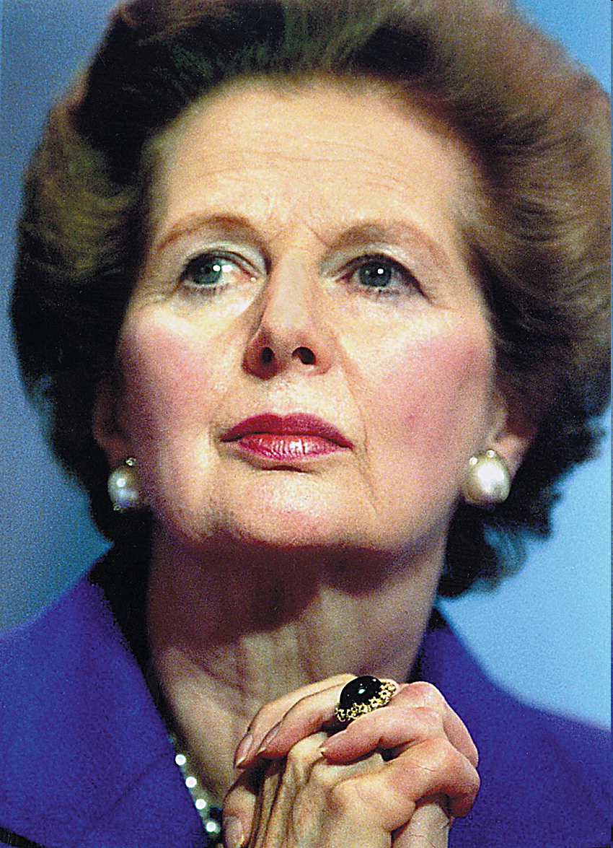
Whither the “then” New Regime: 1983-2012

Slide 35
Return of “Populist” Command Economy- The Once and Future Presidents

Slide 36
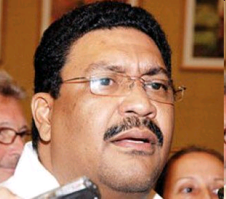
Valdrack Jaentschke
Development Minister in Nicaragua (GSPIA, 1991)
1990s Worked as Consultant for International NGOs Promoting “Democracy”
2009- Declared Government would expel NGOs promoting Opposition To Current Government

Slide 37
Now Vice Minister of Foreign Affairs
MID Graduate School of Public and International Affairs, University of Pittsburgh

Slide 38
Discussion
Assess the idea of forced social engineering
Notes:
38

Slide 39
SATIRE VIDEO
One Response to the Authoritarian Regime

Slide 40
Break
Ten Minutes

Slide 41
The Need for a Grain of Salt
The Role of Satire in Capacity Building for Good Governance?
They Put the Mock in Democracy

Slide 42
Meet the Authors

Slide 43
Discussion Books
Overthrow
A Bend in the River

Slide 44
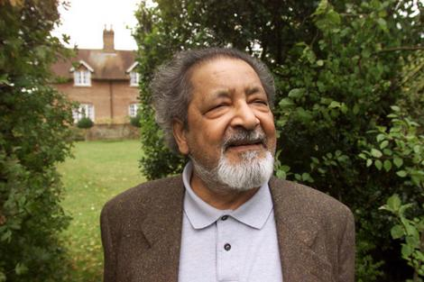
V.S. Naipaul
http://www.youtube.com/watch?v=MAQswLNMW-I

Slide 45
Steven Kinzer

Slide 46
Discussion

