Slide 1
PIA 3395:
Field Seminar in Development Theory

Slide 2
Development Theories
Week One

Slide 3
Overview
The Syllabus
The Methodology

Slide 4
Course Methodology
Focus in this course: Major conceptual approaches to Development Theory (Planning, Management and Policies)
Role of Instructor
That of a “Coach” to support efforts to support efforts to pass comprehensives
No pre-tests, no papers, one mock comp

Slide 5


Slide 6
PHD Students
After Course

Slide 7

Michael Phelps
After Comprehensives

Slide 8
Course Components: ITS SIGN UP TIME
Note: Specific links with Development Policy and Management (PIA 2501)- The Building Course.
1. Golden Oldies: Putting Context in Time
2. Literary Maps: Understanding Linkages of Time and People
3. Synthesis: Extracting Core Meaning
from material

Slide 9


Slide 10

Context in Time Is Important

Slide 11
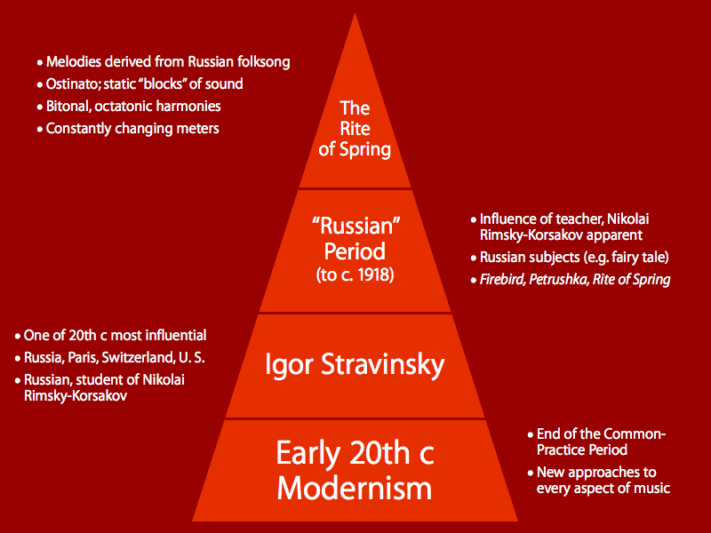

Slide 12
Methodology
The Readers Digest Approach: Books about Books and Writers about Writers (WARNING)
Technique: Literature Mapping: Development Economics vs. Social and political concepts (See Literary Maps in Martinussen).
As part of this process, prepare 6-7 sentences- major themes coming out of the reading. 10-12 authors in literary map on p. 22 and p.30
For ID students Materials from this class form the basis of the beginning of your preparation for the PhD Comprehensives.
    Necessary but not sufficient

Slide 13
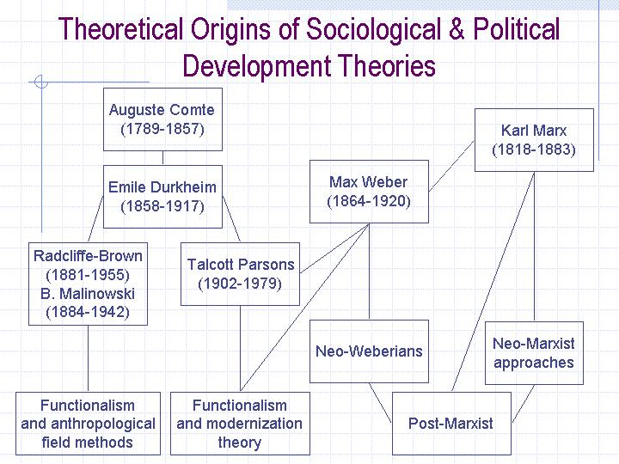

Slide 14
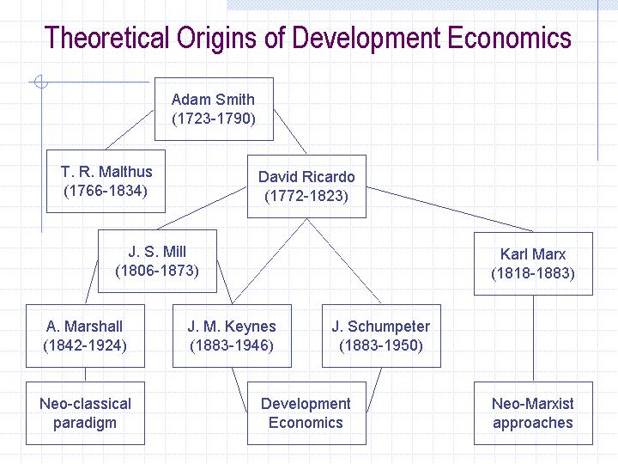

Slide 15
Synthesis
The bringing together of several things to find a common Theme
Reduction of a set of ideas to its core
Short succinct statements of comprehensive understanding .LESS THAN TEN SENTENCES

Slide 16
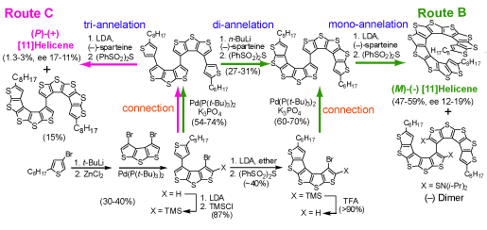
Route B synthesis, monoannelation (No- that’s not for us).

Slide 17
Four questions over the next fifteen weeks-
1. What is Development Studies?
2. To what extent is it a normative rather than an empirical system of knowledge development?
3. What changes of emphasis have occurred in the field since the Second World War?
4. What has been the impact of September 11, 2001 on the field

Slide 18
The Logical Process
The Theoretical Origins of Development Economics and Social and Political origins of Development
    Golden Oldies: Put in context, in time-
    The World According to Barbara Ward and Rupert Emerson:?
    This means the World at the End of Colonialism (Barbara Ward).
The Questions and the Answer in 1960: Capital Accumulation

Slide 19
The Barbara Ward Quote:
“Out of this 'primitive accumulation' came what might be called a 'breakthrough' to a new type of economy where, ...fresh capital [is] applied to all the processes of production...”
Barbara Ward

Slide 20

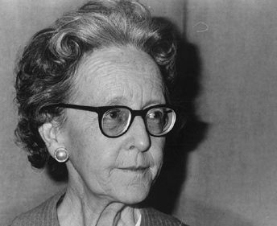
Primary Theory of Development
Dame Barbara Ward
Surplus Accumulation?

Slide 21
Preliminary Criticism of Development Theory:
1. "The Primary Obstacles to Development are Administrative not Economic.“
        Donald Stone
2. Development: “Fad, theory or Problem?”
Martin Staniland
3. “it’s not about the money its about the people.”
                The old Philosopher

Slide 22
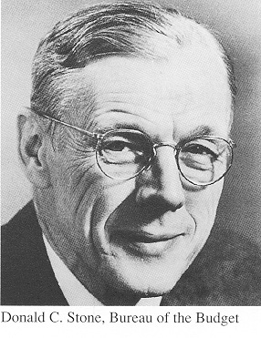

Commentary: No monotheory
Donald C. Stone
Martin Staniland and Students

Slide 23
Development- A Multiplicity of Views:
1. Social Changes: A concept of progress. Society is getting better. Basic Needs Approach
2. Physical and biological changes and population growth
3. Economic Growth- The application of science and the use of savings (capital) to develop it (Primitive Accumulation and take off- Walt Rostow and Arthur Lewis)
4. Debate over the role of Government and the role of Nationalism (Turner and Holme)
5. Debates about Underdevelopment and Dependency

Slide 24

UNDERDEVELOPMENT

Slide 25
Debate over Government and Market
a. Overall Debate: Protestantism and wealth (neo-orthodoxy) vs. Keynesianism
b. Modernization and Keynes
c. Structuralism and dependence
d. Neo-populist basic needs vs. Orthodoxy Market

Slide 26
Critiques of the Role of State
Social Centric: class analysis and Marxist
Discourages entrepreneurialism
Anti-pluralism, corporatist theories
Neo-Classical- Inhibits rational decision-making

Slide 27

Class Theory?

Slide 28

Entrepreneurialism?

Slide 29
Neo-Classical Criticism
Public choice- rational state interests (institutional state)- Development theory is anti-freedom and anti-rational. Rational decisions must be individual
Anti State Centric: bureaucratic politics is the danger
Development Administration vs. Policy vs. Management
The Role of Theory and “Theory Perusal” (Staniland). Should practitioners be anti-theory
Left wing Privatization: the rise of the Non-profits

Slide 30
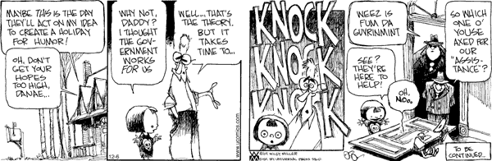

Slide 31
The Normative vs. the Empirical Dimension
Normative vs. Moral (Isbister)- Statements of Value-
eg. Normative is important
a. The Framework: (Descartes- Cartesian)
b. An Ideology: Marxism
eg. Power which the Third World (Estate) Lacks
c. Social Obligations

Slide 32


Normative
John Isbister
Laurentian University Ontario
René Descartes, French Philosopher, 1596-1650
René Descartes 31 March 1596 – 11 February 1650

Slide 33
Empirical Analysis
a. Observation- based on evidence, experience and inference
b. Methodology- Multidisciplinary (quantitative and qualitative)
c. Paradigm of Analysis: Scientific Method
Methodology is a way of carrying out an inquiry consisting of a set of quantitative or qualitative methods
d. The role models and Ideal Types- Allow for measurement

Slide 34

Empirical Criticism of Normative analysis?

Slide 35
Theories
Theories are generalized statements summarizing the relationships between the actions of sets of variables
Deductive theories suggest a hierarchical system of propositions that implies some precisely specified outcomes or events
Inductive models are developed from the observation of patterns of random events and then ordering them

Slide 36
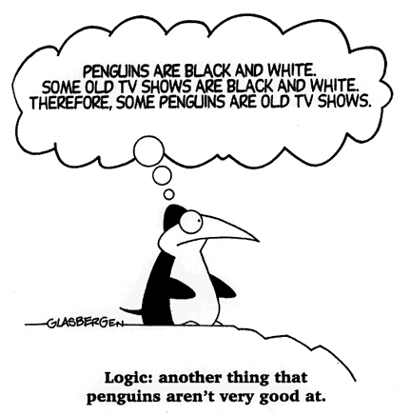

Slide 37
A basic vocabulary
1. paradigms are models, systems, concepts that constitute a framework for research and approaches that constitute a framework for research (Whooo).
2. Models are simplified ways of describing relationships
3. Causality suggests a relationship where one condition influences another issue.
  -Independent variables that changes in the variable effect changes on the other variable
  -Dependent variables suggest that the variables are explained by other actions that the theory seeks to explain
  - And we can have bi-causality

Slide 38
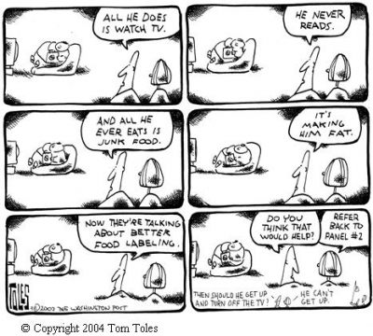
Causality

Slide 39
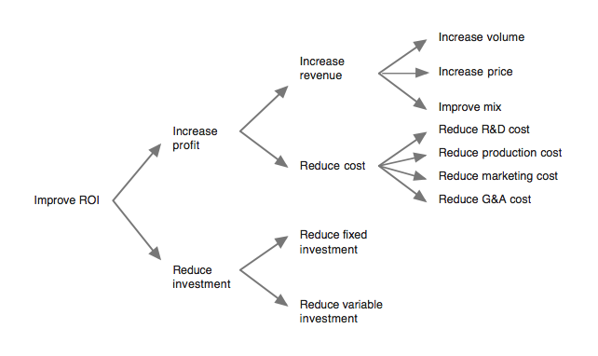
Return on Investment (ROI)
Logical Reasoning

Slide 40
A Basic Vocabulary, Continued
4. The hypothesis is a statement of the relationship between two or more variables when at least one is dependent and the other is independent.
5. Research design development is an operational plan put into an operational framework that is applied in the field

Slide 41
Review of Syllabus
DISCUSSION AND QUESTIONS

